Slide 1
The Flavours of SN II Light Curves
Iair (“ya-eer”) Arcavi
Advisor: Avishay Gal-Yam

Slide 2
Context | progenitor evolution not known
How do massive stars evolve and explode?
Which types of massive stars produce which types of CC SNe?
How do these massive stars lose their outer envelopes to create stripped SNe?

Slide 3
Context | types of core collapse SNe
Type II
Spectrum of the SN shows H
Type Ib
Spectrum of the SN shows no H
Type Ic
Spectrum of the SN shows no H and no He
He
H
He

Slide 4
Method | light curves encode a lot of information
Progenitor radius
Mass & radius of H envelope
Amount of ⁵⁶Ni synthesized
Progenitor wind velocity and mass loss rate
Shock breakout
Shock cooling
Radioactive decay
CSM interaction
Shape
Plateau length /
luminosity
Decline rate
Peak width
Peak luminosity

Slide 5
Method | simplistic view of light curve shapes?
L
L
Continuum?
IIP
IIL
t
t
Continuum?
He
H
He
H
Notes:
For O stars at solar abundances, during main sequence: about 10^-7 - 10^-6 msolar per year; In RSG phase: 10^-6 – 10^-5 msolar per year. (Fryer 2007)

Slide 6
Method | gather a large sample of light curves
The Caltech Core Collapse Program
Light curves and spectra for 48 core collapse SNe: 13 Type Ib/c – Drout et al. 2011 5 Type IIn (interaction) – Kiewe et al. 2011 30 Type II – this work
Notes:
4 missing refs, 4 bad subs, 2 no texp, 1 few data, 3-pec, 1 rising, 15 in the plot.

Slide 7
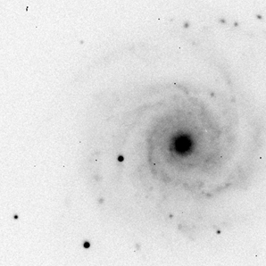
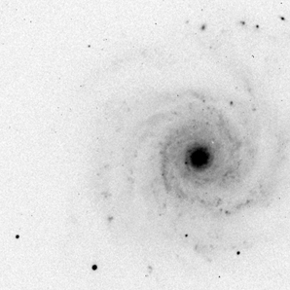
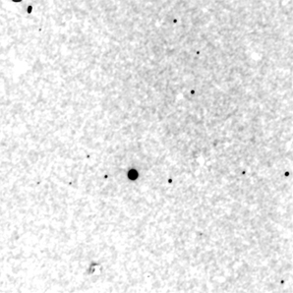
Method | uniformly reduce the data
We use image subtraction (via the common PSF method) to create light curves
Find in our sample: IIP + IIL + “Rising” + Peculiar
SN image
Reference image
Subtraction
Notes:
4 missing refs, 4 bad subs, 2 no texp, 1 few data, 3-pec, 1 rising, 15 in the plot.

Slide 8
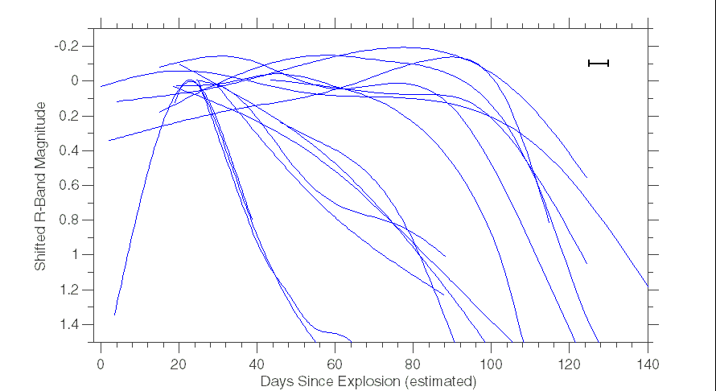
Results | three light curve families
Plateau
Rapid Decline
Slow Decline
All of the rapid decliners in the sample are SNe IIb
SN2004fx – Hamuy et al. 2006 (preliminary)
Notes:
4 missing refs, 4 bad subs, 2 no texp, 1 few data, 3-pec, 1 rising, 15 in the plot.

Slide 9
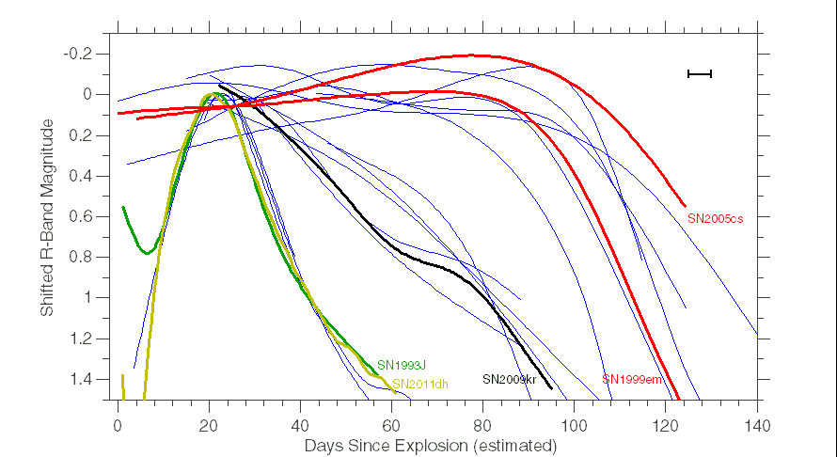
Results | three light curve families
Plateau
Rapid Decline
Slow Decline
SN1993J – Richmond et al. 1994
SN1999em – Leonard et al. 2002
SN2004fx – Hamuy et al. 2006 (preliminary)
SN2005cs – Pastorello et al. 2009
SN2011dh – Arcavi et al. 2011
Notes:
4 missing refs, 4 bad subs, 2 no texp, 1 few data, 3-pec, 1 rising, 15 in the plot.

Slide 10
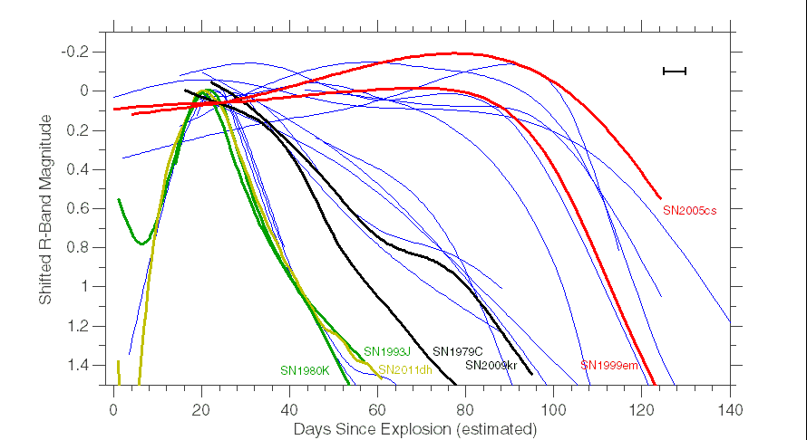
Results | three light curve families
Plateau
Rapid Decline
Slow Decline
SN1980K – Hurst & Taylor, 1986 (pseudo-visual)
SN1993J – Richmond et al. 1994
SN1999em – Leonard et al. 2002
SN1979C – Balinskaia et al. 1980
SN2004fx – Hamuy et al. 2006 (preliminary)
SN2005cs – Pastorello et al. 2009
SN2011dh – Arcavi et al. 2011
Notes:
4 missing refs, 4 bad subs, 2 no texp, 1 few data, 3-pec, 1 rising, 15 in the plot.

Slide 11
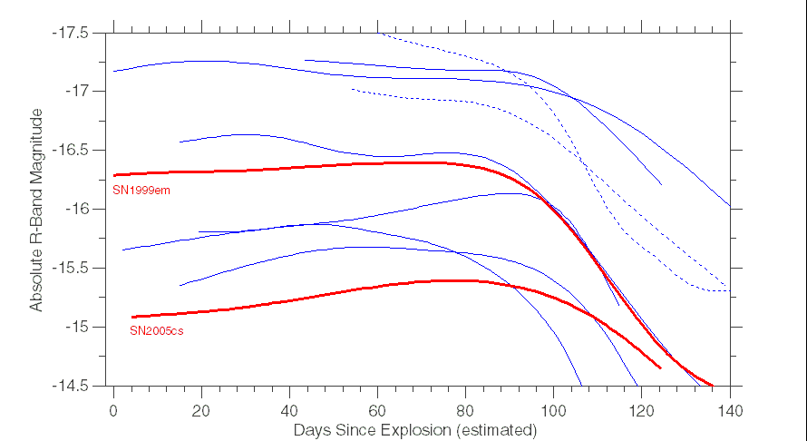
Results | IIP: range of luminosities but not of lengths
SN1999em – Leonard et al. 2002
SN2005cs – Pastorello et al. 2009
= Explosion dates not well constrained
Notes:
4 missing refs, 4 bad subs, 2 no texp, 1 few data, 3-pec, 1 rising, 15 in the plot.

Slide 12
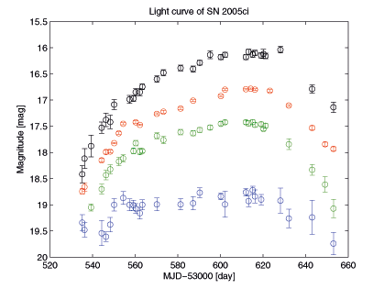
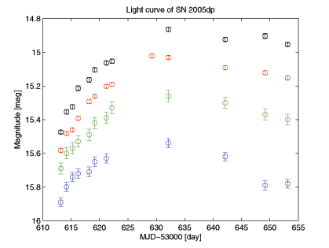
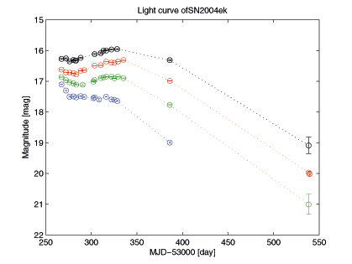
Results | the outliers: “rising” SNe

Slide 13
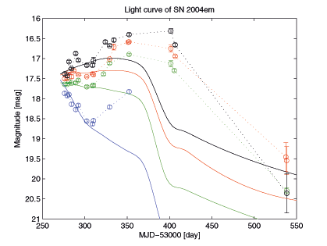
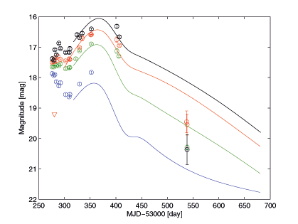
Results | the outliers: SN2004em
vs. SN1999em (Leonard et al. 2002)
vs. SN1998A (Pastorello et al. 2005)

Slide 14
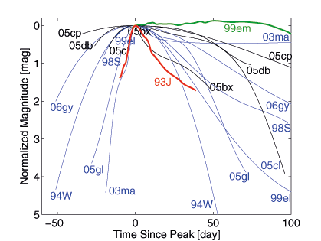
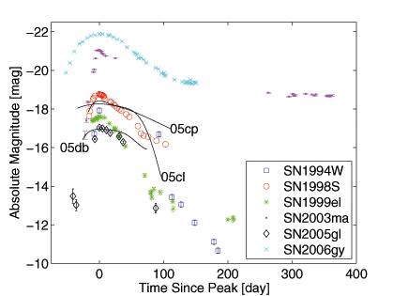
Results | IIn: a zoo
Large range of slopes
… and of peak magnitudes
see Kiewe et al. 2011

Slide 15
Results | three light curve families
Plateau
Rapid Decline
Slow Decline
SN1993J – Richmond et al. 1994
SN1999em – Leonard et al. 2002
SN2004fx – Hamuy et al. 2006 (preliminary)
SN2005cs – Pastorello et al. 2009
SN2011dh – Arcavi et al. 2011
Notes:
4 missing refs, 4 bad subs, 2 no texp, 1 few data, 3-pec, 1 rising, 15 in the plot.

Slide 16
Conclusions | binaries make most IIb‘s?
no companion
SN IIP (why the uniformity in plateau lengths?)
H
(ZAMS)
companion
H
SN IIb
winds
SN IIL (small range of masses can make a less common type of SN IIb)
H
Mass

Slide 17
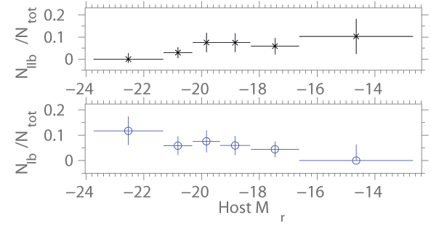
Supplementary Studies | host galaxy metallicities
369 core collapse SNe from the PTF
lower metallicity
(Arcavi et al. in prep.)

Slide 18
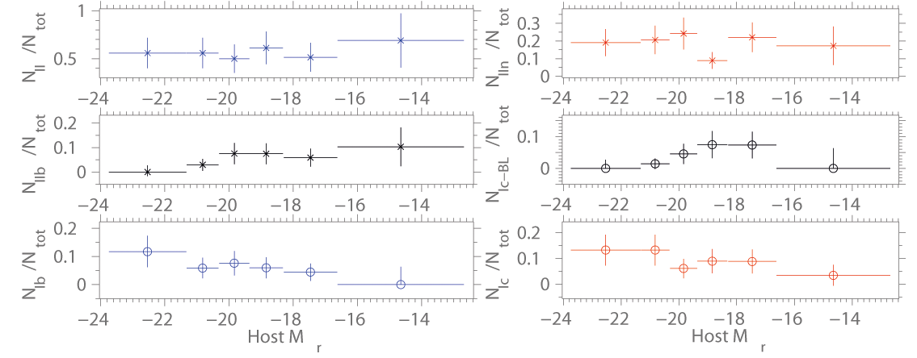
Supplementary Studies | host galaxy metallicities
369 core collapse SNe from the PTF
lower metallicity
lower metallicity
(Arcavi et al. in prep.)

Slide 19
Conclusions | Ib’s & IIb‘s come from same systems?
no companion
SN IIP (why the uniformity in plateau lengths?)
H
(ZAMS)
low metallicity
H
SN IIb
companion
high metallicity
SN Ib
winds
SN IIL (small range of masses can make a less common type of SN IIb)
H
Mass

Slide 20
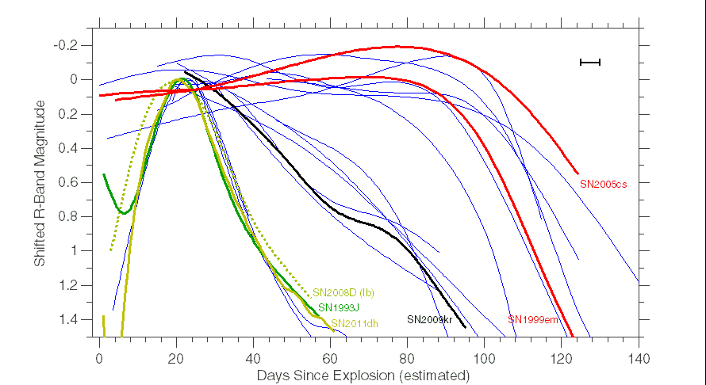
Results | three light curve families
Plateau
Rapid Decline
Slow Decline
SN1993J – Richmond et al. 1994
SN1999em – Leonard et al. 2002
SN2004fx – Hamuy et al. 2006 (preliminary)
SN2005cs – Pastorello et al. 2009
SN2011dh – Arcavi et al. 2011
SN2008D – Soderberg et al. 2008
Notes:
4 missing refs, 4 bad subs, 2 no texp, 1 few data, 3-pec, 1 rising, 15 in the plot.

Slide 21
Summary
Type II SN light curves from CCCP show:
Several sub-classes: Plateau | Slow Decline | Rapid Decline | Rise | Peculiar 9 | 5 | 3 (all IIb‘s) | 3 | 1
Plateaus range in luminosity but fairly uniform in lengths (~100 days)
SNe IIn are much more diverse
Binarity (and metallicity) can be the dominant factor for making SNe IIb (Ib)
Where are the short plateau IIP’s / intermediate IIP-IIL?
Next step: 400 light curves from PTF (320 SNe II)
Notes:
4 missing refs, 4 bad subs, 1 few data,

