Slide 1
GRB Prompt X-ray Emission
T. Sakamoto (CRESST/UMBC/GSFC)
Notes:
13-14 pages (1 page / 1min 30 sec)

Slide 2
Contents
Basic prompt emission characteristics of long GRB
SN-GRB samples (spectroscopically confirmed)
Comparison with typical long GRBs
Duration
Lag-Luminosity
Spectral parameters
E_{peak}-E_{iso}/L_{iso} relations
Spectral evolution
Searching for a hard X-ray emission of supernova using the Swift/BAT survey data
Summary

Slide 3
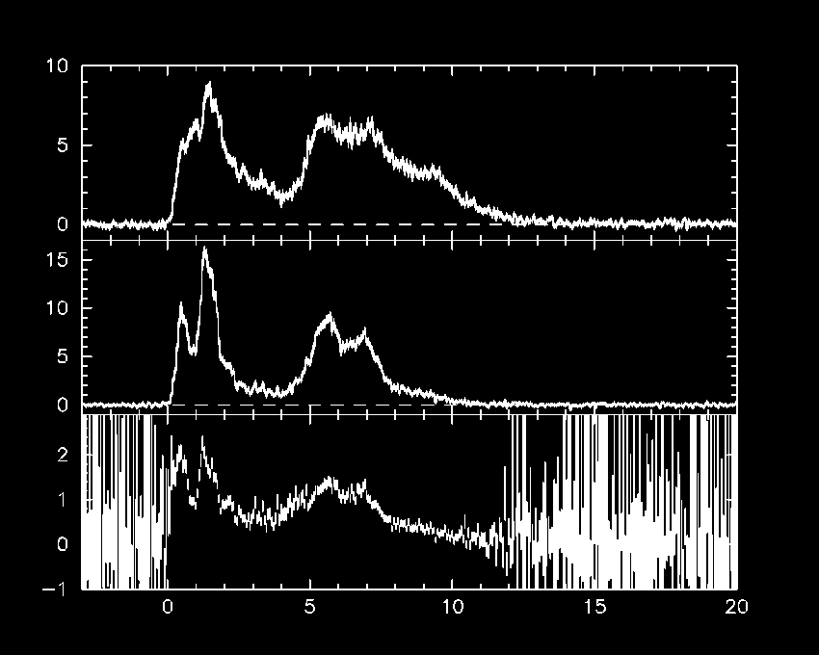
Basic characteristics
GRB 050525A (Swift/BAT)
15-25 keV
Rate [c/s/det]
50-100 keV
50-100 keV
15-25 keV
Time [s]

Slide 4
1. Duration
GRB 050525A (Swift/BAT)
15-25 keV
Rate [c/s/det]
50-100 keV
50-100 keV
15-25 keV
Time [s]

Slide 5
2. Spectral Lag
GRB 050525A (Swift/BAT)
15-25 keV
Rate [c/s/det]
50-100 keV
Time [s]

Slide 6
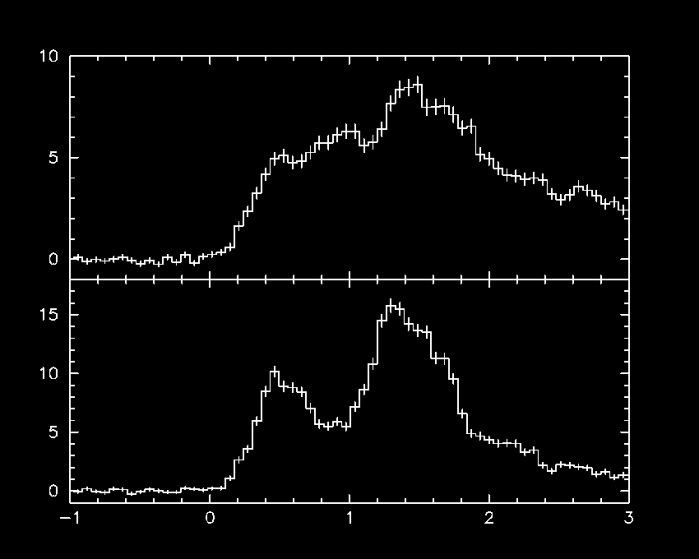
2. Spectral Lag
GRB 050525A (Swift/BAT)
15-25 keV
15-25 keV
Rate [c/s/det]
50-100 keV
50-100 keV
50-100 keV
15-25 keV
Time [s]

Slide 7
2. Spectral Lag
GRB 050525A (Swift/BAT)
lag
15-25 keV
15-25 keV
Rate [c/s/det]
50-100 keV
50-100 keV
50-100 keV
15-25 keV
Time [s]

Slide 8
3. Peak flux (Peak Luminosity; L_{iso})
GRB 050525A (Swift/BAT)
15-25 keV
Rate [c/s/det]
50-100 keV
50-100 keV
15-25 keV
Time [s]

Slide 9
4. Fluence (Radiated energy; E_{iso})
GRB 050525A (Swift/BAT)
15-25 keV
Rate [c/s/det]
50-100 keV
50-100 keV
15-25 keV
Time [s]

Slide 10
5. Spectral evolution
GRB 050525A (Swift/BAT)
15-25 keV
Rate [c/s/det]
50-100 keV
50-100 keV
15-25 keV
Time [s]

Slide 11
Empirical spectral models of GRBs
Band function
(Band et al. 1993)
(α ∼ −1)
dN/dE
E^{α} exp (−E/E₀)
E₀ = E_{peak} / (2 + α)
E^{β}
(β ∼ −2.5)
E_{break} = (α − β) E₀
Energy

Slide 12
SN-GRB List (Spectroscopically IDed)
GRB | SN | Mission | Redshift | SN-type | Reference
980425 | 1998bw | BATSE/BSAX | 0.0085 | Ic | Kaneko et al. 2007 Galama et al. 1998
030329 | 2003dh | HETE-2 | 0.1685 | Ic | Vanderspek et al. 2004 Hjorth et al. 2003
031203 | 2003lw | INTEGRAL | 0.1005 | Ibc | Sazonov et al. 2004 Malesani et al. 2004
060218 | 2006aj | Swift | 0.0331 | Ic | Campana et al. 2006 Pian et al. 2006
091127 | 2009nz | Swift | 0.490 | Ic | Berger et al. 2004
100316D | 2010bh | Swift | 0.059 | Ic | Starling et al. 2011 Chornock et al. 2011
101219B | 2010ma | Swift | 0.55 | Ic | Sparre et al. 2011
- Spectral evolution from a power-law to SN feature

Slide 13
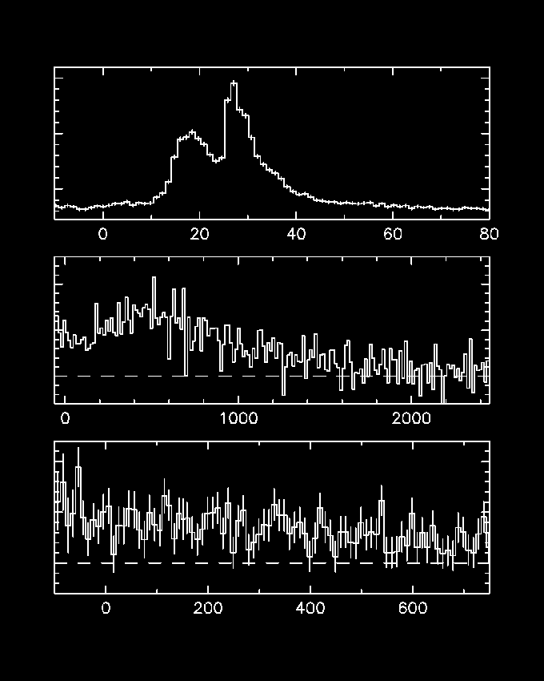
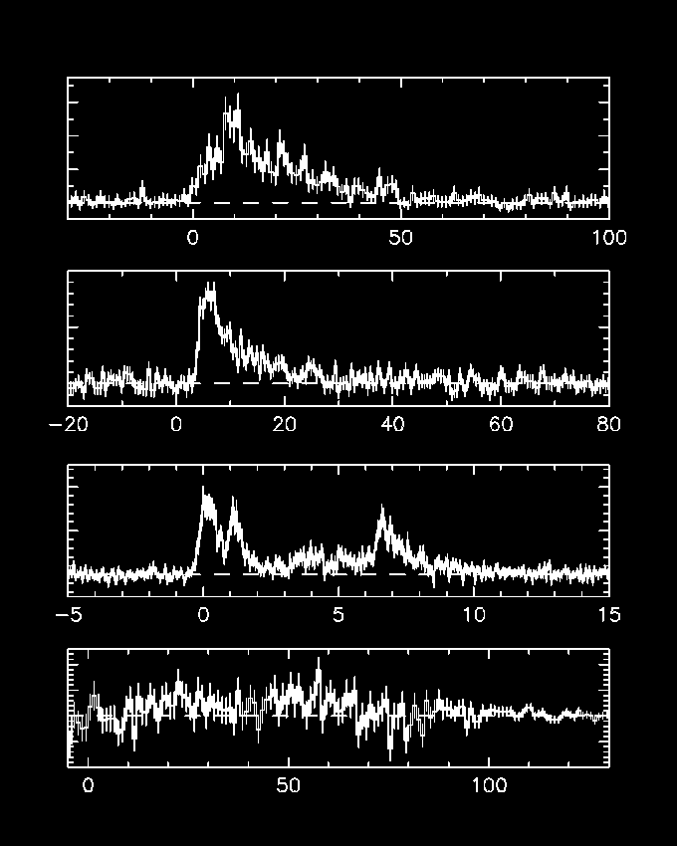
Prompt Emission Light curve
Y-axis: rate [c/s]
3000
GRB 030329
WXM 2-25 keV
6
GRB 980425
WFC 2-26 keV
4
2000
2
0
1000
1000
GRB 031203
IBIS 20-40 keV
GRB 060218
BAT 15-25 keV
500
0.01
0
0
2
GRB 091127
BAT 15-25 keV
1
0.01
GRB 100316D
BAT 15-25 keV
0
0.1
GRB 101219B BAT
0
0
Time [s]

Slide 14
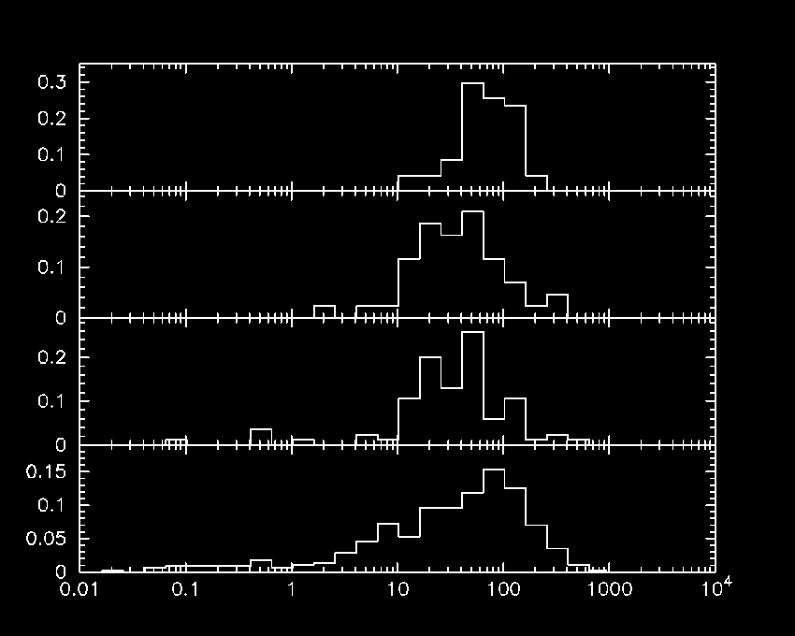
Duration
BeppoSAX/WFC: 2-5 keV
(Vetere et al. 2007)
HETE-2/WXM: 2-25 keV
(Sakamoto et al. 2005)
Fraction of total GRBs
INTEGRAL/ISGRI: 20-200 keV (?)
(INTEGRAL SDC web)
Swift/BAT: 15-200 keV
(Sakamoto et al. 2011)
Duration [s]

Slide 15
Duration
BeppoSAX/WFC: 2-5 keV
(Vetere et al. 2007)
980425
HETE-2/WXM: 2-25 keV
(Sakamoto et al. 2005)
030329
Fraction of total GRBs
INTEGRAL/ISGRI: 20-200 keV (?)
(INTEGRAL SDC web)
031203
Swift/BAT: 15-200 keV
(Sakamoto et al. 2011)
060218
100316D
091127
101219B
Duration [s]

Slide 16
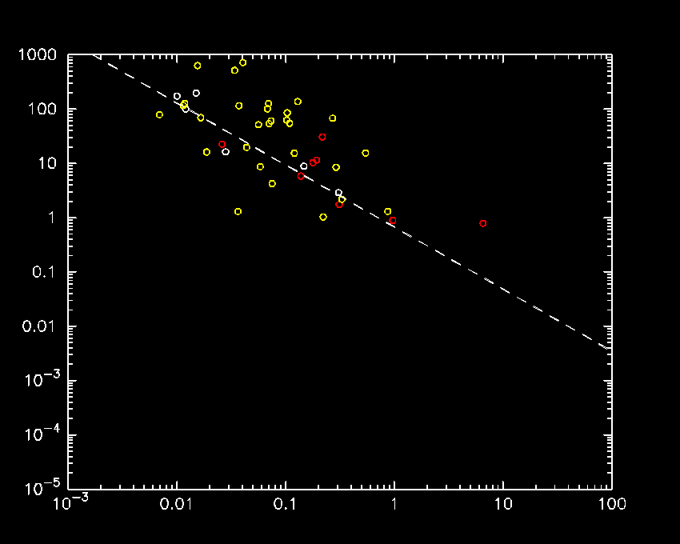
Spectral Lag
Peak Luminosity [10⁵¹ erg/s]
L_{iso} ~ lag ^{-1.14}
(Norris et al. 2000)
BATSE (Norris et al. 2000)
HETE-2 (Arimoto et al. 2010)
Swift (Ukwatta et al. 2010)
lag [s]

Slide 17
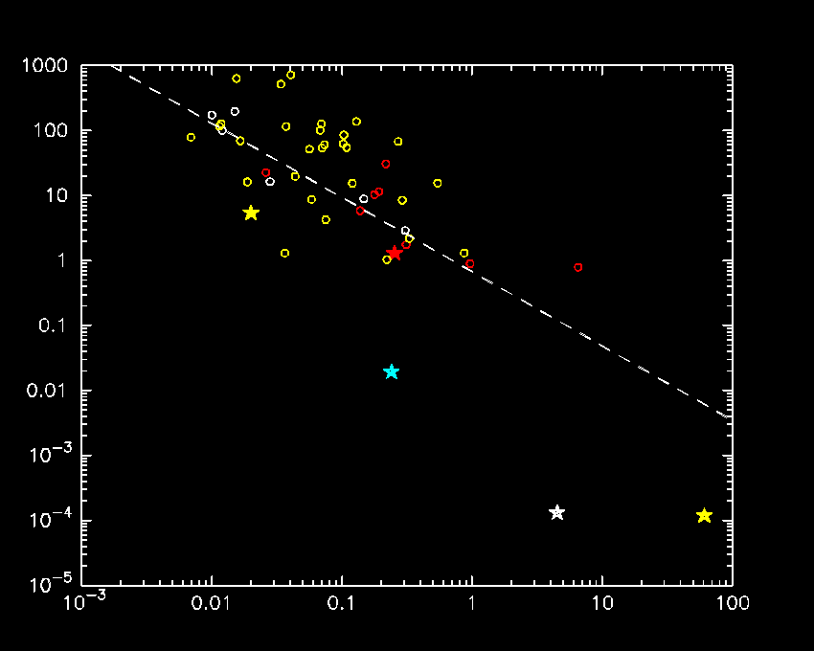
Spectral Lag
091127
030329
Peak Luminosity [10⁵¹ erg/s]
031203
L_{iso} ~ lag ^{-1.14}
(Norris et al. 2000)
BATSE (Norris et al. 2000)
HETE-2 (Arimoto et al. 2010)
Swift (Ukwatta et al. 2010)
980425
060218
lag [s]

Slide 18
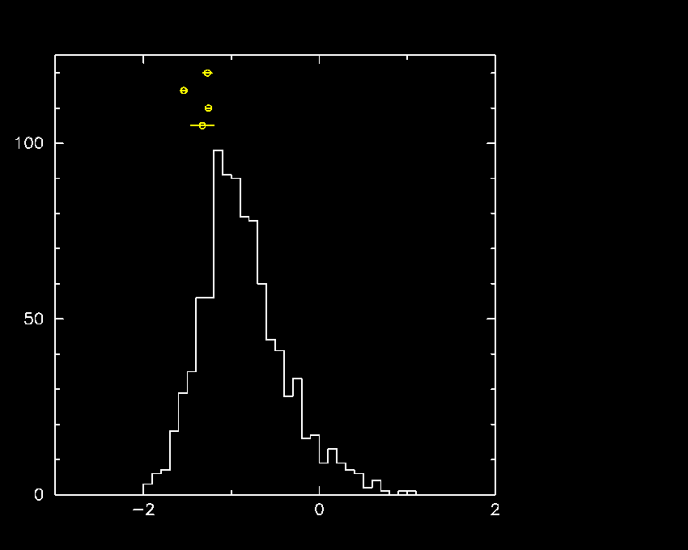
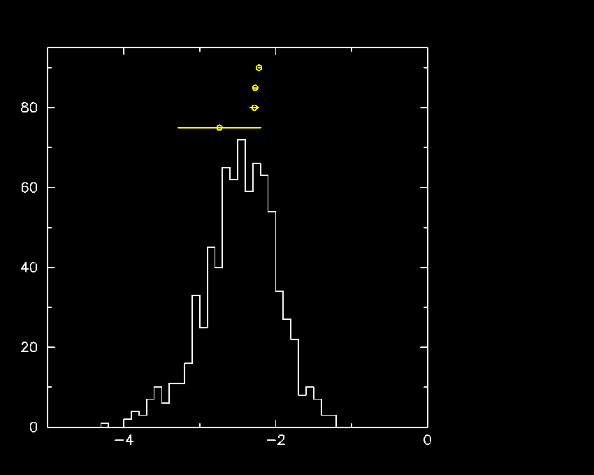
Band low (α) and high (β) photon index
BATSE long GRBs (Goldstein et al. )
Low energy photon index α
High energy photon index β
091127
060218
030329
980425
091127
060218
030329
980425
Number of GRBs
α
β

Slide 19
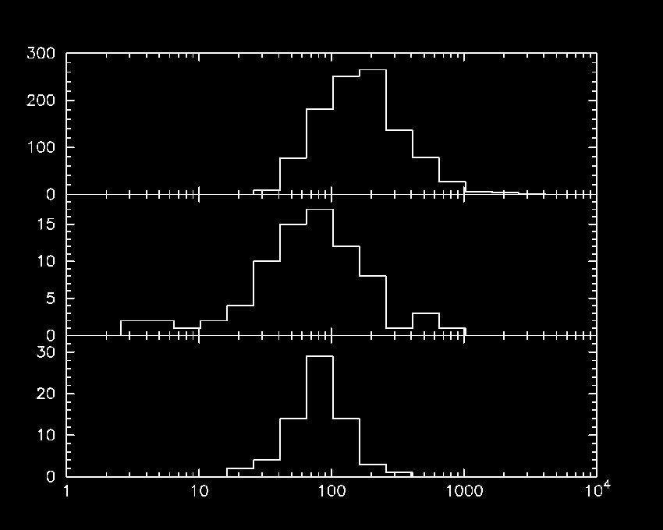
Band E_{peak} distribution
BATSE (Band)
(Goldstein et al. )
980425
HETE-2 (Band & CPL)
(Sakamoto et al. and
Pelangeon et al.)
030329
Number of GRBs
Swift (CPL)
(Sakamoto et al.)
091127
060218
E_{peak} [keV]

Slide 20
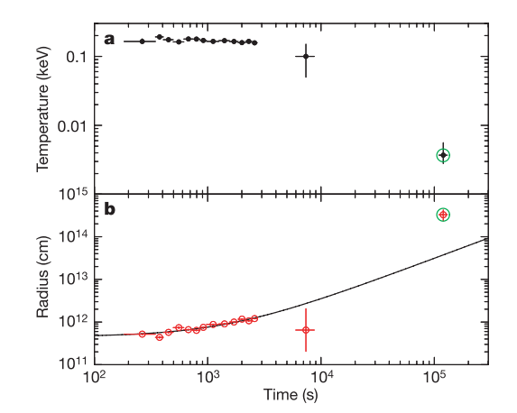
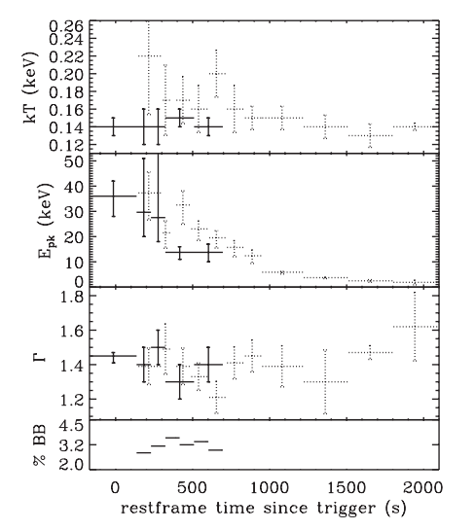
BB component in X-ray spectrum
060218 (Campana et al. 2006)
100316D (Starling et al. 2011)
091127 (delayed slew; T₀+~900s)
101219B: (T₀+152 T₀+300s)
kT = 0.12 (+-0.02) keV
PL: χ²/dof (104.12/102)
BB+PL: χ²/dof (85.80/100) (F-test P=6.3e-5)

Slide 21
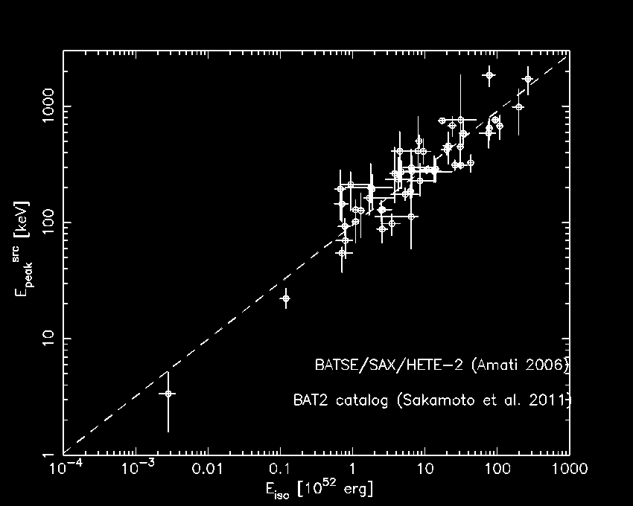
E_{peak}-E_{iso} (Amati) relation
(Amati et al. 2002)
E_{peak} ~ E_{iso}^{0.5}

Slide 22
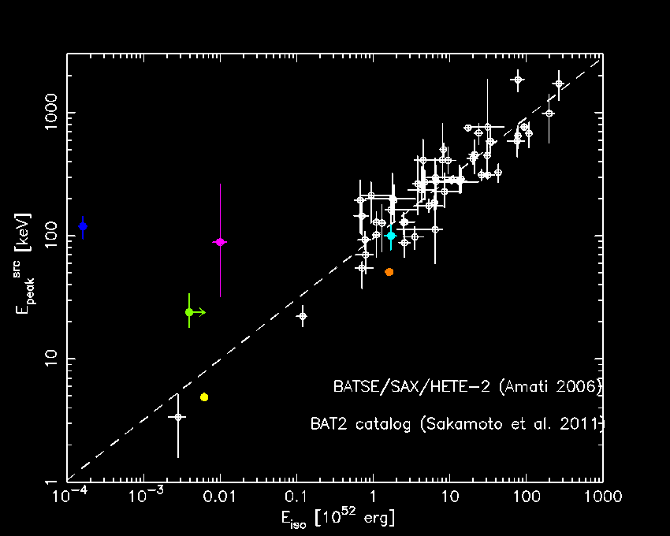
E_{peak}-E_{iso} (Amati) relation
(Amati et al. 2002)
980425
031203
030329
091127
100316D
060218

Slide 23
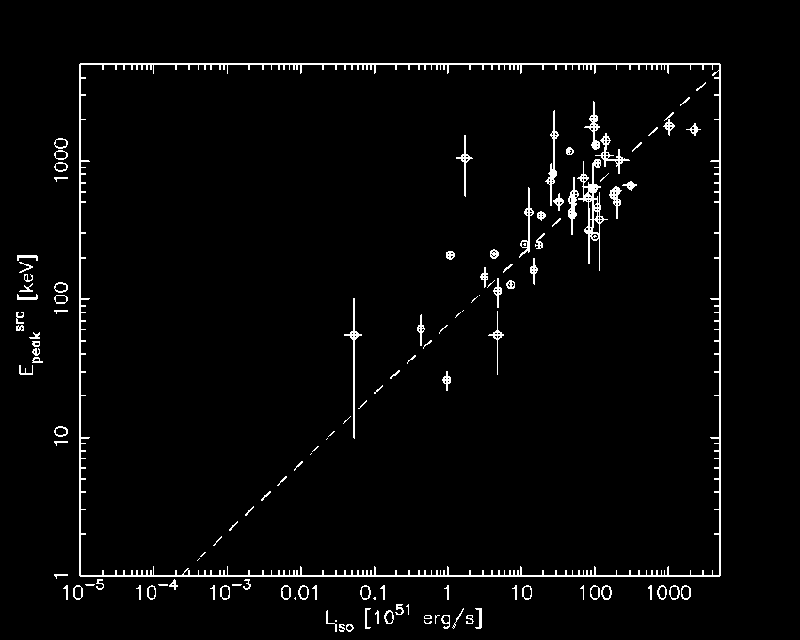
E_{peak} – L_{iso} (Yonetoku) relation
(Yonetoku et al. 2004)
E_{peak} ~ L_{iso}^{0.5}
Swift GRBs
(Nava et al. 2012)

Slide 24
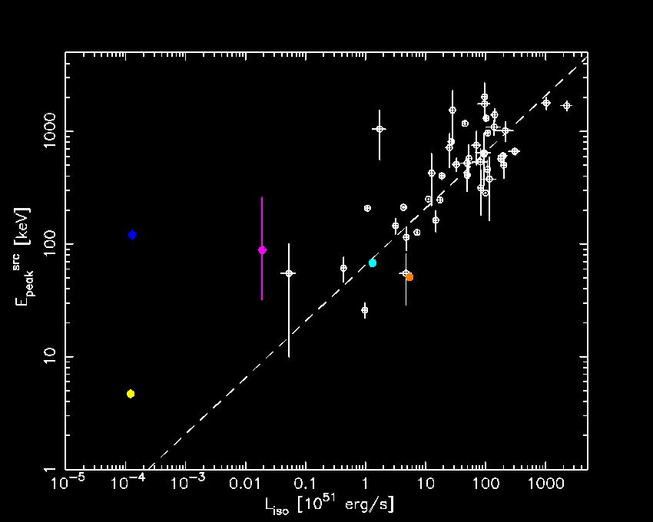
E_{peak} – L_{iso} (Yonetoku) relation
(Yonetoku et al. 2004)
031203
980425
030329
091127
060218
Swift GRBs
(Nava et al. 2012)

Slide 25
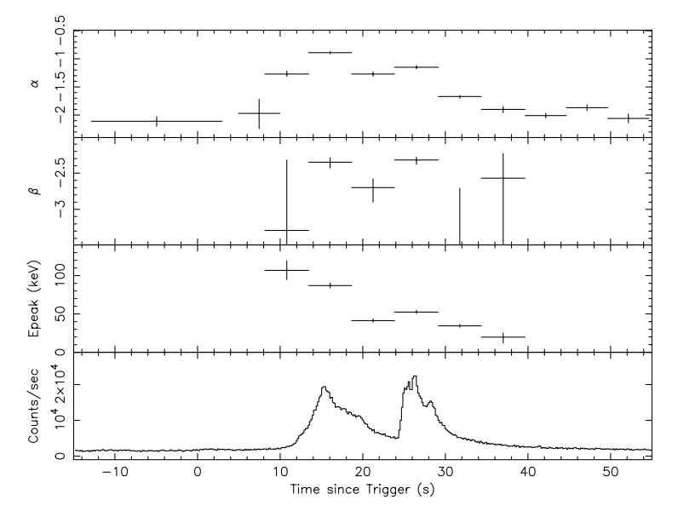
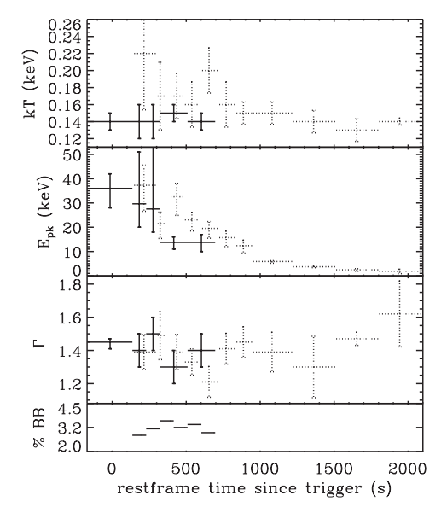
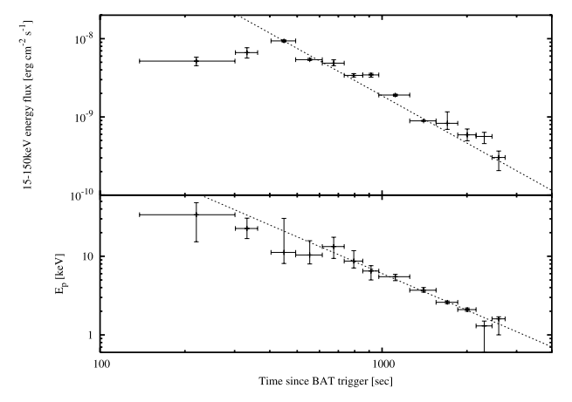
Spectral evolution
030329 (Vanderspek et al. 2004)
100316D (Starling et al. 2011)
060218 (Toma et al. 2007)

Slide 26
Searching for a Hard X-ray Emission of a Supernova Using the Swift BAT Survey Data
T. Sakamoto (CRESST/GSFC), R. Knoche (UMCP),
P. Roming (SwRI), T. Pritchard (PSU/SwRI)

Slide 27
Motivation, samples and analysis
Motivation
Is there any hard X-ray emission around the onset time of optically identified type Ibc SNe?
Sample
- 123 Ibc and IIp SNe (< 100 Mpc) found by the optical survey (2005-2010)
Ibc
IIp
9 SNe (d < 30 Mpc)
52 SNe (30 Mpc <= d < 70 Mpc)
23 SNe (70 Mpc <= d < 100 Mpc)
3 SN-GRBs (060218/100316D/101219B)
39 SNe (< 100 Mpc)
Data analysis
Swift/BAT survey data (~28 days prior to the discovery date)
Swift/UVOT b band light curve for monitored SNe

Slide 28
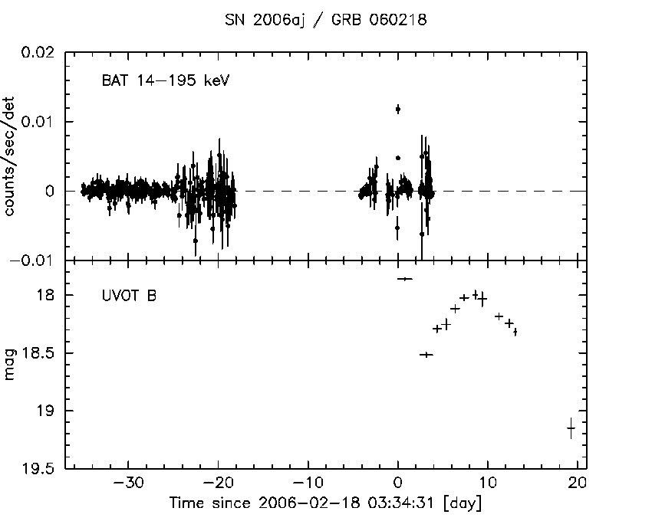
GRB 060218/SN 2006aj
19 σ detection
SN 2006aj / GRB 060218
SN 2006aj / GRB 060218

Slide 29
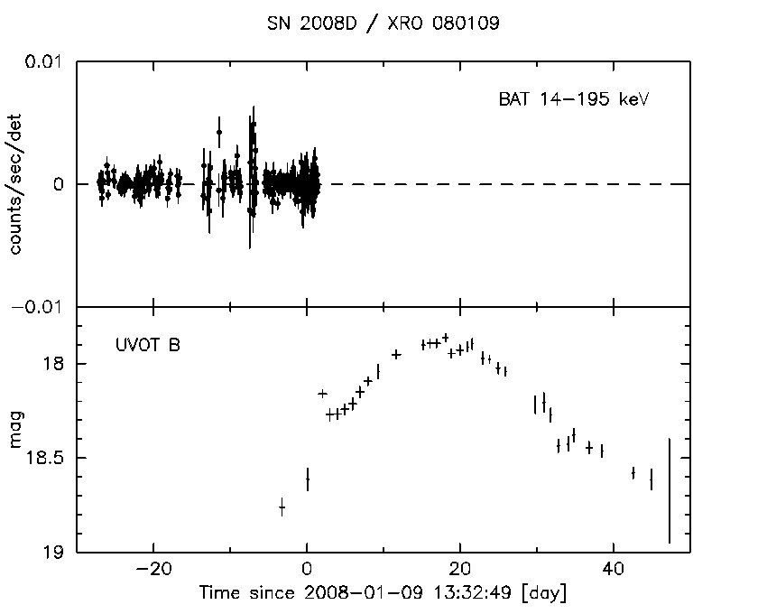
SN 2008D
(Soderberg et al. 2008)

Slide 30
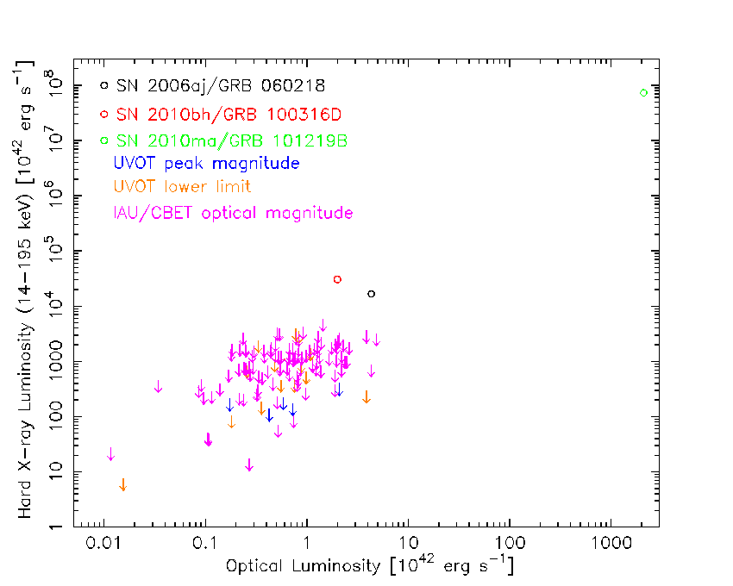
Hard X-ray vs. Optical Luminosity

Slide 31
Hard X-ray vs. Optical Luminosity
No hard X-ray emission found for ordinary Ibc/IIp SNe
Fundamental different mechanism is required to produce a GRB from a supernova (Soderberg et al. 2006)

Slide 32
Summary
Burst duration, spectral lag and spectral parameters (Band α, β and E_{peak}) of SN-GRBs are consistent with typical GRBs.
Addition to the Band function spectrum, 060218 and 100316D (possible 101219B) show kT = 0.1-0.2 keV blackbody component in the prompt spectrum.
The most of SN-GRBs follows the empirical relations; lag-L_{iso}, E_{peak}-E_{iso} and E_{peak}-L_{iso}. However, 980425 and, possibly, 031203 are outliers of those relations.
Spectral evolution is commonly seen in SN-GRBs.
Majority of SN-GRBs share same prompt emission properties of typical GRBs.
Poster #27: “Connecting Gamma-Ray Bursts and Supernovae in the Swift Era: Probing the Cosmic Gamma-Ray Burst Rate, “ A. Lien, T. Sakamoto, N. Gehrels, D. Palmer, and C. Graziani

