Slide 1
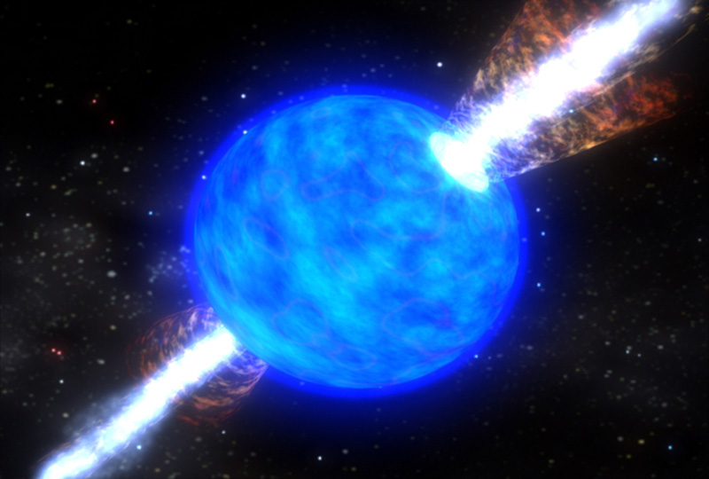
Recent Observations of GRB-Supernovae
Bethany Elisa Cobb
The George Washington University
IAU Symposium 279
March 13, 2012

Slide 2
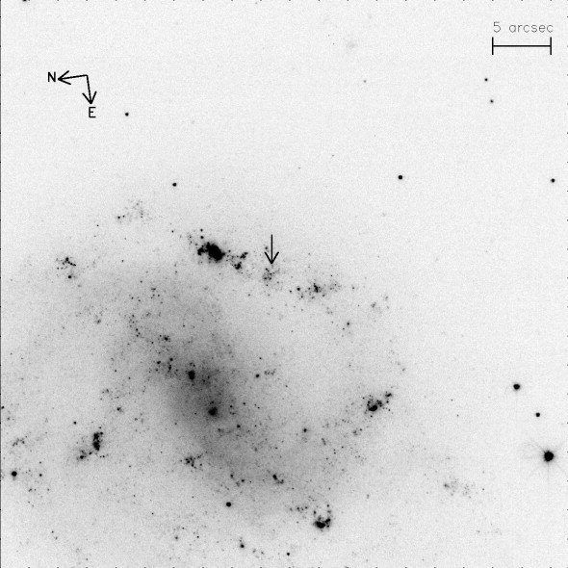
GRB-SNe Connection
Energy considerations
Long-duration GRBs associated with star-forming host galaxies
GRBs occur in environments similar to those of ‘plain’ SNe-Ic
(Fynbo et al. 2000)

Slide 3
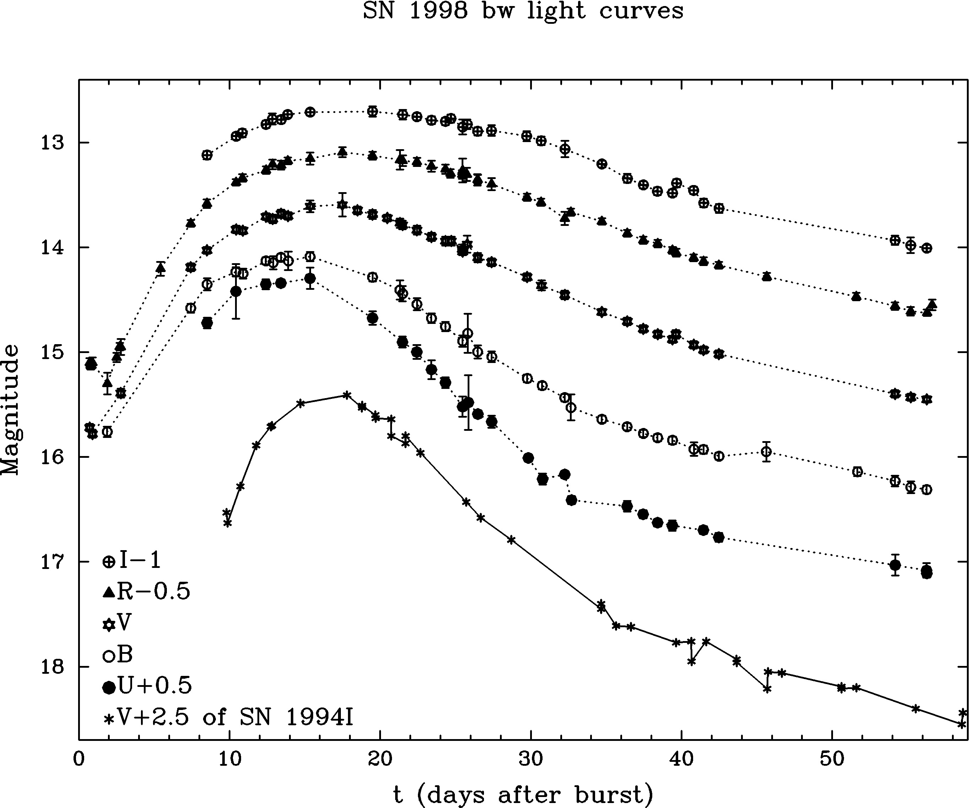
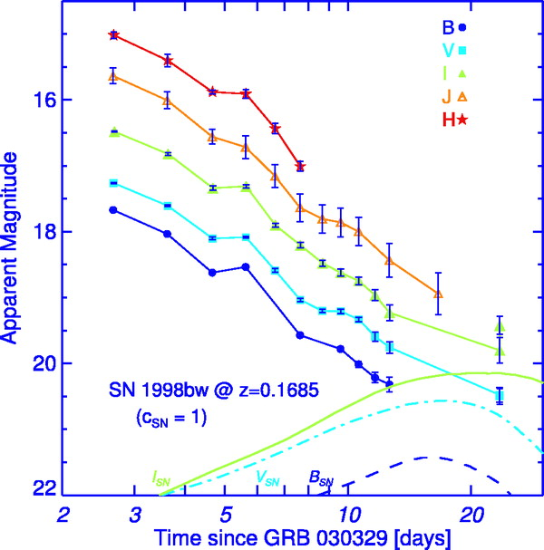
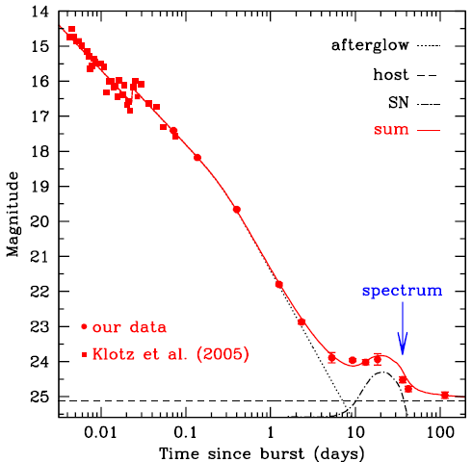
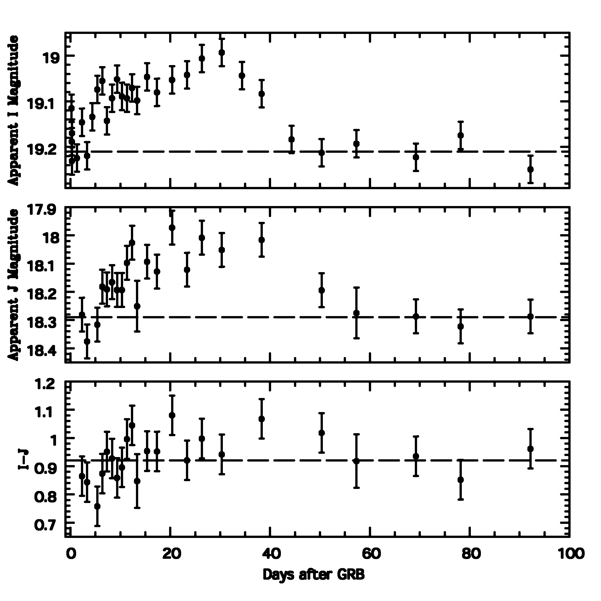
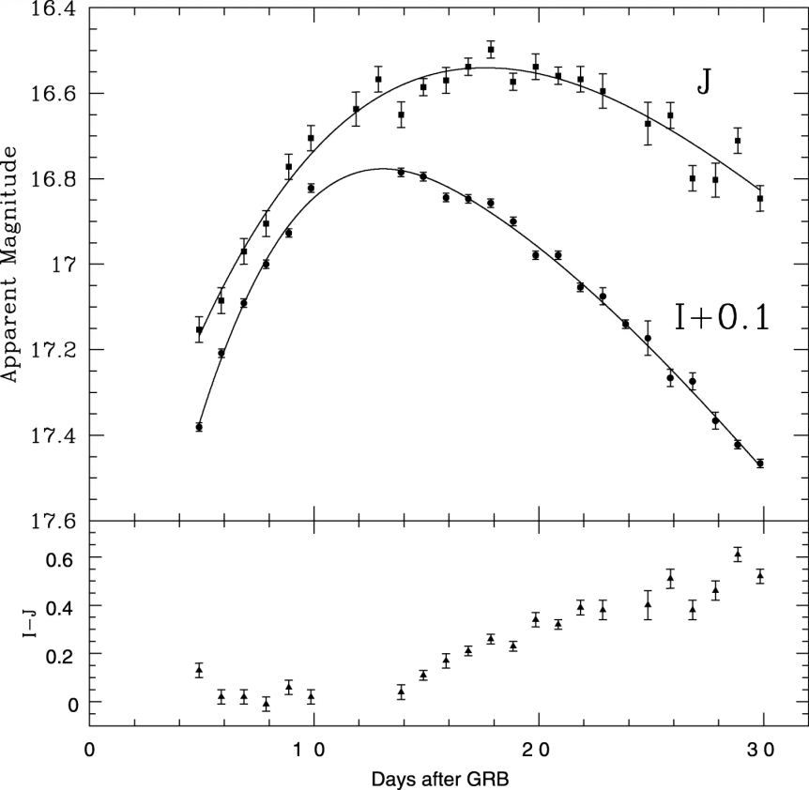
Early GRB-SNe Examples
GRB | SN | Redshift | Example Citations
980425 | 1998bw | 0.0085 | Galama et al. 1998
030329 | 2003dh | 0.16 | Hjorth et al. 2003 Stanek et al 2003 Bloom et al. 2003
031203 | 2003lw | 0.11 | Cobb et al. 2004 Gal-Yam et al. 2004 Malesani et al. 2004 Thomsen et al. 2004
050525A | 2005nc | 0.606 | Della Valle et al. 2006
060218 | 2006aj | 0.033 | Campana et al. 2006 Ferrero et al. 2006 Mirabal et al. 2006 Cobb et al. 2006
(Galama et al..1998)
(Bloom al..2004)
Cobb et al. (2004)
(Della Valle et al. 2006)
Cobb et al. 2006

Slide 4
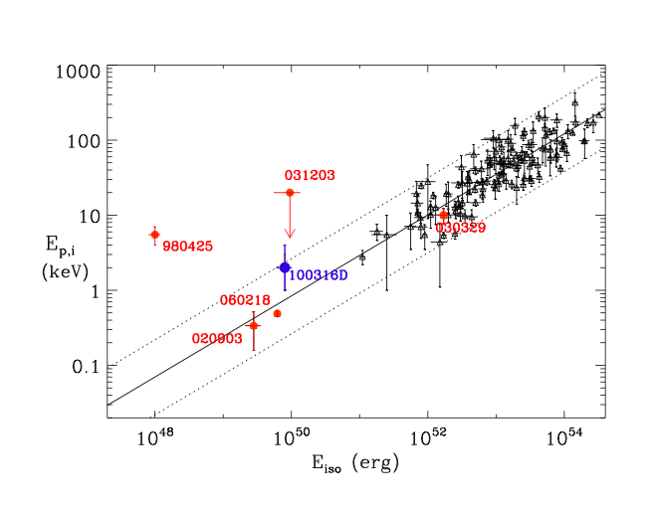
Low-Luminosity, Low-Redshift GRB-SNe
Early, well-studied (photometry & spectra) GRB-SN examples (980425, 031203, 060218):
→ Low redshift
→ Low gamma-ray luminosity (E_{iso} ~ 10⁴⁸⁻⁵⁰)
→ Occasionally divergent from E_{peak} – E_{iso} correlation (Amati relation)
→ Faint/undetected optical afterglows
Do these represent a special population?
Are all (long-duration) GRBs associated with supernovae?
Answers require additional
GRB-SN examples…
(Bufano et al. 2011)
Notes:
SN associated with GRBs of low-luminosity (e.g. 2 to 4 orders of magnitude smaller than for a typical GRB at cosmological distances)
Crutial to test whether the SN-GRB connection holds in general for high-redshift, high luminosity GRBs
-- additional examples of SN-like bumps in late-time light curves, though host galaxy and afterglow contaminations has at times made interpretation difficult

Slide 5
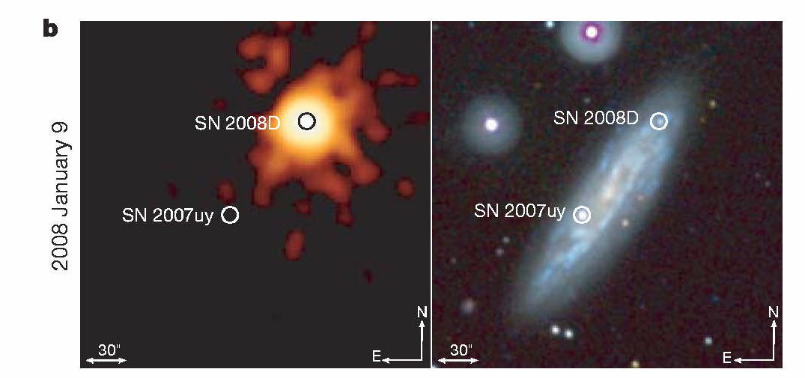
XRF 080109 / SN 2008D (z = 0.007)
Serendipitous detection (during Swift/XRT observations of SN2007uy) (Berger & Soderberg 2008: GCN 7159)
No associated GRB
Optical transit identified 1.4 hours after XRF (no contemporaneous optical emission)
Extreme temporal coverage from very early times allowed for detailed modeling of progenitor (Soderberg et al. 2008)
He-rich Ibc, E_{X} ~ 10⁴⁶ → “borderline” event? A link between standard Ibc SNe and GRB-SNe?
Collapse of ~ 30 M star, forming a black hole and a weak, mildly relativistic jet (Mazzali et al. 2008)
X-ray
UV
(Soderberg et al. 2008)
Notes:
Thought it WAS in field of view of BAT at the time of the X-ray Flash

Slide 6
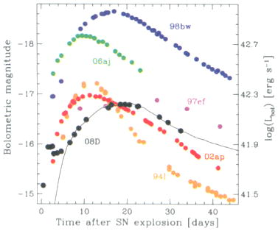
XRF 080109 / SN 2008D (z = 0.007)
Synthesized ~ 0.09 M of ⁵⁶Ni
⁵⁶Ni synthesis similar to that in the broad-lined SN-Ic 02ap, but much less than that in GRB-SNe such as 98bw (0.7 M)
“Shock breakout” (Soderberg et al. 2008) or “failed relativistic jet” (due to low energy or damping by the He layer not found in pre-GRB stars) (Mazzali et al. 2008)
Suggests GRB-like central engine activity may be present in all black hole forming SNe Ibc
(Mazzali et al. 2008)

Slide 7
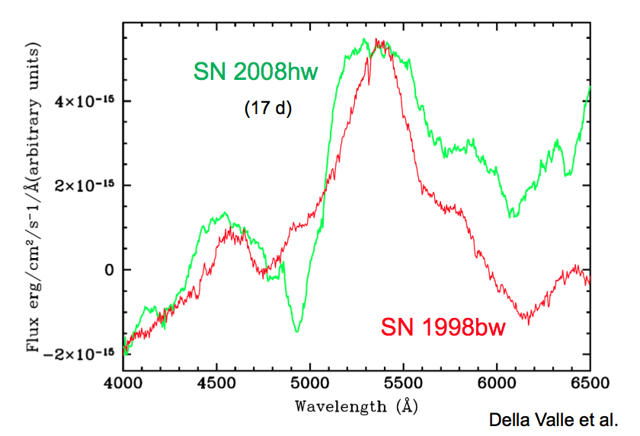
GRB 081007 / SN 2008hw (z = 0.53)
E_{iso} ~ 10⁵¹ ergs
Brightening detected in optical afterglow (Soderberg et al. 2008; GCN 8662)
Spectra 17 days-post burst (with galaxy template subtracted) revealed the broad bumps indicative of a GRB-SN (similar to SN 1998bw) (Della Valle et al. 2008: CBET 1602)
SMARTS 1.3m I-band
Afterglow Observations
0.7 hrs post burst
22.7 hrs
47.9 hrs
69.9 hrs

Slide 8
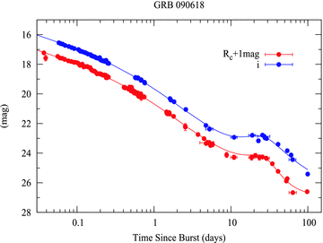
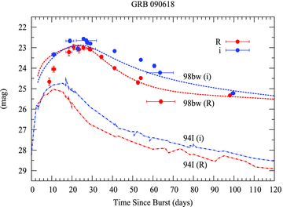
GRB 090618 / SN 2009?? (z = 0.54)
Extremely bright bursts (at all wavelengths) triggered Swift, Fermi, Super-AGILE etc.
E_{iso} ~ 3 × 10⁵³ ergs (Page et al. 2011)
Light curve bump associated with change in color (Cano et al. 2011)
[No spectral identification of this GRB-SN]
AG + SN
SN

Slide 9
GRB 091127 / SN 2009nz (z = 0.49)
E_{iso} ~ 10⁵³ ergs
Bright optical afterglow detected by numerous instruments
Optical afterglow brightened ~ 10 days post-burst, following an evolution similar to SN 1998bw (Cobb et al. 2010, GCN 10400)
Spectra reveal the broad features typical of GRB-SNe (Berger et al. 2011)
(Cobb et al. 2010)
Notes:
Slightly faster in evolution
Slightly dimmer

Slide 10
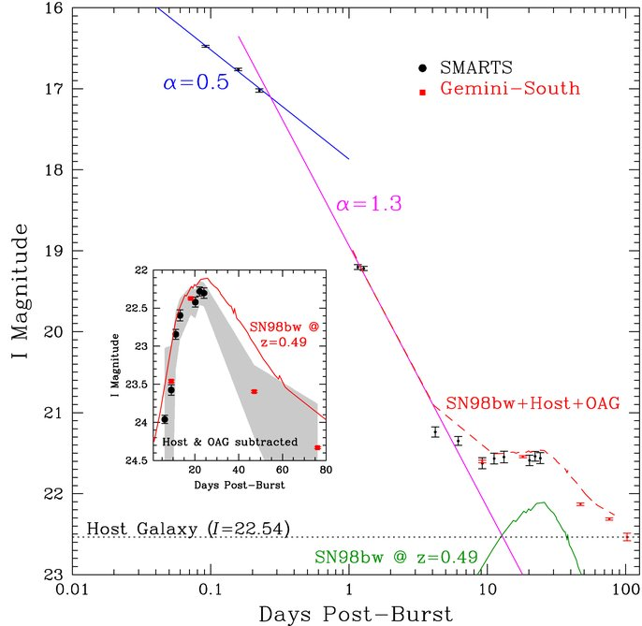
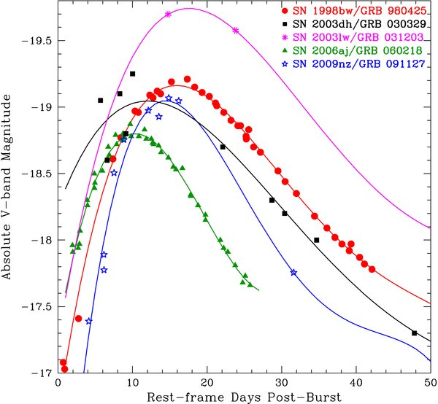
GRB 091127 / SN 2009nz (z = 0.49)
03lw
98bw
06aj
03dh
09nz
(Cobb et al. 2010)
(Cobb et al. 2010)

Slide 11
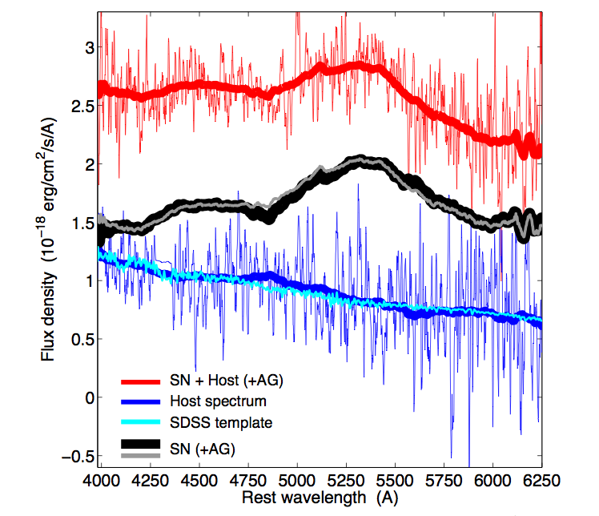
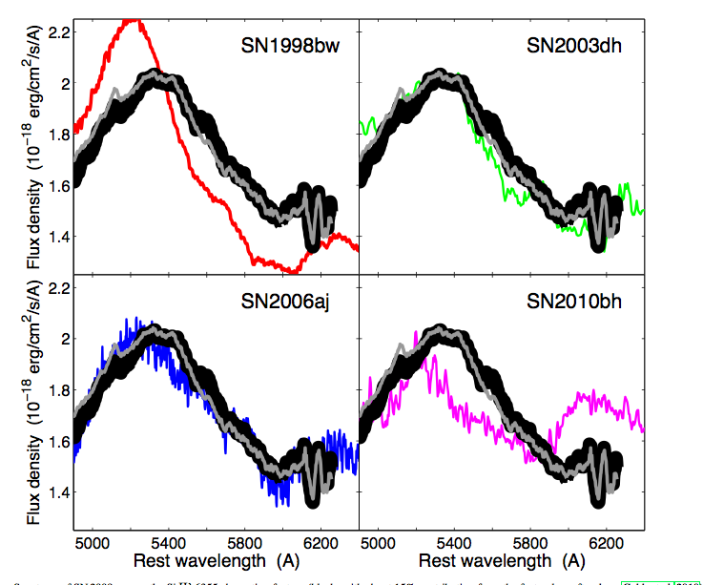
GRB 091127 / SN 2009nz (z = 0.49)
HOST + SN (+ AG)
→ Subtraction of late-time (1 year) host-galaxy spectrum from SN+host spectrum obtained ~ 24 days post burst
SN (+ AG)
HOST
(Berger et al. 2011)
(Berger et al. 2011)

Slide 12
GRB 100316D / SN 2010bh (z = 0.06)
Soft gamma-ray spectrum reminiscent of GRB 060218 / SN 2006aj (Sakamoto et al. 2010: GCN 10511)
E_{iso} ~ 4 – 6 ×10⁴⁹ ergs
No optical afterglow detection, but bright, nearby galaxy adds significant uncertainty
Brightening noted in imaging ~ 1.5 post-burst (Levan et al. 2010: GCN 10523)
Spectra revealed high-equivalent-width nebular emission lines, similar to SN 1998bw (Chornock et al. 2010: GCN 10541)
(Starling et al. 2011)

Slide 13
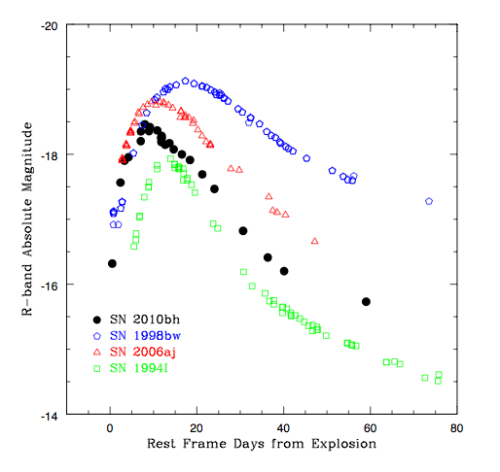
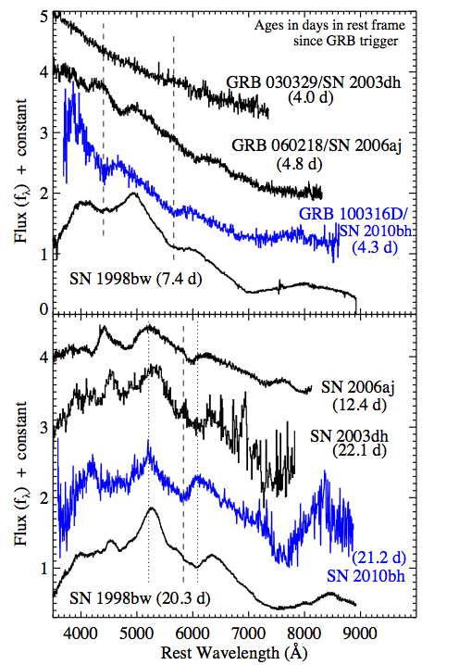
GRB 100316D / SN 2010bh (z = 0.06)
98bw
06aj
10bh
94I
(not a GRB-SN)
(Chornock et al. 2010)
(Bufano et al. 2011)

Slide 14
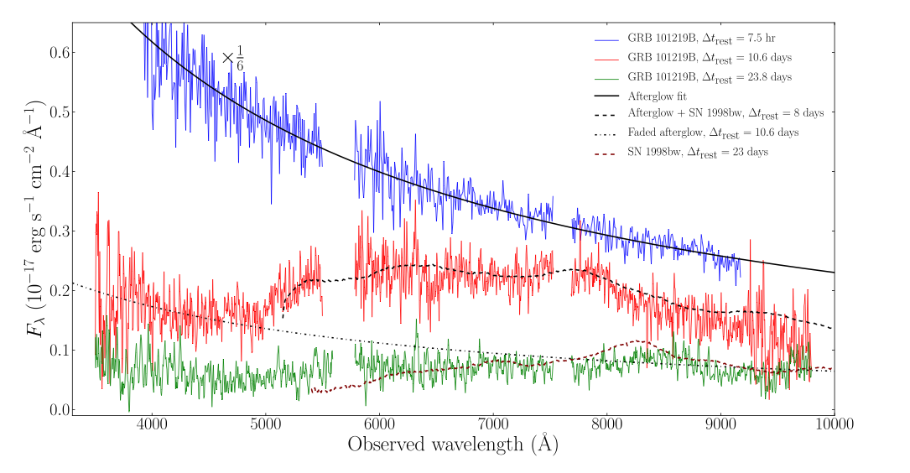
GRB 101219B / SN 2010ma (z = 0.55)
Burst has typical E_{iso} (~ 4 × 10⁵¹ ergs), bright afterglow & obeys “Amati” relation (Sparre et al. 2011)
Afterglow light curve flattens & changes color ~ 5 days post-burst, indicating contributions from SN (Olivares et al. 2011: GCN 11578)
SN detected as broad undulations in the afterglow spectrum obtained at 16.5 days post-burst (de Ugarte Postigo et al. 2011: GCN 11579)
7.5 hrs & afterglow fit
10.6 days & SN 1998bw @ 8 days
23.8 days & SN 1998bw @ 23 days
(Sparre et al. 2011)
Notes:
Blue spectrum (drop at ~ 5000 A) consistant with UV line blanketing in the SN spectrum – the blue afterglow component dominates at these wavelengths
Relatively faint host galaxy, so clean SN signal is observed
Little/no host galaxy extinction

Slide 15
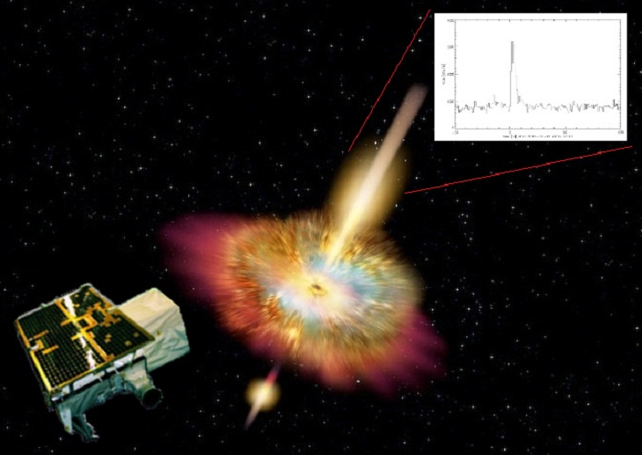
Newest Example: GRB 111211A / SN 2011?? (z = 0.478)
SuperAGILE long-duration GRB (Lazzarotto et al. 2011: GCN 12666)
Optical afterglow detected 8.5 hrs post-burst (Kann et al. 2011: GCN 12668)
Supernova detected in optical imaging as flat temporal evolution of GRB afterglow
Spectrum 20.3 days post-burst revealed SN component similar to SN 2006aj / GRB 060218 near maximum (de Ugarte Postigo et al. 2012: GCN 12802)
Stay tuned!
(SuperAGILE 2012)
Notes:
Long GRB detected by SuperAGILE @ 11 December 2011, at 22:17:33 UT (Lazzarotto et al. GCN 12666, 2011)
Optical afterglow detected 8.5 hrs after GRB by GROND (Kann et al. GCN 12668, 2011)
X-shooter spectrography 1.3 days after GRB, redshift measured z=0.478 (Vergani et al. GCN 12677, 2011)
10.4m GTC telescope + OSIRIS imaging + spectroscopy (de Ugarte Postigo et al. GCN 12802, 2012) On 27 December 2011 (15.3 days after the burst) we obtained imaging in r-band of 6x180s with a seeing of ~0.9". This image clearly shows the afterglow of GRB 111211A at a magnitude of r ~ 22.6 (compared to SDSS stars) superposed to its resolved host galaxy but slightly offset towards the North East. Spectroscopy of the afterglow was obtained on 1 January 2012 (20.3 days after the burst) under good seeing conditions (~1"). At that time, the afterglow was detected at r ~ 22.7 in the acquisition frame, implying an almost flat evolution since the previous epoch which indicates a possible supernova component contributing to the light curve. We obtained 3x1800s spectroscopy at a resolution of ~ 500 and wavelength coverage from ~ 5 000 to 10 000 Angstrom. The spectrum shows both emission from the GRB and the host galaxy. The host shows emission lines of [OII], H-beta, [OIII] and H-alpha at a redshift of 0.478, consistent with the redshift of the GRB (Vergani et al. GCN 12677). The spectrum at the position of the afterglow shows undulations typical of a SN spectrum similar to the spectrum of the type Ic SN 2006aj / GRB 060218 close to maximum.

Slide 16
Conclusions
GRB | SN | Redshift
980425 | 1998bw | 0.0085
030329 | 2003dh | 0.16
031203 | 2003lw | 0.11
050525A | 2005nc | 0.606
060218 | 2006aj | 0.033
XRF 080109 | 2008D | 0.007
081007 | 2008hw | 0.53
090618 | 2009?? | 0.54
091127 | 2009nz | 0.49
100316D | 2010bh | 0.06
101219B | 2010ma | 0.55
111211A | 2011?? | 0.478
Recent GRB-SN observations have significantly added to the “GRB-SNe zoo”:
Additional clear photometric/spectrographic observations of GRB-SNe associated with “typical energy” GRBs and GRBs at cosmological distances
Identification of “linking” event XRF 080109 / SN 2008D filing out the continuum from “typical” SNe to the “hyper” SNe associated with GRBs
Both local GRBs and cosmological GRBs are intimately linked with SNe
Questions still remain thanks to examples of low-redshift GRBs (060505 & 060614) without detected SNe…
Notes:
Another instances of a GRB with large gamma-ray energies (E_iso = 4.2e51) with a bright afterglow. (GRB-SNe no longer just associated with special cases of GRBs)
Data now clearly indicate that the GRB-SN connection is not only proven for the local universe, but extends that connection to the main population of cosmological GRBs

