Slide 1
Constraining the progenitors of gamma-ray bursts
Andrew Levan
University of Warwick

Slide 2
Parameter space
Kouveliotou et al. 1993

Slide 3
Parameter space
Kulkarni & Kasliwal 2010

Slide 4
Parameter space
SGRBs
LGRBs
?
TDEs?
SGRs
LLGRBs
AGN
Galactic sources (SGR, LMXB, HMXB, microquasar, gamma-ray pulsars etc)

Slide 5
Parameter space
SGRBs
LGRBs
?
TDEs?
SGRs
LLGRBs
AGN
031203
060218
030329
100316D
Galactic sources (SGR, LMXB, HMXB, microquasar, gamma-ray pulsars etc)

Slide 6
Origins
Long GRBs from stellar core collapse of WR stars?
Short GRBs from compact binary mergers?
Collapse of giants (Woosley & Heger 2011)
Shock breakout (e.g. Nakar et al. 2011)
SGR giant flares (e.g. Hurley et al. 2005; Tanvir et al. 2005)
Tidal disruption events (Levan et al. 2011; Bloom et al 2011)
AGN outbursts (only very long? – Burrows et al. 2011)
Galactic sources (flare stars, SGRs, XRBs etc)

Slide 7
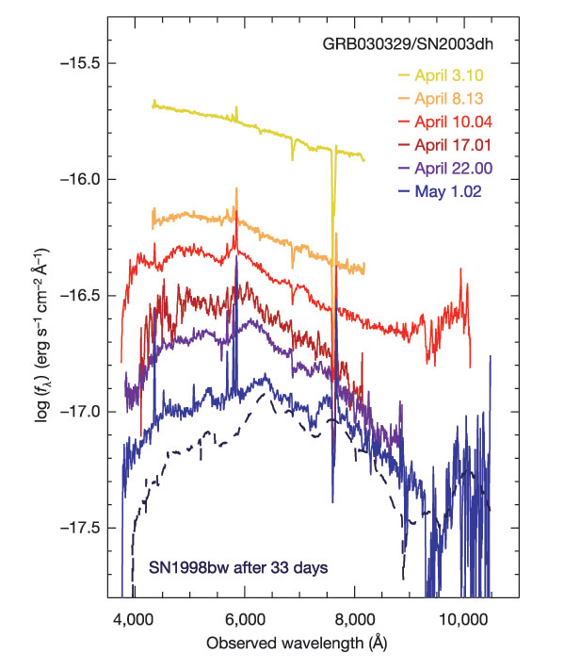
Routes to progenitors
Spare et al. 2010
Hjorth et al. 2003
Pros: Unambiguous signature, much physical detail
Beware: outliers of GRB distribution

Slide 8
Routes to progenitors
Lipkin et al. 2004
Pros: Larger redshift range, easier to obtain good time coverage
Beware: afterglow complexity,interlopers
Woosley & Bloom 2007

Slide 9
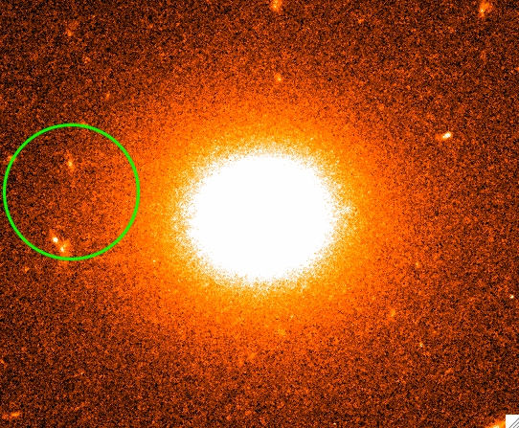
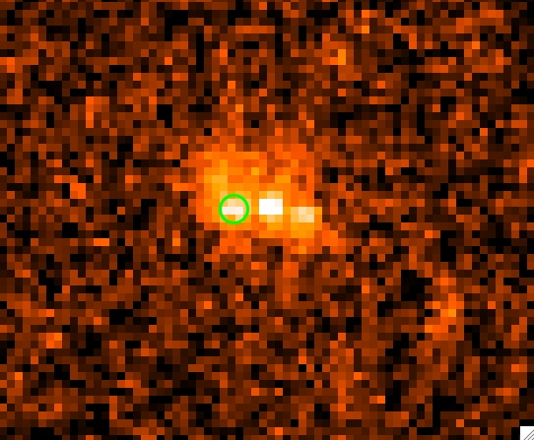
Routes to progenitors
GRB locations
SGRB
CCSN
LGRB
Pros: Large sample sizes, little redshift cut
Beware: interpretation is tough
Fruchter et al. 2006; Svensson et al. 2010; Fong et al. 2010

Slide 10
Routes to progenitors
Host environments
Pros : Good physical detail. Characterization of progenitor environments (i.e. not just of SN)
Beware: Selection effects
Modjaz et al. 2010

Slide 11
Routes to progenitors
Host environments
Pros : Good physical detail. Characterization of progenitor environments (i.e. not just of SN)
Beware: Selection effects
Svensson et al. 2010, 2012

Slide 12
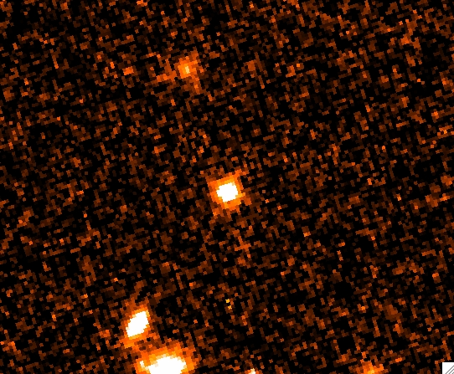
GRB 101225A / GRB 111209A

Slide 13
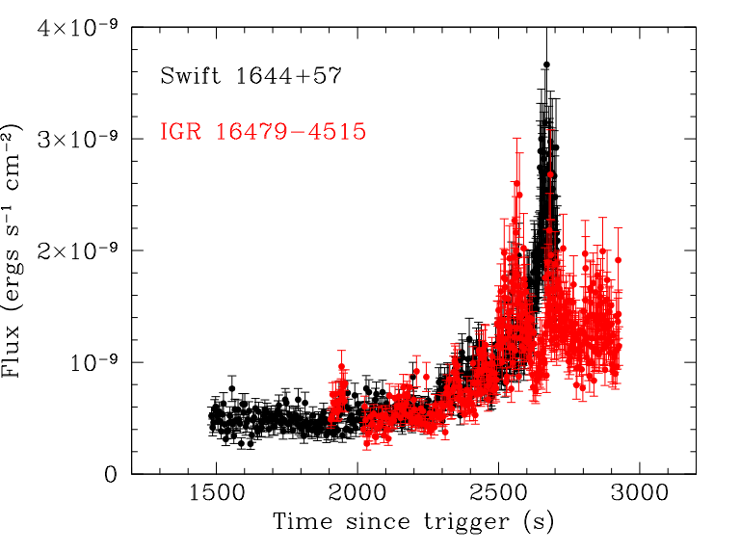
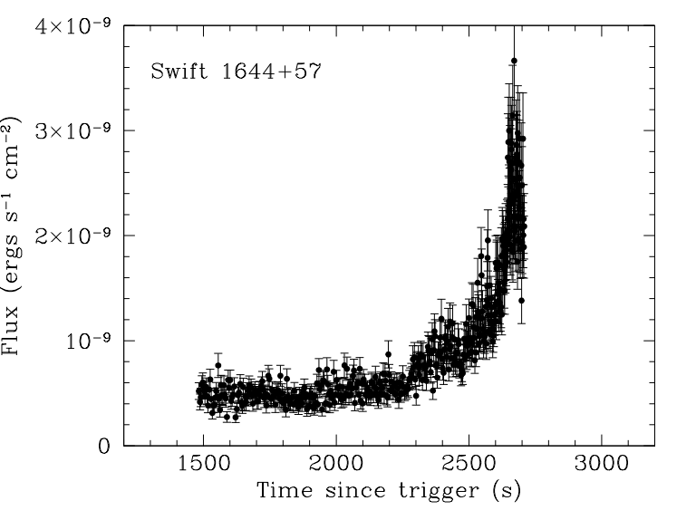
GRB 110328A
…….striking similarities with what was observed during the 2008 March 19 outburst of the supergiant fast X-ray transient (SFXT) IGR J16479-4514 - Kennea et al. ATEL 3242

Slide 14
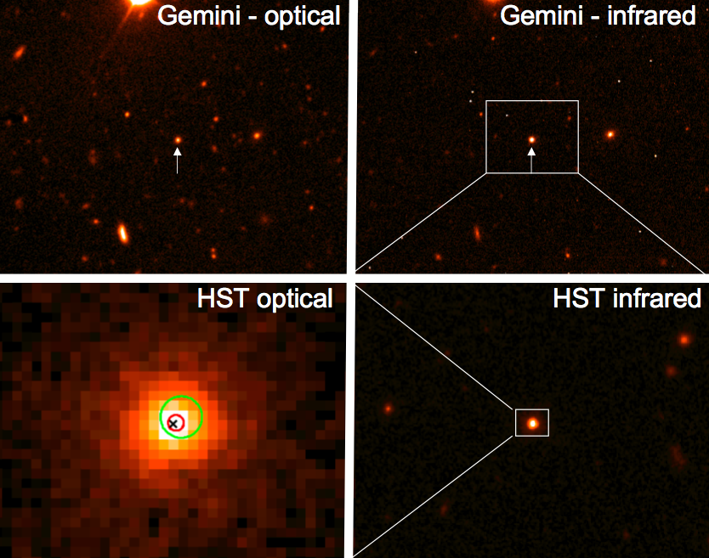
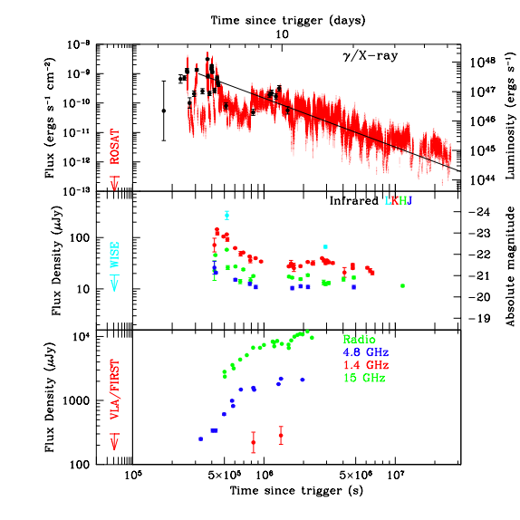
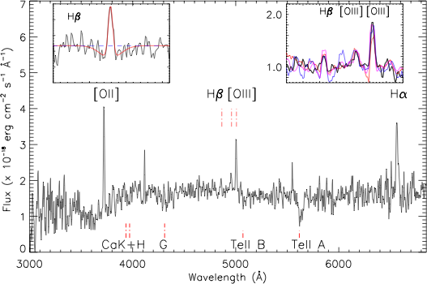
Levan et al. 2011; Bloom et al. 2001; Burrows et al. 2011; Zauderer et al. 2011

Slide 15
Conclusions
Some LGRBs conclusively linked to stellar core collapse.
Many “prime examples” are outliers of the GRB distribution
The gamma-ray sky is diverse
There may be well be more progenitor systems waiting to be found.

Slide 16
The future
Unlike optical astronomy most recent discoveries in gamma-ray transients are of longer durations.
These events might be new physical systems or e.g. very high redshift GRBs.
Increase the ability of detectors to find then.
  Higher orbits for new missions?
  High cadence + improved sensitivity
  Change pointing strategy for Swift?

