Slide 1
3D Core-Collapse Supernova Simulations
Neutron star kicks
Nickel distribution
Annop Wongwathanarat
Hans-Thomas Janka
Ewald Müller
Max-Planck-Institut
für Astrophysik
IAU Symposium 279
14 Mar 2012

Slide 2
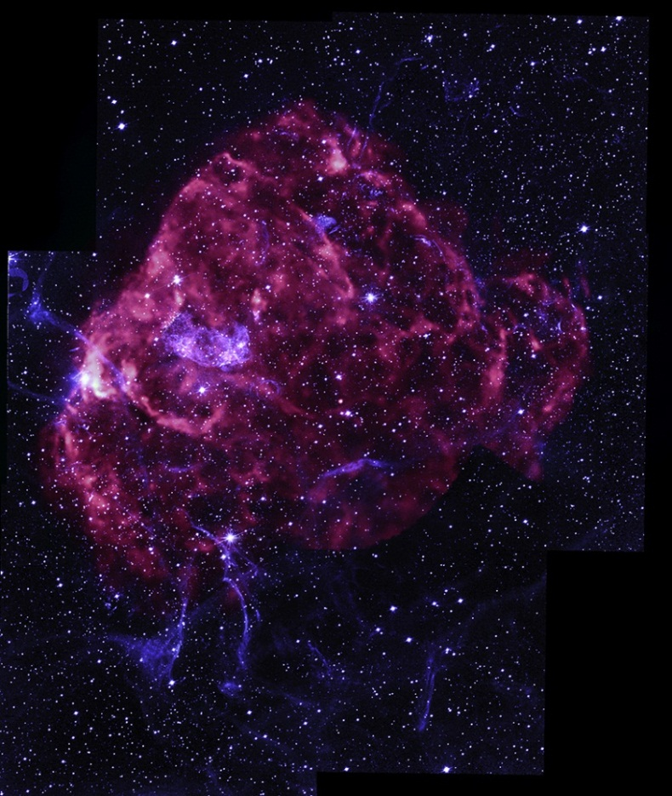
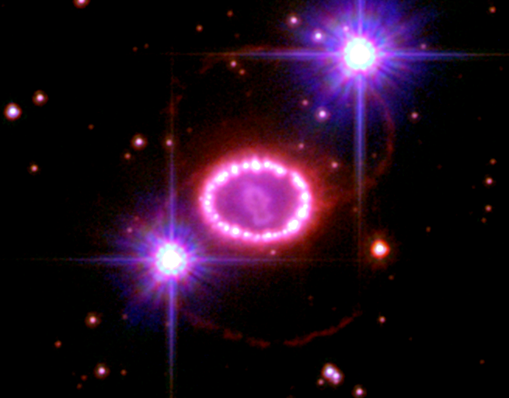
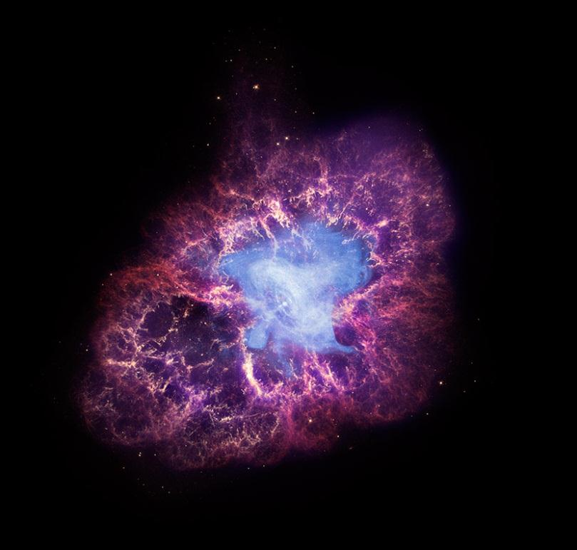
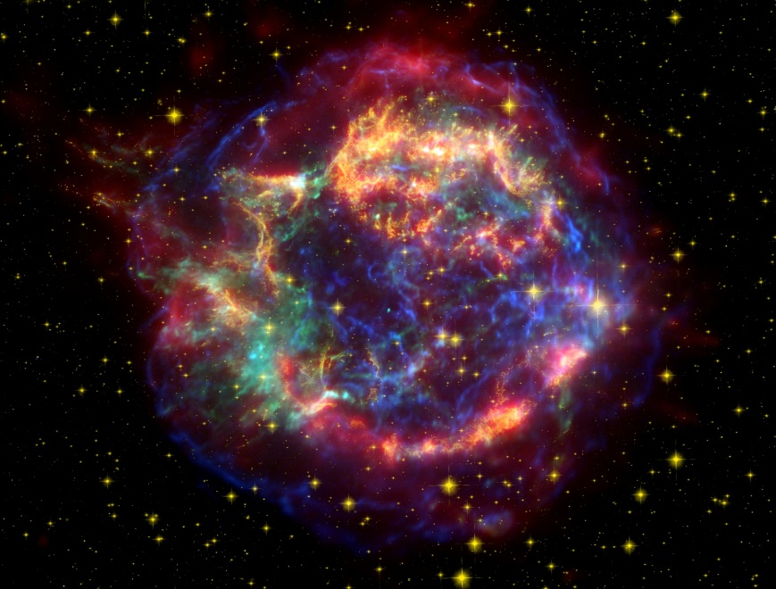
SN asymmetries

Slide 3
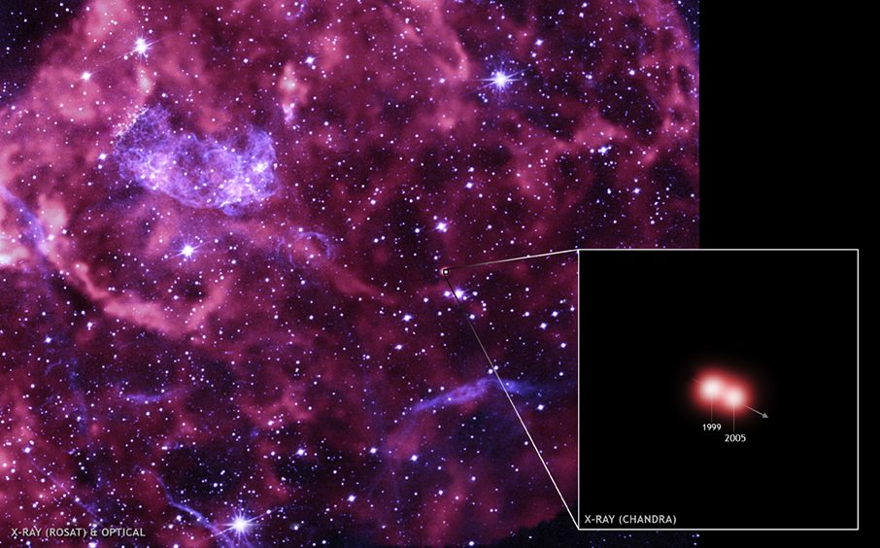
Neutron star kicks
Kick mechanism??
Puppis A SNR
1600 km/s
average pulsars velocity: 200-500 km/s

Slide 4
Numerical techniques
1D post-bounce model at 15 ms
PROMETHEUS
excise dense PNS core (1.1 M⊙)
radial contraction of computational grid
prescribe neutrino luminosities at inner grid boundary
1D ray-by-ray grey neutrino transport
tabulated EOS by Janka & Müller (1996)
4 nuclear species in NSE (n, p, ⁴He, ⁵⁴Mn)
passive nuclear burning of 13 alpha group nuclei (⁴He- ⁵⁶Ni plus neutron rich tracer)
3D Newtonian self-gravity
1D GR correction
seed random perturbation of 0.1% amplitude
Yin-Yang grid 2 degree angular, 400 radial

Slide 5
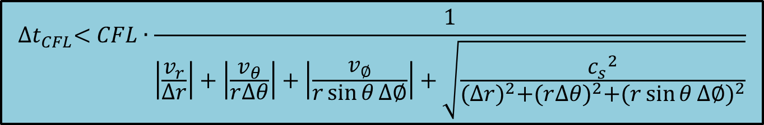
Numerical techniques
Latitude-Longitude grid
$${∆t}_{CFL}<CFL∙\frac{1}{\left|\frac{v_{r}}{∆r}\right|+\left|\frac{v_{θ}}{r∆θ}\right|+\left|\frac{v_{∅}}{r\sin{θ}∆∅}\right|+\sqrt{\frac{{c_{s}}^{2}}{{(∆r)}^{2}+{(r∆θ)}^{2}{+(r\sin{θ}∆∅)}^{2}}}}$$

Slide 6
Numerical techniques
Yin-Yang grid
Kageyama & Sato (2004)
get rid of high latitude
allow for much larger time step
40,80,160 times for 2,1,0.5 degree resolution
all equations remain the same
easy to implement
two patches are identical

Slide 7
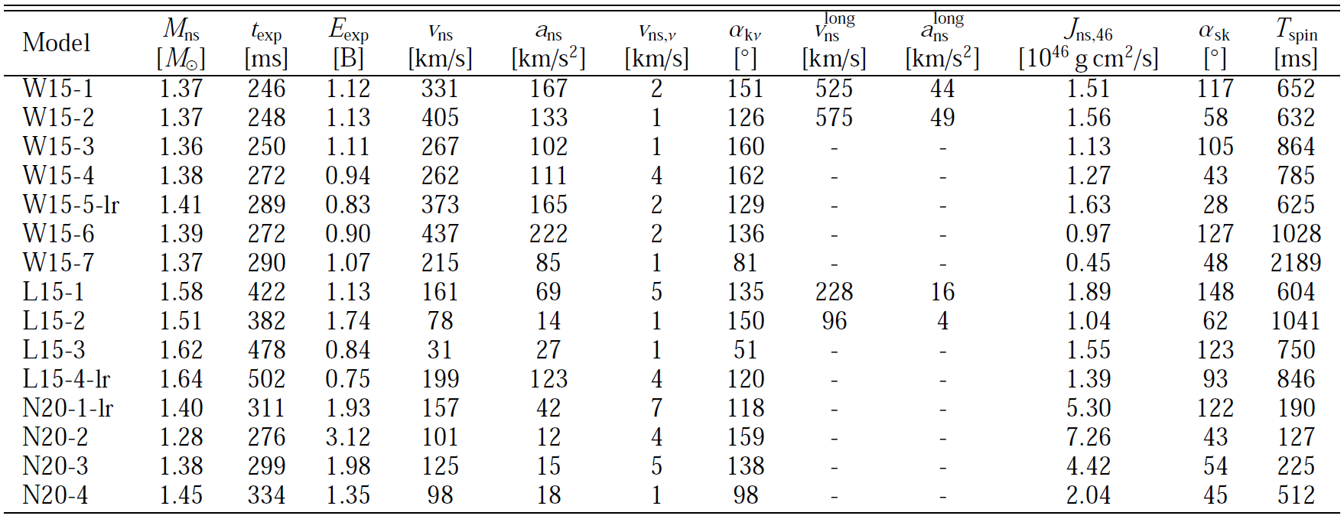

Neutron star kicks
W
L
N
at t = 1.3 s
get to nearly 600 km/s later
$${ \vec{v}}_{ns}\left(t\right)=−{\vec{P}}_{gas}(t)/M_{ns}(t)$$
v_{ns} from 31-437 km/s
To be submitted

Slide 8
Neutron star kicks
W15-2

Slide 9
Neutron star kicks
W15-2
405 km/s
L15-2
78 km/s

Slide 10
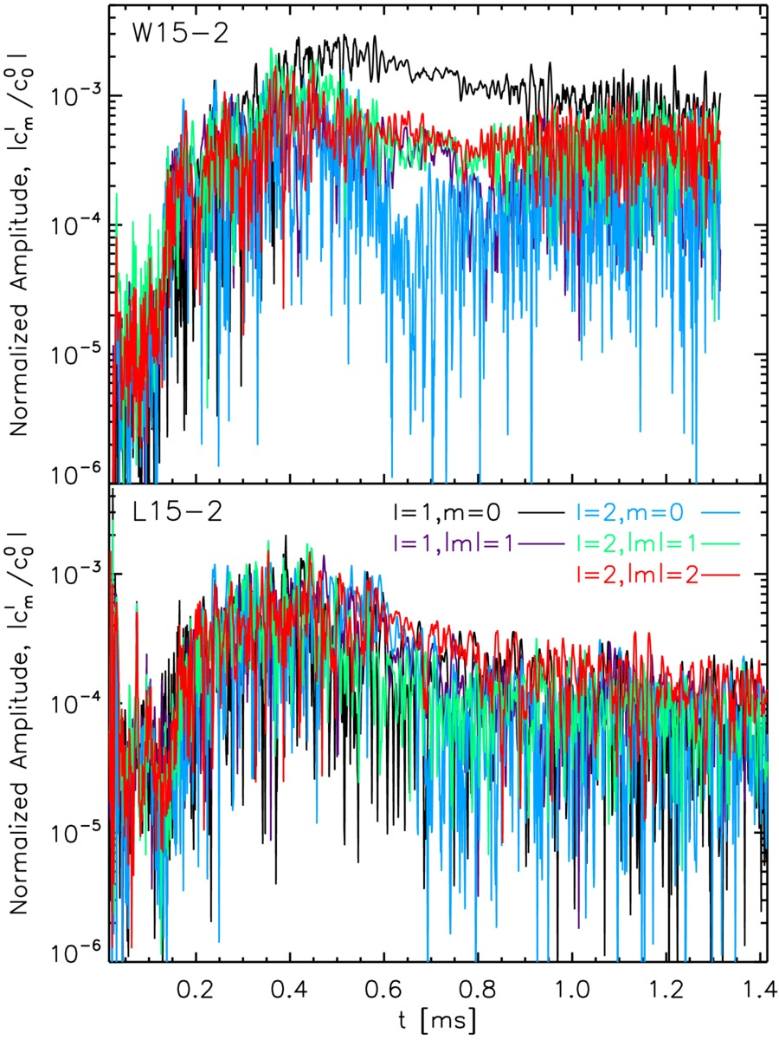

Neutron star kicks
surface mass density
$$Σ\left(r,θ,φ\right)=∫ρ\left(r,θ,φ\right) dr$$
Spherical harmonics decomposition
Large l=1,m=0 mode

Slide 11
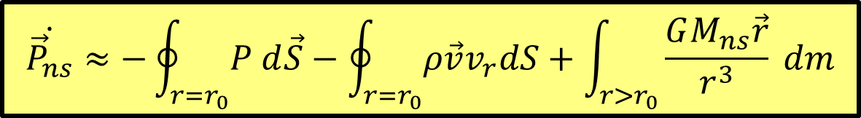
Neutron star kicks
$$\dot{{\vec{P}}_{ns}}≈−\oint_{r=r_{0}}{P d\vec{S}}−\oint_{r=r_{0}}{ρ\vec{v}v_{r}dS}+\int_{r>r_{0}}{\frac{GM_{ns}\vec{r}}{r^{3}} dm}$$
gravitational drag term is dominant
Same conclusion as in 2D simulations (Scheck et al. 2006, Nordhaus et al. 2010,2011)

Slide 12
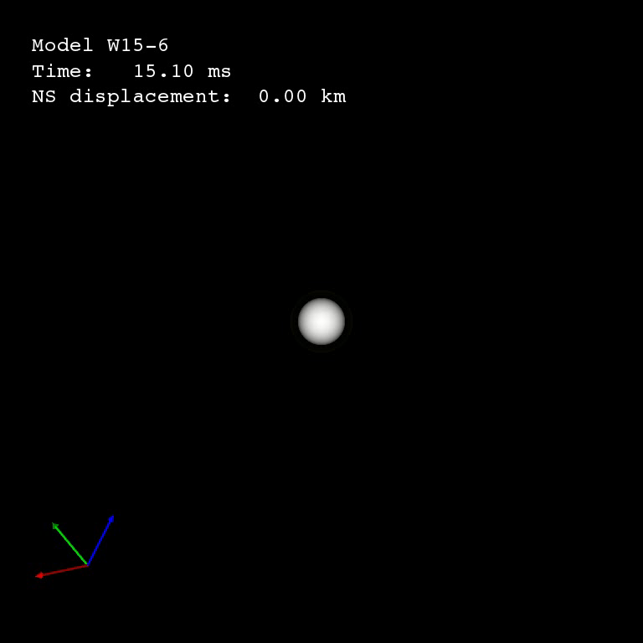

Neutron star kicks
$$Σ\left(r,θ,φ\right)=w\left(r,θ,φ\right)∫ρ\left(r,θ,φ\right) dr$$
surface mass density
W15-6
437 km/s

Slide 13
Nickel distribution
Ni shows hemispheric asymmetry
asymmetry can be as large as 50%
observed??? Constrain kick mechanism???

Slide 14
Conclusions
Perform a set of 3D CCSN simulations
Follow the evolution from 15 ms to 1.3 s after bounce
Estimate the NS kick velocity
Obtain highest kick velocity of 437 km/s
Will grow beyond 600 km/s
Kick mediated by long-ranged gravitational drag
Possibility for kick beyond 1000 km/s ???
More heavy elements synthesized opposite to kick direction in case of high kick models
50% hemispheric asymmetry in case of high kicks
Can be used to constrain kick mechanism if observed

Slide 15
Neutron star spins
Spin period : 127-2189 ms
Spiral mode SASI ???
Spin-kick alignment ???
Random spin-kick angle

