Slide 1
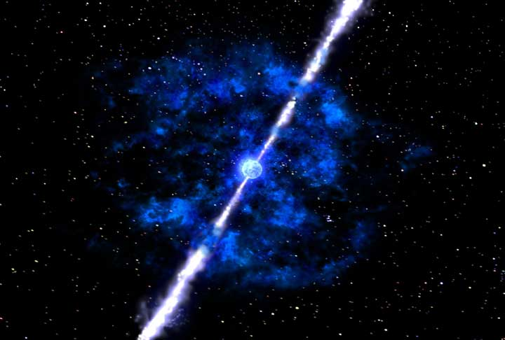
Host Galaxies of Gamma-Ray Bursts
Emily Levesque University of Colorado at Boulder March 15, 2012

Slide 2
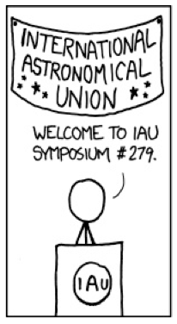





COLLABORATORS
Lisa Kewley, Kirsten Larson, H. Jabran Zahid
Edo Berger, Ryan Chornock, Alicia Soderberg
Andrew Fruchter, John Graham, Claus Leitherer
Megan Bagley
Sylvia Ekstrom, Georges Meynet, Daniel Schaerer
xkcd
2-22-12

Slide 3
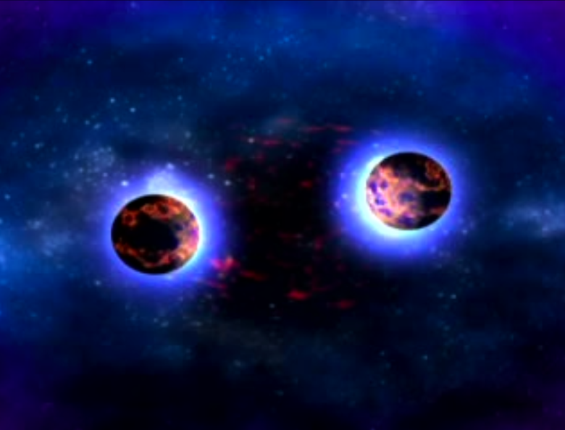
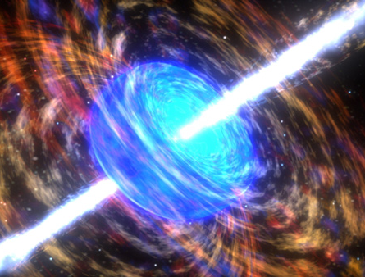
Background - using hosts - Z effects - host survey
Metallicity - cutoff? - local Z? - energetics?
New Questions
SGRB hosts: late-type galaxies, generally large offsets for the SGRB positions -- parent stellar populations, progenitor ages, progenitor scenarios
LGRB hosts: young star-forming galaxies, LGRBs concentrated in bluest regions --progenitor ages, conditions for progenitor evolution

Slide 4
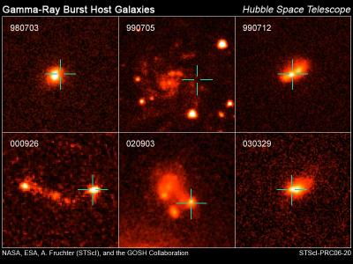
Background - using hosts - Z effects - host survey
Metallicity - cutoff? - local Z? - energetics?
New Questions
LGRBs are often cited as potentially powerful and unbiased tracers of star formation.
For this to be true, their ISM environments need to be typical of the general galaxy population…
In recent years, several studies found evidence that LGRBs occur in low-Z environments (e.g., Stanek et al. 2006, Fruchter et al. 2006, Kewley et al. 2007 Modjaz et al. 2008, Kocevski et al. 2009…)
Fruchter et al. 2006

Slide 5
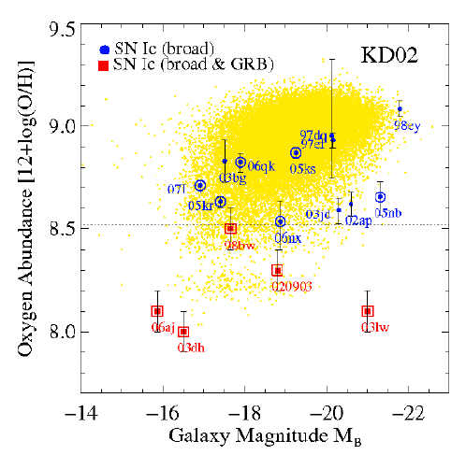
Background - using hosts - Z effects - host survey
Metallicity - cutoff? - local Z? - energetics?
New Questions
Use Maryam’s figure instead
A low-metallicity bias is supported by stellar evolutionary theory under the collapsar model…
Modjaz et al. 2008

Slide 6
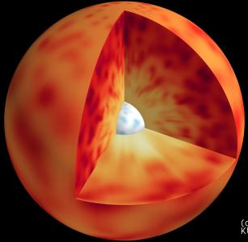
Background - using hosts - Z effects - host survey
Metallicity - cutoff? - local Z? - energetics?
New Questions

Slide 7
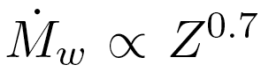
Background - using hosts - Z effects - host survey
Metallicity - cutoff? - local Z? - energetics?
New Questions
(Vink et al. 2001)
M_{w}

Slide 8
Background - using hosts - Z effects - host survey
Metallicity - cutoff? - local Z? - energetics?
New Questions
(Vink et al. 2001)
M_{w}
…stronger winds at higher Z lead to more angular momentum loss.
Diminished core rotation should prevent LGRB production in high-Z hosts.

Slide 9
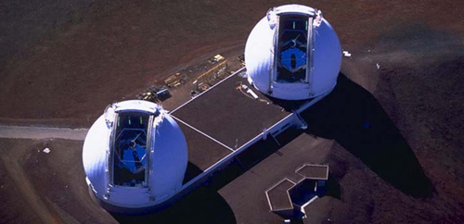
Background - using hosts - Z effects - host survey
Metallicity - cutoff? - local Z? - energetics?
New Questions
LGRB Host Survey
selected from GCN archives and GHostS
Nearby (z < 1)
Confirmed LGRBs (> 2 s duration)
S/N = 20 for weak lines, continuum detection
obtained spectra using LRIS and NIRSPEC at Keck, LDSS3 at Magellan; rest-frame 3000Å - 7000Å (near-IR for z > 0.5 Hα, [NII] features)
LRIS
NIRSPEC

Slide 10
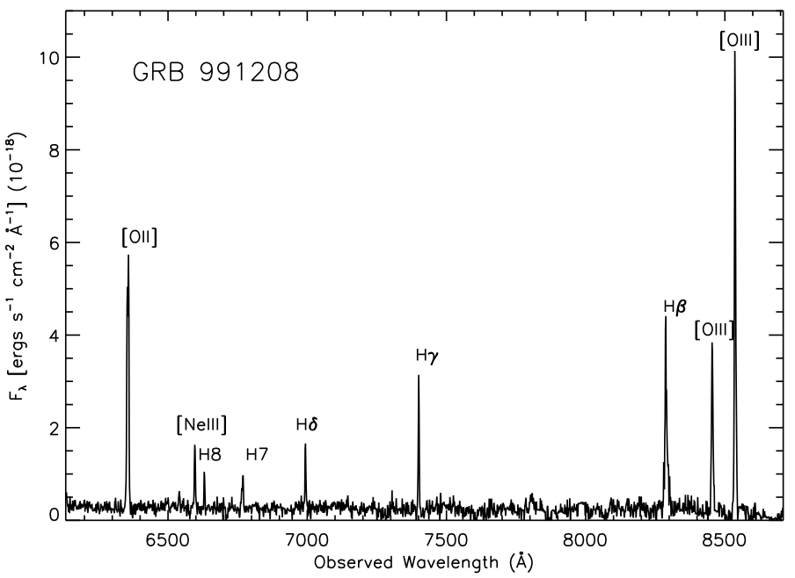
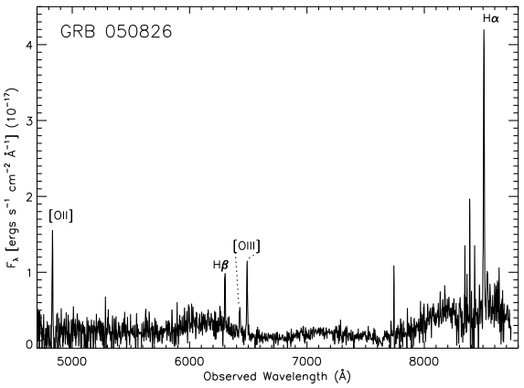
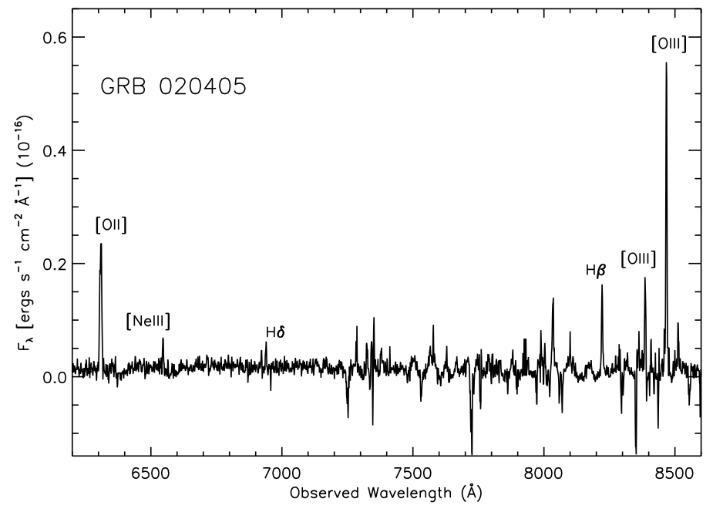
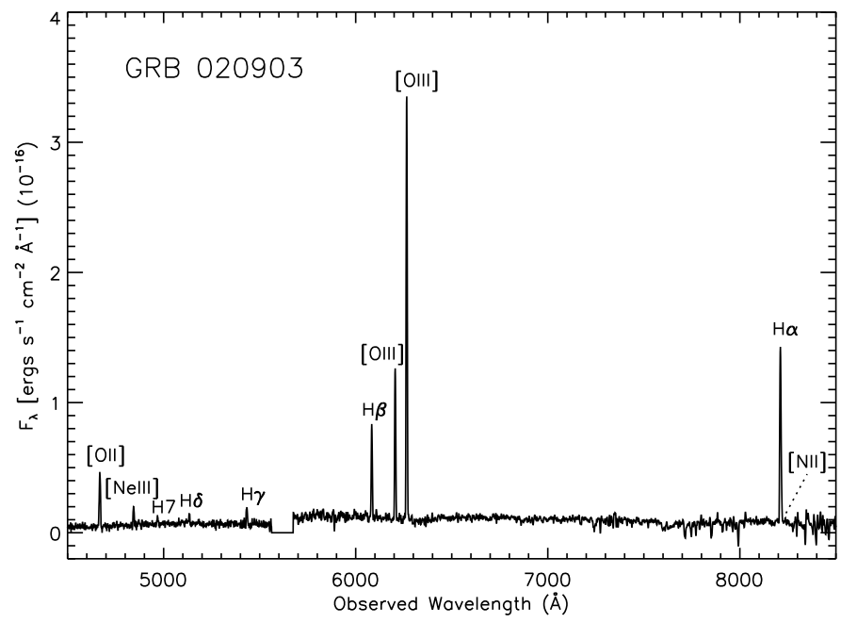
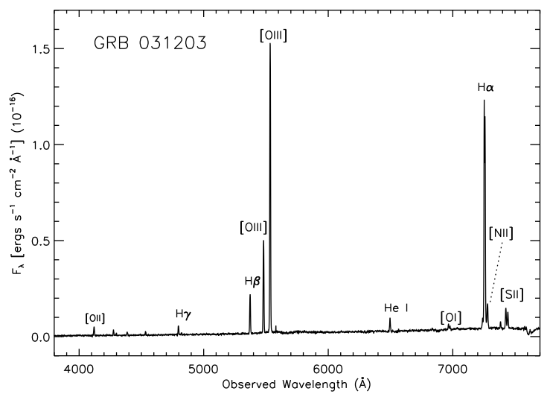
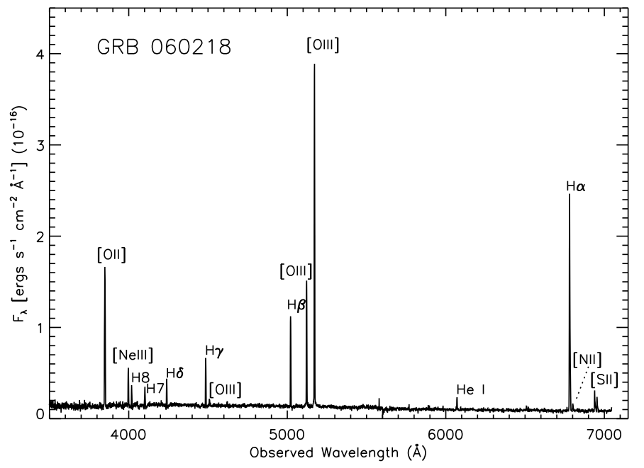
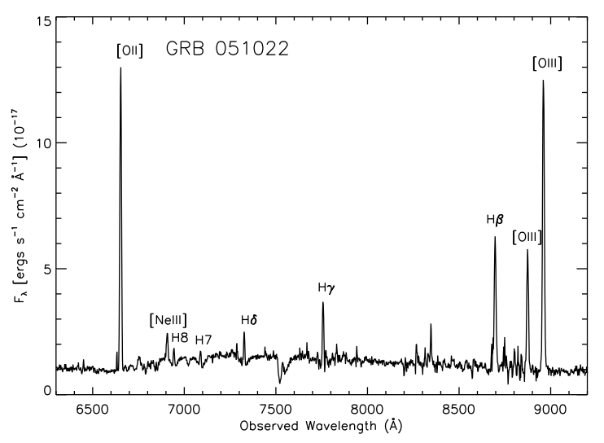
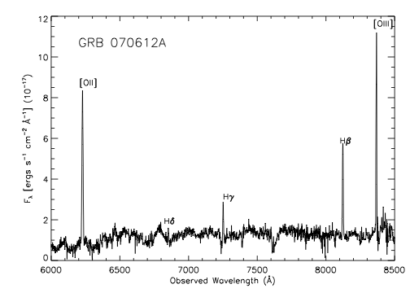
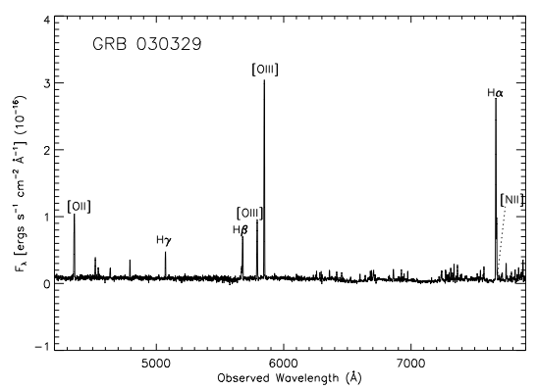
Background - using hosts - Z effects - host survey
Metallicity - cutoff? - local Z? - energetics?
New Questions
LGRB Host Survey
GRB 991208
LRIS
GRB 050826
LDSS
GRB 020405
LDSS
GRB 020903
LRIS
GRB 031203
LRIS
GRB 060218
LRIS
16 z < 1 LGRB host galaxies
12 hosts in survey, 4 with high-quality literature data
6 nearby (z < 0.3) hosts; 10 intermediate (0.3 < z < 1) hosts
LRIS
GRB 070612A
LRIS
GRB 030329
LRIS
GRB 051022
Levesque et al. 2010a,b

Slide 11
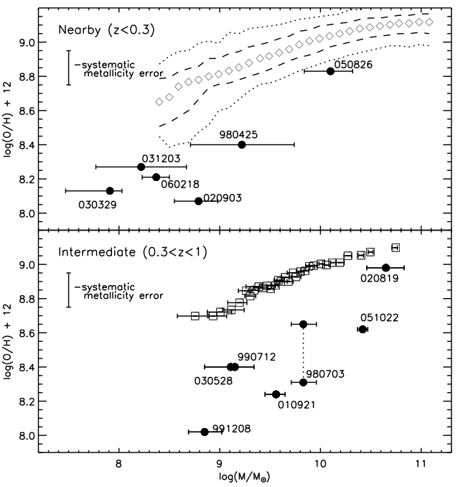
Background - using hosts - Z effects - host survey
Metallicity - cutoff? - local Z? - energetics?
New Questions
Maximum host Z?
-- SDSS
The simplest collapsar model predicts a cutoff metallicity.
Instead the hosts: - show no cutoff - follow their own robust M-Z relation
Tremonti et al. (2004)
-- DEEP2
Zahid et al. (2010)
r = 0.80, p = 0.001
Levesque et al. 2010b

Slide 12
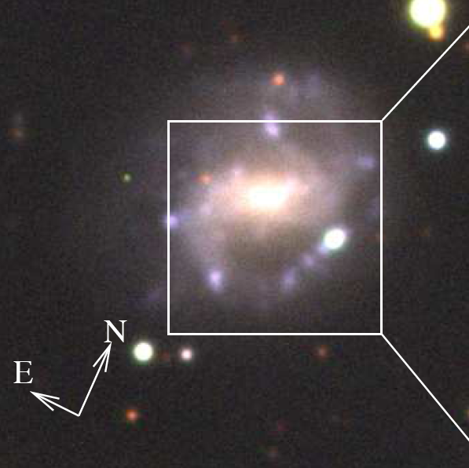
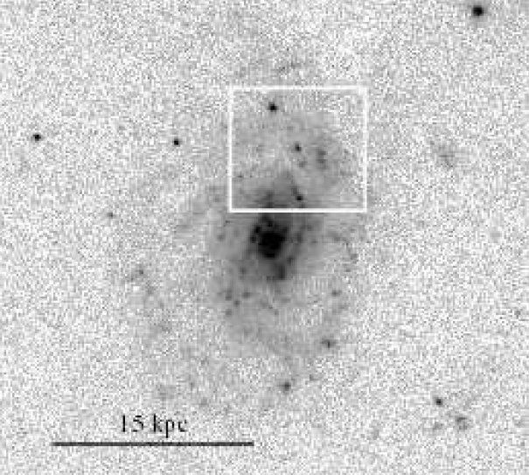
Background - using hosts - Z effects - host survey
Metallicity - cutoff? - local Z? - energetics?
New Questions
- are these “global” metallicities accurate estimates?
- how does the explosion site environment compare to the galaxy as a whole?
Maximum host Z? Low local Z?
GRB 060505
Christensen et al. 2008
Thone et al. 2008

Slide 13
Background - using hosts - Z effects - host survey
Metallicity - cutoff? - local Z? - energetics?
New Questions
Maximum host Z? Low local Z?
-- SDSS
Tremonti et al. (2004)
-- DEEP2
Zahid et al. (2010)
r = 0.80, p = 0.001
Levesque et al. 2010b

Slide 14
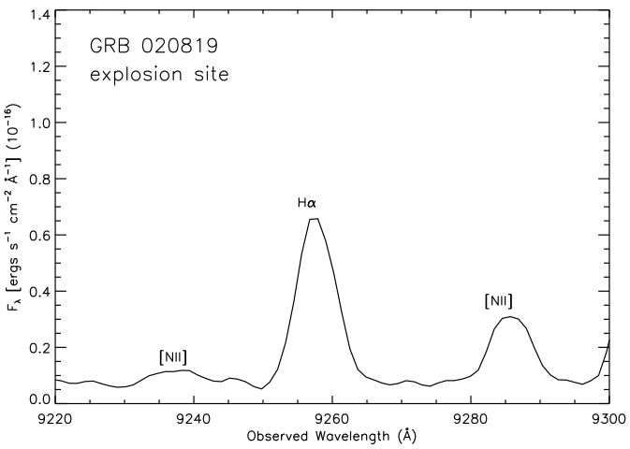
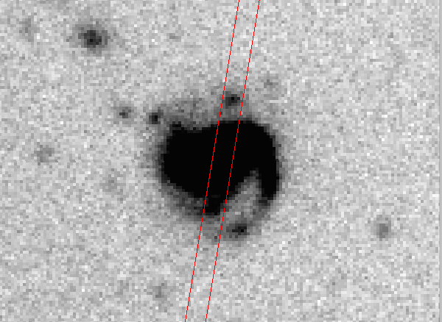
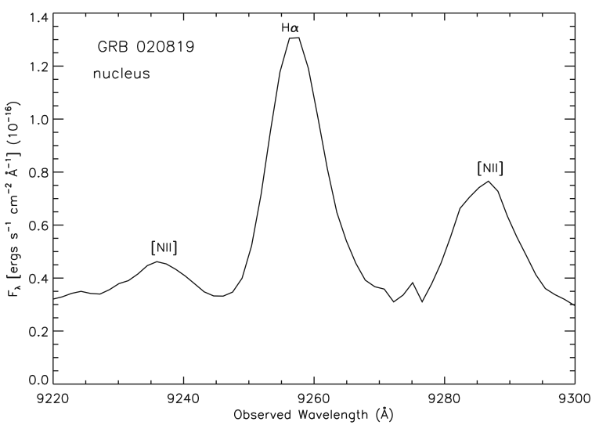
Background - using hosts - Z effects - host survey
Metallicity - cutoff? - local Z? - energetics?
New Questions
Maximum host Z? Low local Z?
Observed GRB 020819 host galaxy nucleus AND explosion site:
log(O/H)+12=9.0±0.1
GRB 020819 host
log(O/H)+12=9.0±0.1
Levesque et al. 2010c

Slide 15
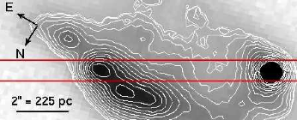
Background - using hosts - Z effects - host survey
Metallicity - cutoff? - local Z? - energetics?
New Questions
Maximum host Z? Low local Z?
GRB 100316D: very nearby (z = 0.06) GRB/SN
Two longslit spectra across the host complex, centered on the explosion site
GRB 100316D - “site”
Levesque et al. 2011

Slide 16
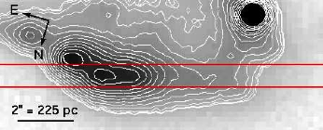
Background - using hosts - Z effects - host survey
Metallicity - cutoff? - local Z? - energetics?
New Questions
Maximum host Z? Low local Z?
GRB 100316D: very nearby (z = 0.06) GRB/SN
Two longslit spectra across the host complex, centered on the explosion site and the extended host emission.
GRB 100316D - “host”
Levesque et al. 2011

Slide 17
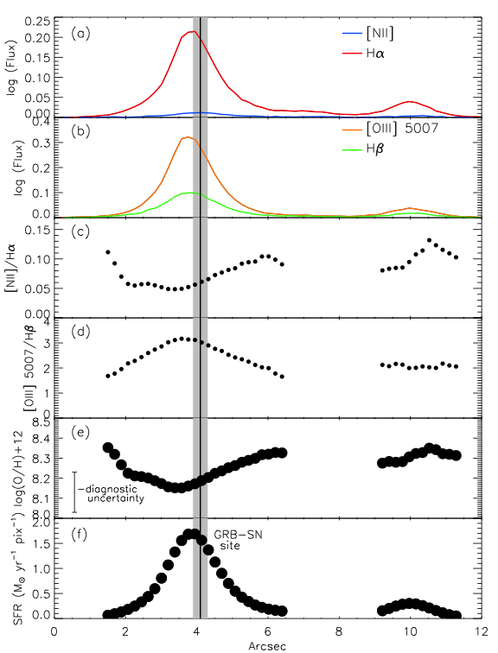
Background - using hosts - Z effects - host survey
Metallicity - cutoff? - local Z? - energetics?
New Questions
Maximum host Z? Low local Z?
“site”
- GRB occurred near Z minimum and SFR maximum
Levesque et al. 2011

Slide 18
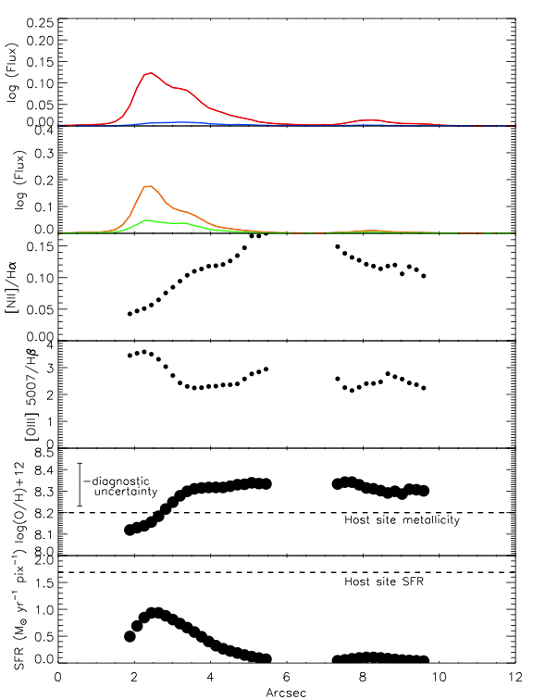
Background - using hosts - Z effects - host survey
Metallicity - cutoff? - local Z? - energetics?
New Questions
Maximum host Z? Low local Z?
“host”
- GRB occurred near Z minimum and SFR maximum
- Z gradient across entire galaxy is very low
Levesque et al. 2011

Slide 19
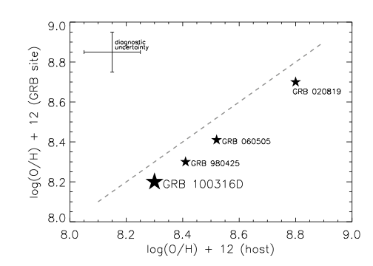
Background - using hosts - Z effects - host survey
Metallicity - cutoff? - local Z? - energetics?
New Questions
Maximum host Z? Low local Z?
Levesque et al. 2011
- From current sample, “host” and “site” metallicities are comparable, with “site” metallicities slightly lower
- What does this mean for larger host studies?

Slide 20
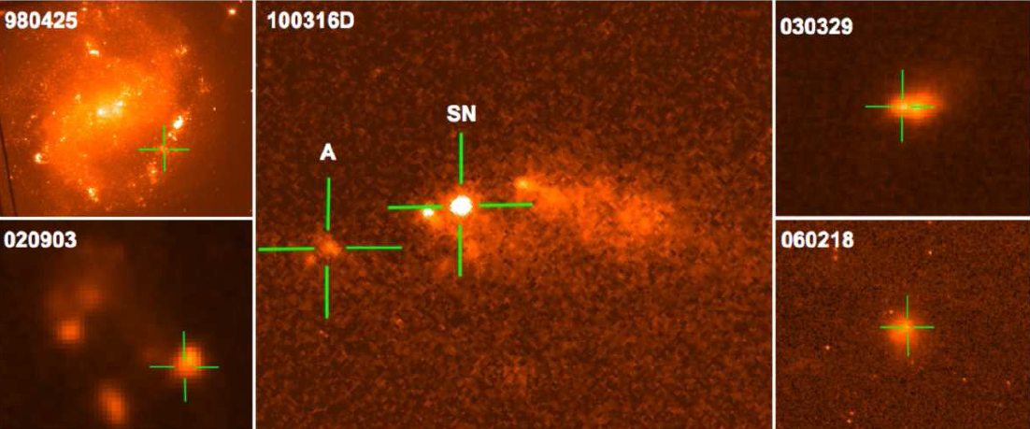
Background - using hosts - Z effects - host survey
Metallicity - cutoff? - local Z? - energetics?
New Questions
- More studies of LGRB and GRB/SN explosions sites are required
- The nearby sample offers an excellent unexplored opportunity for study…
Maximum host Z? Low local Z?
✓
✓
Starling et al. 2011

Slide 21
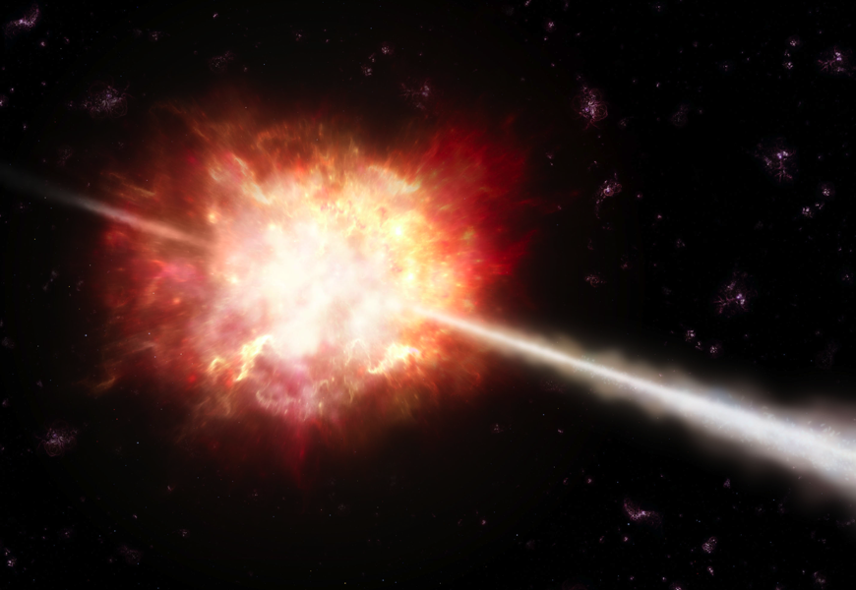
Background - using hosts - Z effects - host survey
Metallicity - cutoff? - local Z? - energetics?
New Questions
Maximum host Z? Low local Z? Effect on energetics?
We should also consider the energetic properties of LGRBs.
E_{γ,iso} = assumes a quasi-spherical burst θ_{j} = opening angle of the GRB jet E_{γ} = E_{γ,iso} × (1-cos(θ_{j}))

Slide 22
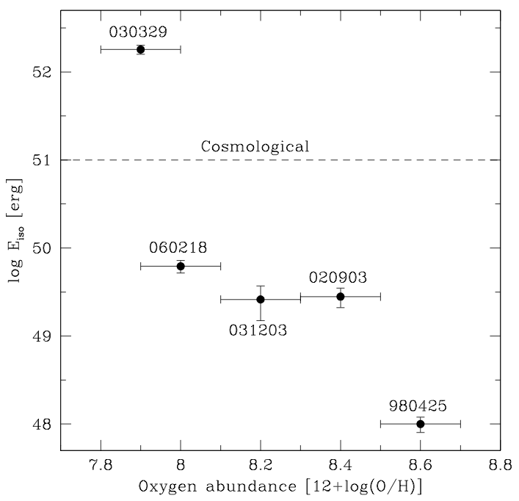
Background - using hosts - Z effects - host survey
Metallicity - cutoff? - local Z? - energetics?
New Questions
Maximum host Z? Low local Z? Effect on energetics?
Stanek et al. 2006
We should also consider the energetic properties of LGRBs.
From anticipated metallicity effects on massive stars, LGRBs at higher metallicity SHOULD have lower E_{γ,iso} and/or E_{γ}

Slide 23
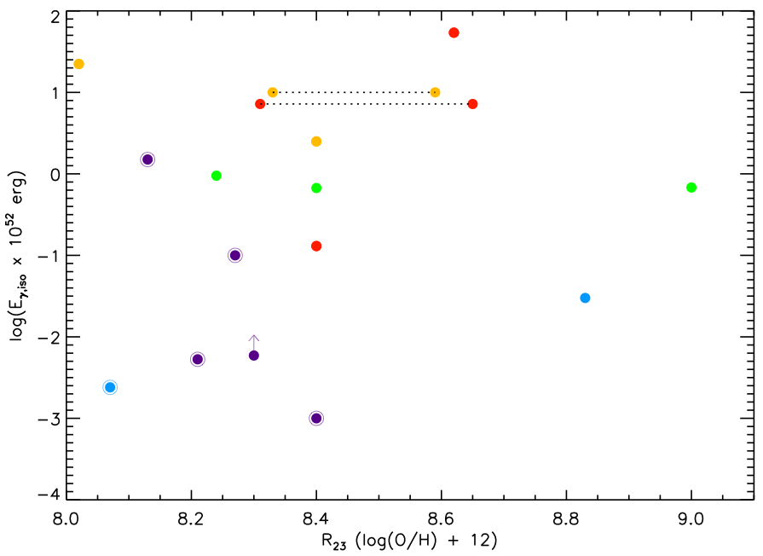
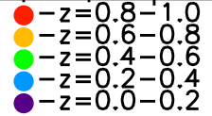
Background - using hosts - Z effects - host survey
Metallicity - cutoff? - local Z? - energetics?
New Questions
Maximum host Z? Low local Z? Effect on energetics?
We should also consider the energetic properties of LGRBs.
r = 0.08/0.10
p = 0.78/0.72
metallicity error
Levesque et al. 2010d
However, we find no statistically significant correlation between host galaxy metallicity and E_{γ,iso}

Slide 24
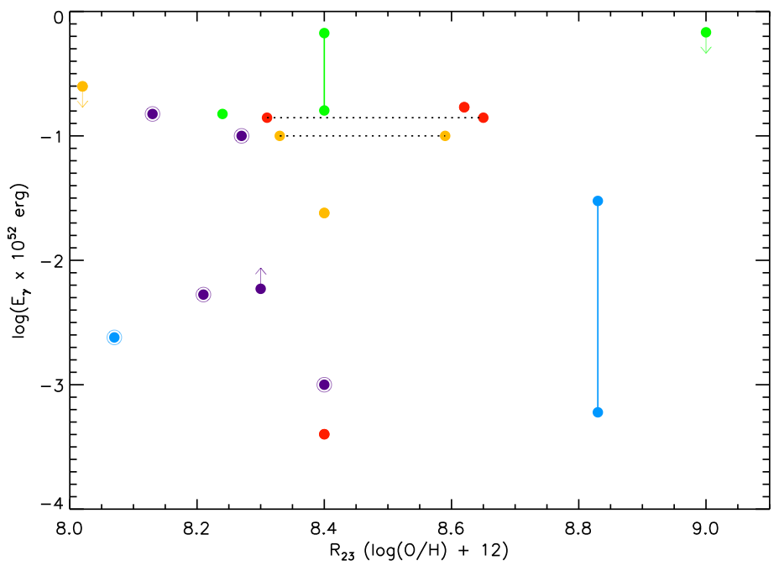
Background - using hosts - Z effects - host survey
Metallicity - cutoff? - local Z? - energetics?
New Questions
Maximum host Z? Low local Z? Effect on energetics?
We should also consider the energetic properties of LGRBs.
r = 0.16/0.32
p = 0.64/0.34
metallicity error
Levesque et al. 2010d
However, we find no statistically significant correlation between host galaxy metallicity and E_{γ,iso}, or E_{γ}.

Slide 25
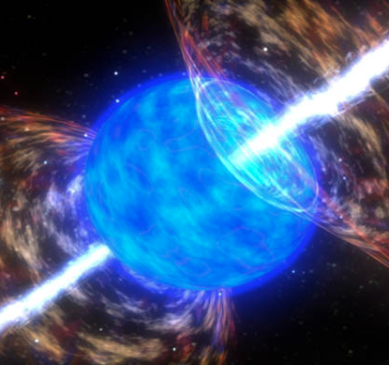
Background - using hosts - Z effects - host survey
Metallicity - cutoff? - local Z? - energetics?
New Questions
Maximum host Z? Low local Z? Effect on energetics? So what DOES metallicity do?...
?
other progenitor scenarios?
other energetic signatures?
other models of stellar evolution and rotation?

Slide 26
Background - using hosts - Z effects - host survey
Metallicity - cutoff? - local Z? - energetics?
New Questions
Some new metallicity questions…
Treatments of stellar rotation
Solid-body: most common model assumption BUT: limits GRB occurrence to low-metallicity environments
Differential: more modern stellar models BUT: also depends on internal magnetic field; amount of coupling between core and envelope strongly affects GRB production and metallicity dependence!
Detailed stellar rotation models are KEY to understanding how metallicity is (literally) connected to GRB production.

Slide 27
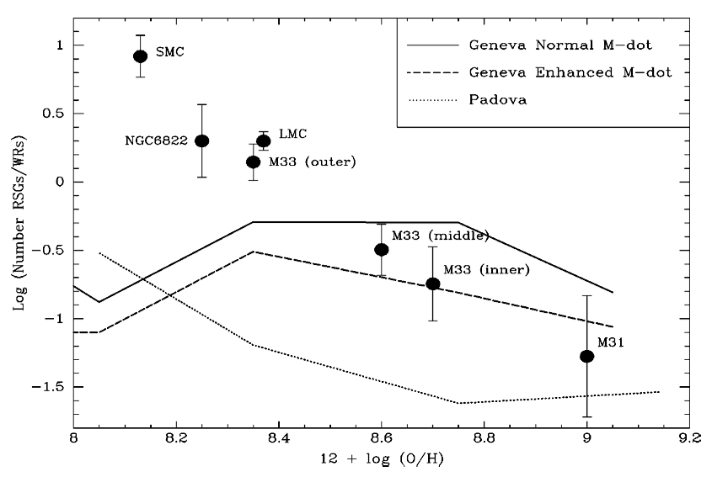
Background - using hosts - Z effects - host survey
Metallicity - cutoff? - local Z? - energetics?
New Questions
Some new metallicity questions…
LGRBs occur in low metallicity environments
LGRBs originate from C or O Wolf-Rayet stars
Massey 2003

Slide 28
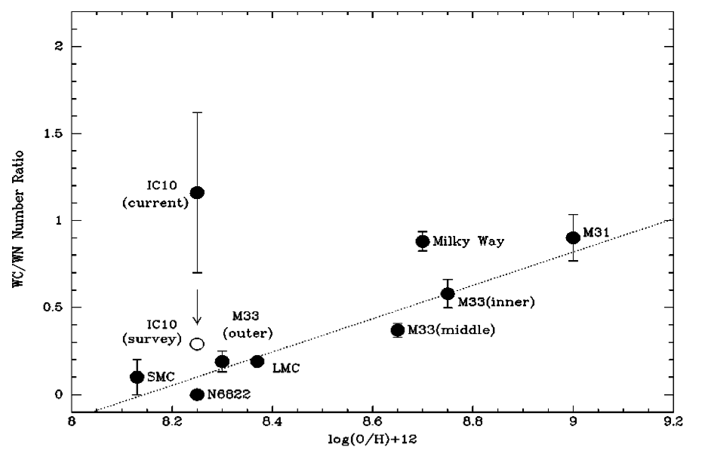
Background - using hosts - Z effects - host survey
Metallicity - cutoff? - local Z? - energetics?
New Questions
Some new metallicity questions…
LGRBs occur in low metallicity environments
LGRBs originate from C or O Wolf-Rayet stars
Massey 2003

Slide 29

Background - using hosts - Z effects - host survey
Metallicity - cutoff? - local Z? - energetics?
New Questions
Some new metallicity solutions?
Contemplating binary scenarios…

Slide 30
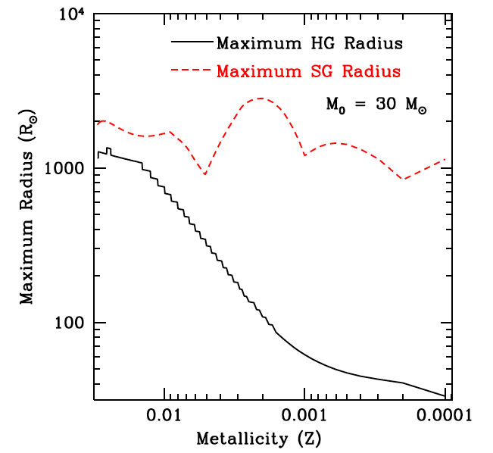
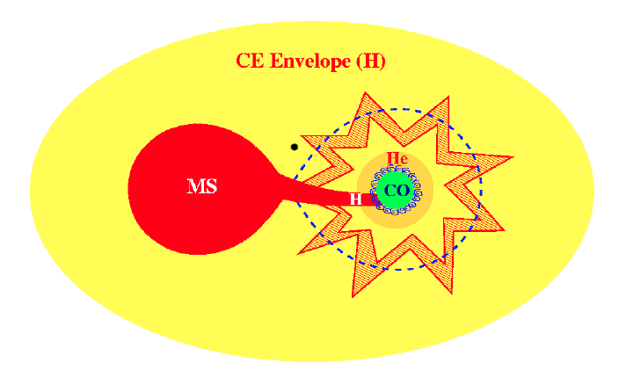
Background - using hosts - Z effects - host survey
Metallicity - cutoff? - local Z? - energetics?
New Questions
Some new metallicity solutions?
Contemplating binary scenarios…
terminal CE phase: higher rate at low Z due to stellar wind effects (Podsiadlowski et al. 2010)
interim CE phase/RLO: higher rate at low Z due to wider range of permissible Roche lobe radii (Linden et al. 2010)
Podsiadlowski et al. (2010)
Linden et al. (2010)

Slide 31
Background - using hosts - Z effects - host survey
Metallicity - cutoff? - local Z? - energetics?
New Questions
Conclusions
The modern LGRB progenitor model must:
1. Be more common at low metallicity
2. Still be possible to produce at high metallicity
3. Not directly connect metallicity and energetics
4. Correspond with statistics of LGRB production and evolved stellar populations
Notes:
So to conclude, from our studies of LGRB progenitor environments we now know that the modern LGRB progenitor model must…

