Slide 1
The soft X-ray landscape of GRBs: thermal components
Rhaana Starling
University of Leicester
Royal Society Dorothy Hodgkin Fellow
With special thanks to Martin Sparre (DARK/Leicester) and Kim Page (Leicester)

Slide 2
Outline
GRB X-ray spectra – the basic shape
The Swift XRT X-ray afterglow sample
Review of known thermal X-ray components
GRB101219B: a new example
Complicating factors, and limits on the recovery of similar blackbody components

Slide 3
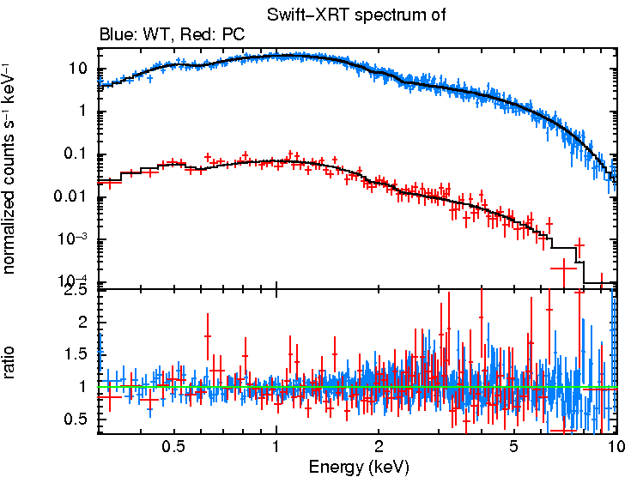
Typical X-ray spectrum
(Swift XRT, 2 count-rate-dependent operational modes)
curvy shape reflects instrumental response
GRB 100901

Slide 4
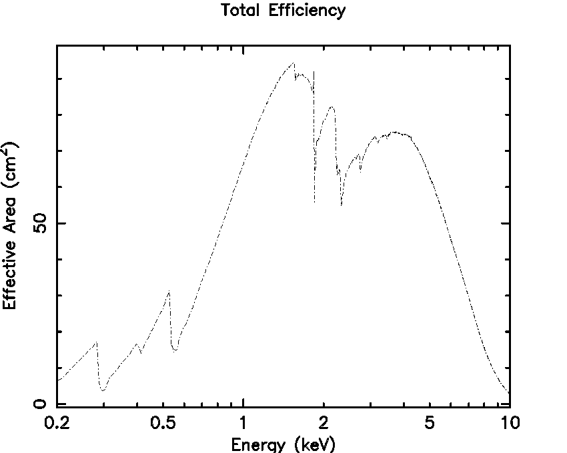
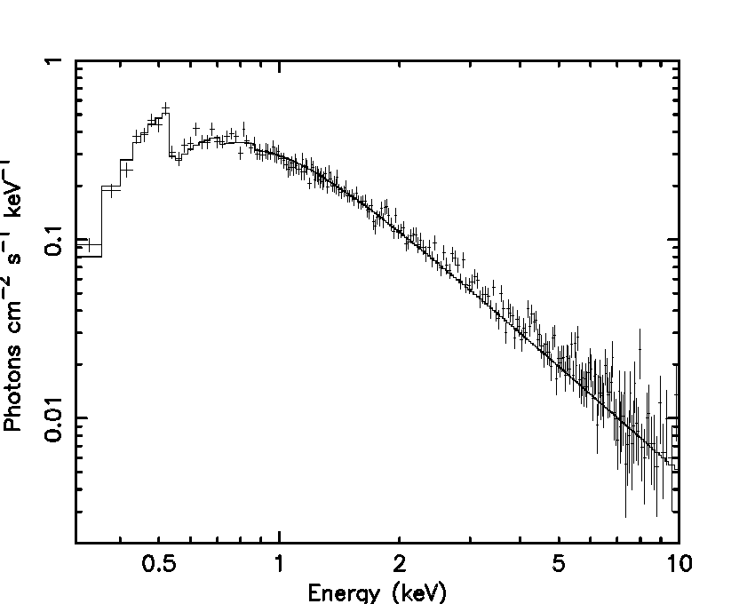
Instrumental response taken out →
power law continuum + absorption components

Slide 5
www.swift.ac.uk/xrt_live_cat/
Evans et al. 2009

Slide 6
Additional components in soft X-rays
060218 landmark discovery of thermal X-ray emission in a (albeit unusual) GRB (Campana et al. 2006)
Similar case of 100316D also evidence for early thermal component (Starling et al. 2010; Olivares et al. 2011)
“One is an oddity, two is a class!”

Slide 7
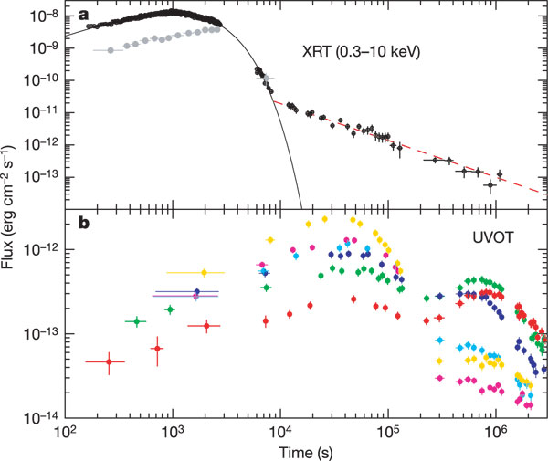
Thermal X-ray components
GRB 060218 / SN2006aj: thermal X-ray component highly significant. Propagates into UV.
Unusual GRB:
long duration, low energy spectral peak, low-z
Campana et al. 2006
UV: shock breakout
Optical: radioactive heating in SN ejecta

Slide 8
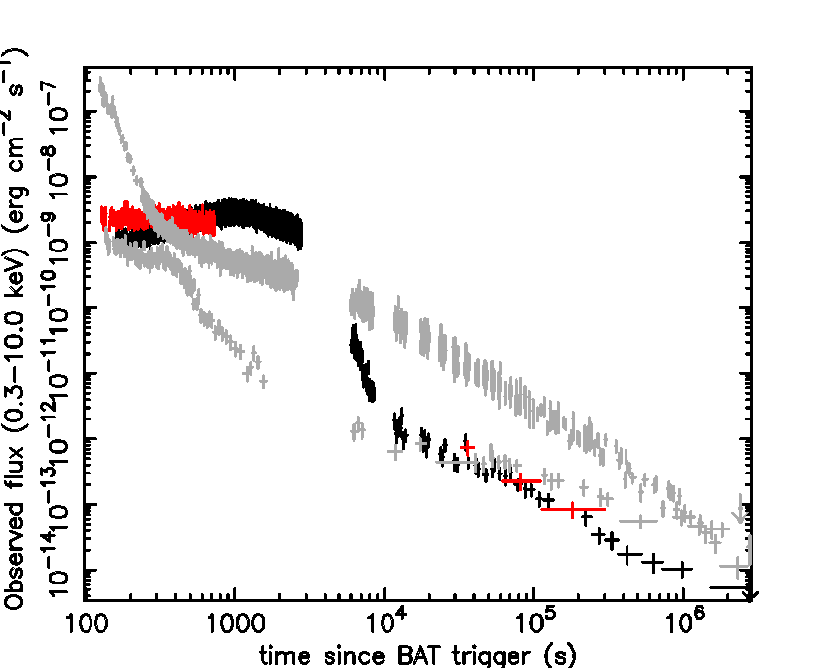
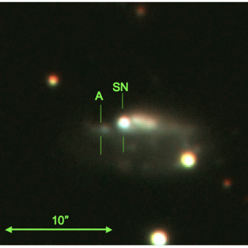
Along came similar looking GRB 100316D / 2010bh
Gemini-S/GMOS
(Starling et al. 2011)
060218
100316D
But reside in different host types
(Modjaz et al. 2006; Wiersema et al. 2007; Starling et al. 2011)

Slide 9
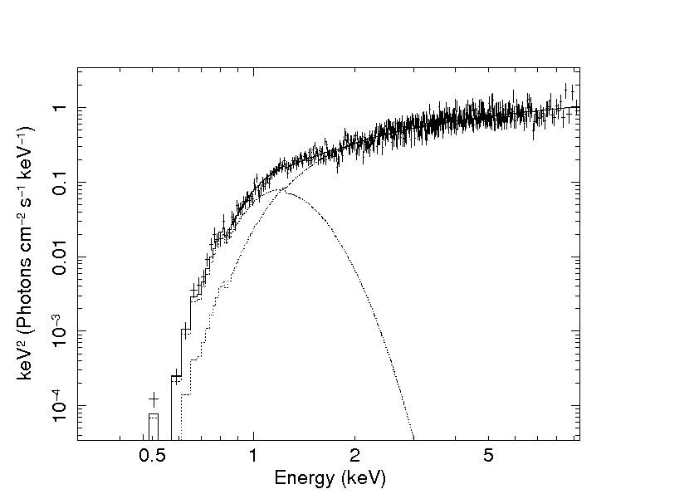
Blackbody contributes ~30% of source X-ray flux, with kT = 0.14 keV and L ~ 3 x 10⁴⁶ erg s⁻¹

Slide 10
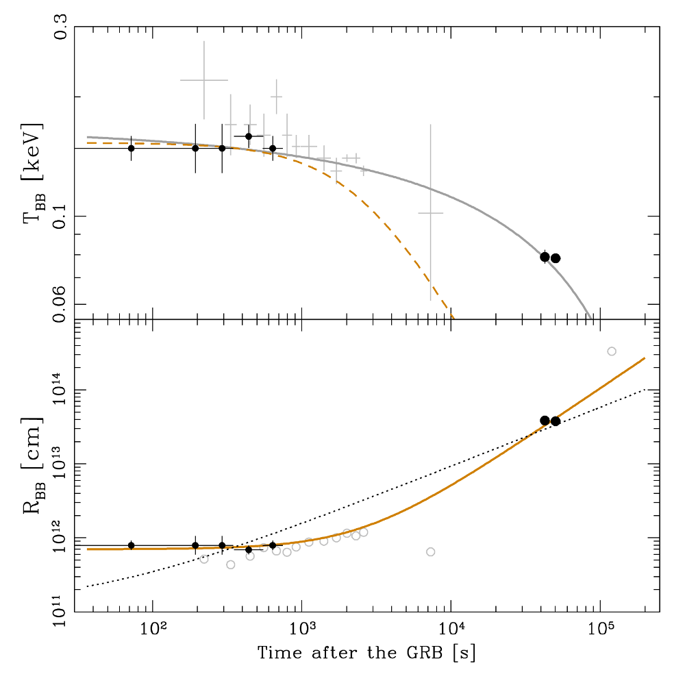
Olivares et al. 2012 show cooling into optical with GROND
X-ray data adapted from
Kaneko et al. 2007+Starling et al. 2011

Slide 11
Additional components in soft X-rays
What is thermal component - many papers
Signature of SN shock breakout?
Related to central engine/accretion process?
Or emission from a cocoon?
If SN-related, provides earliest observable SN signature

Slide 12
060218 + 100316D: nearby, underluminous, long-duration GRBs (XRFs) with spectroscopic SNe.
separate GRB class or extension of the typical long GRB population?

Slide 13
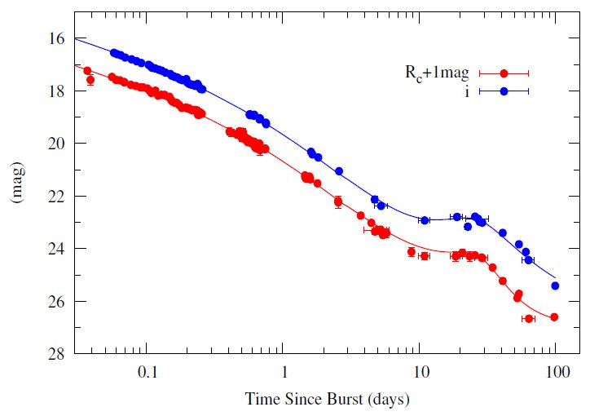
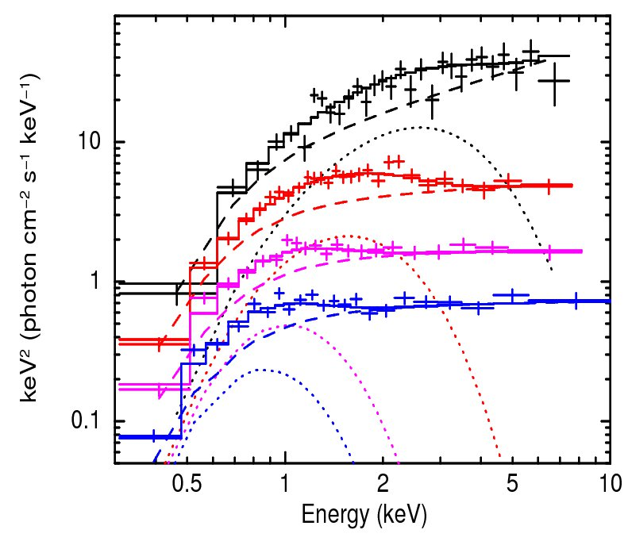
GRB 090618 ‘typical’ GRB in all respects
+optical SN and displaying strong curvature → thermal X-ray emission at early times
Page et al. 2011
Cano et al. 2010
z=0.54, E_{iso}=3x10⁵³ erg T_{BB}=0.9→0.3 keV
L_{BB}=10⁴⁹ erg/s

Slide 14
Additional X-ray components – when?
Systematic search reveals more candidates – introducing GRB 101219B / SN2010ma
z=0.5519
N_{H}~10²¹ cm⁻²
BB lumin = 1x10⁴⁷ erg s⁻¹ T_{BB} = 0.2 keV
BB Flux = 11% of total observed, unabsorbed flux 0.3-10 keV
Less prominent than previous examples, similar BB parameters.
Spectroscopic SN detection: Sparre et al. 2011

Slide 15
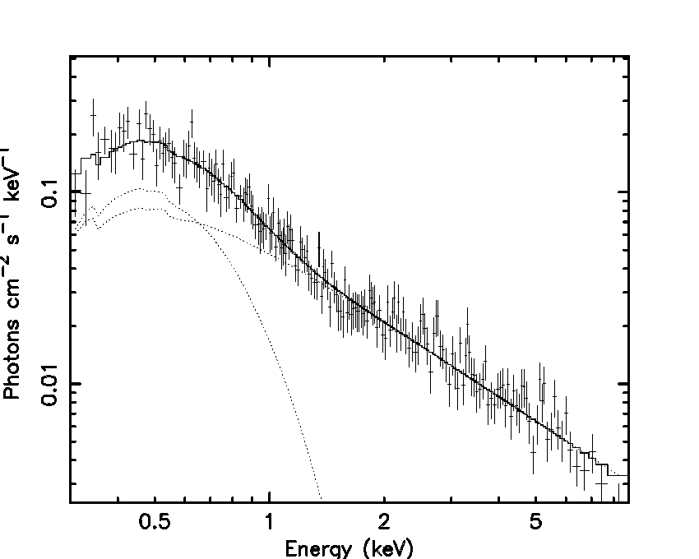

Slide 16
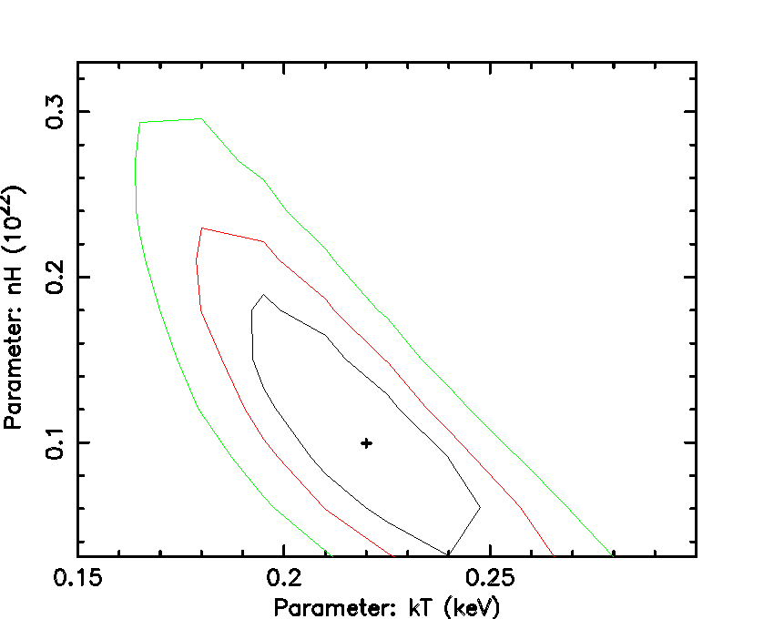

Slide 17
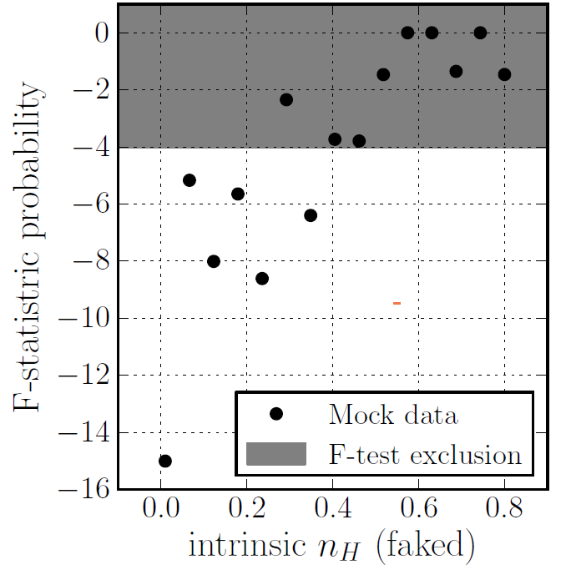
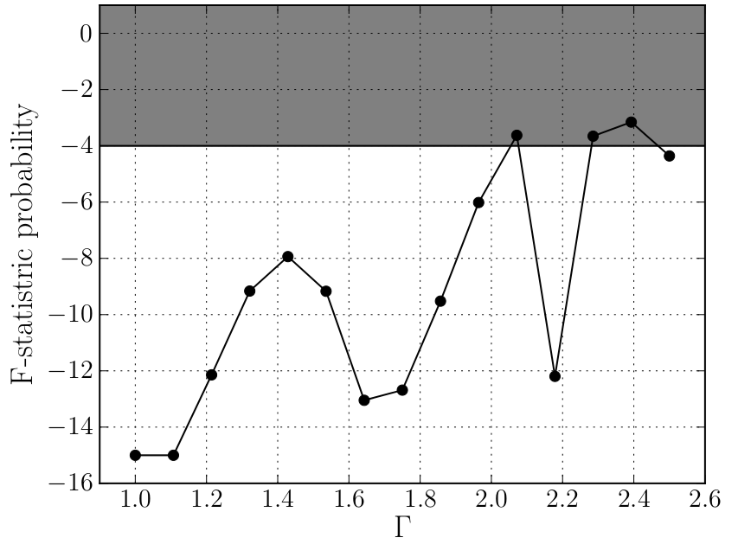
Thermal X-ray components – when?
Simulations show when we can expect to recover such a component (Sparre et al. in prep)
N_{H}<4x10²¹
All Γ

Slide 18
Complications
Modelling an early GRB X-ray spectrum requires
N_{H} correct
E_{pk} tracking

Slide 19
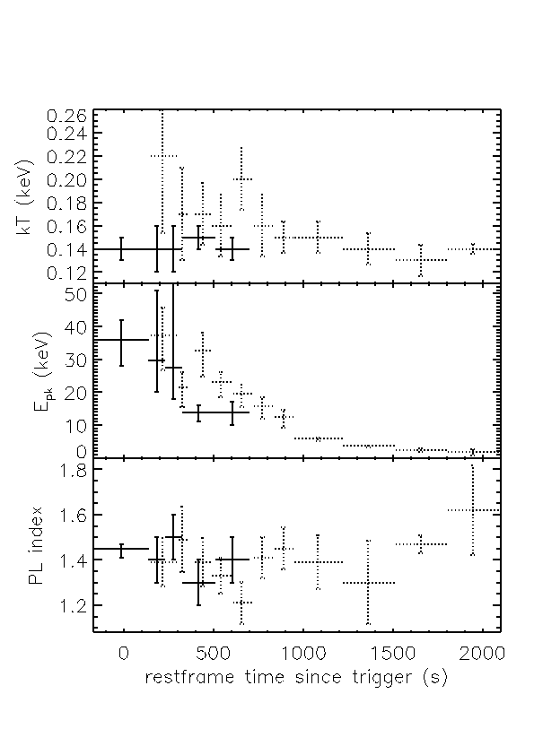
BAT-XRT joint fits allow us to locate spectral peak energy and track its movement out to 760 s in 100316D 2000s in 060218
160s in 090618
Blackbody temperature
Non thermal spectral peak energy
Power law index
GRB 100316D
GRB 060218 Kaneko et al. 2007

Slide 20
Potential complexities
Modelling an early GRB X-ray spectrum requires
N_{H} correct
E_{pk} tracking
flare removal
prompt/afterglow continuum

Slide 21
(very) approximate comparison of the known thermal X-ray components
GRB-SN z E_{pk} E_{iso} T₉₀ kT F_{BB}/F_{tot} L_{BB} R_{BB}
keV erg s keV % erg/s cm
060218 0.033 40→3 4x10⁴⁹ 2100 0.22→0.14 50+ 10⁴⁵ 5x10¹¹
100316D 0.059 40→14 >4x10⁴⁹ >1300 0.14 30 10⁴⁶ 8x10¹¹
090618 0.54 13 2.5x10⁵³ 113 0.9→0.3 20 10⁴⁹ 6x10¹²
101219B 0.55 70 4x10⁵¹ 51 0.2 11 10⁴⁷
+ ???

