Slide 1
LOCATions of WR stars, SNE IB/c and GRBs
Giorgos Leloudas
Oskar Klein Centre, Stockholm University

Slide 2
Stripped SNE: the questions
No progenitor detection
Should be WR stars
How is the H envelope lost?
Strong winds
Binary interactions
What gives a GRB?

Slide 3
Stripped SNe: the diagnostics
Single progenitors: the envelope is stripped by stellar winds.
Wind strength depends on metallicity (Vink & De Koter 2005)
Prediction: in the single progenitor scenario, SNe Ic expected to occur in more metal- rich environments than SNe Ib
Massive stars are like Rock N’ Roll stars: live fast and die young!
Proximity to recent star formation.
On metallicity: Prantzos & Boissier 2003, Sollerman+ 2005, Prieto+ 2008, Modjaz+ 2008, Anderson 2009, Boissier & Prantzos 2009
On proximity to SF: Anderson+ 2008, Kelly+ 2011

Slide 4
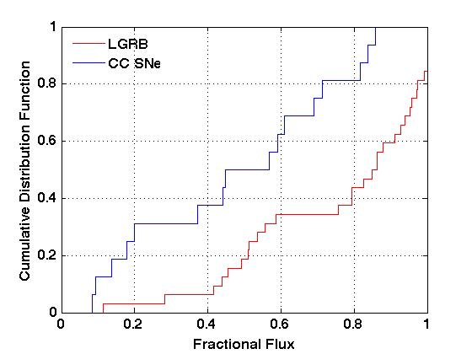
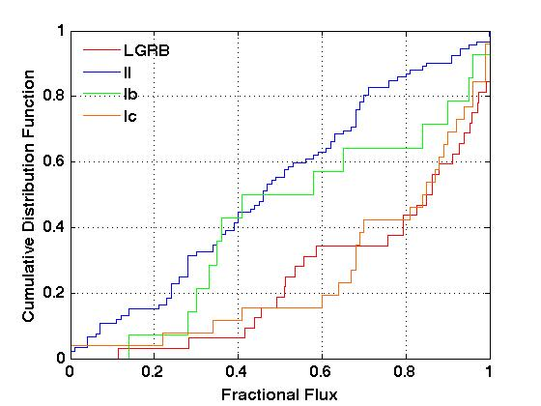
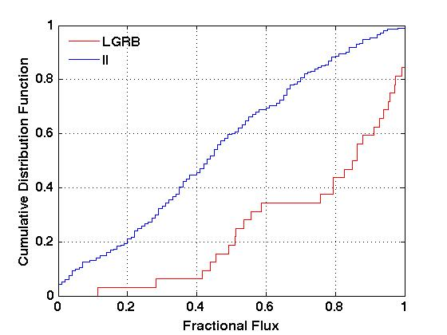
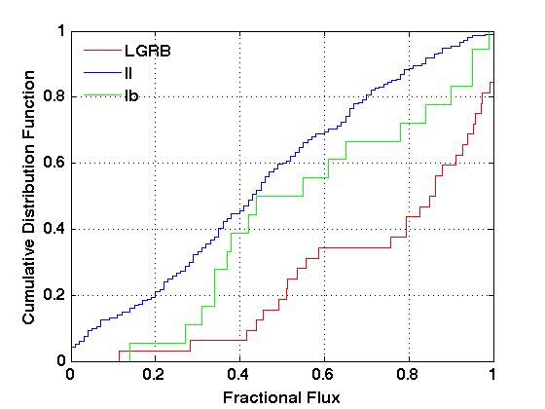
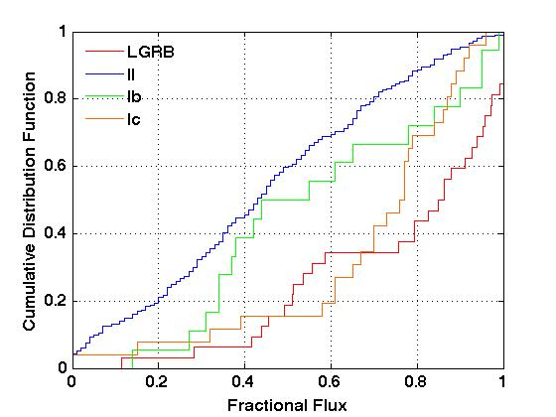
Location with respect to galaxy light
GRBs tend to occur in the brightest locations of their hosts (Fruchter+ 2006)
SNe Ic in brighter pixels than Ib, and Ib in brighter than II (Kelly+ 2008)
This statistic also used in theoretical studies with predictive power (Larsson+ 2007, Raskin+ 2008)
KS test p=0.3%
See also NCR (Anderson+ 2008)

Slide 5
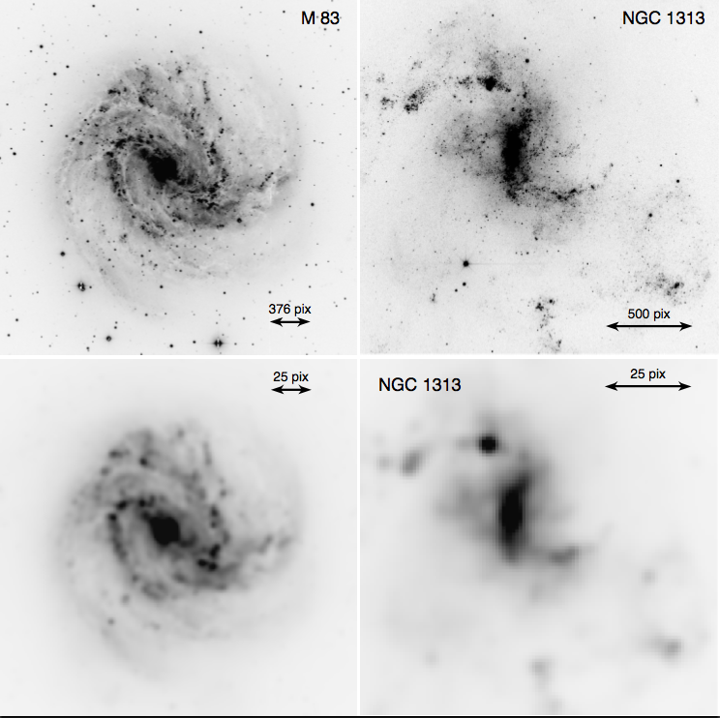
The next obvious step
If they have WR progenitors, their locations within their hosts should be similar
Theoretically:
WN → SN Ib
WC → SN Ic
Used work of Crowther & collaborators
See talk by Joanne Bibby.
Completeness (or robust estimate) is crucial
M 83 (Hadfield+ 2005)
NGC 1313 (Hadfield & Crowther 2007)
Removed foreground stars & resampled
Leloudas+ 2010

Slide 6
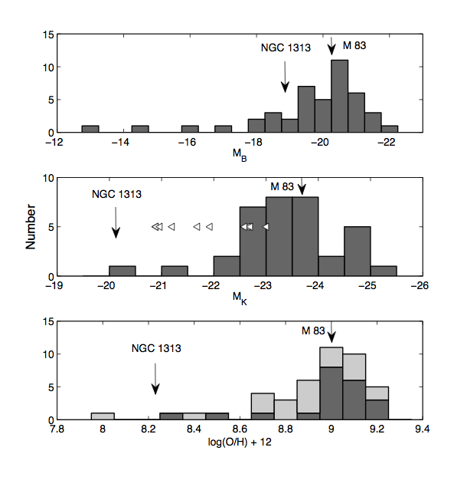
On the statistics
2 galaxies but > 1000 WR stars.
N_{SN}=44, N_{GRB}=32
Many galaxies w. 1 explosion vs. few galaxies w. many progenitors
Galaxies are not special, so results can be generalized.
Metallicity is important
Now data available for 2 more galaxies (Bibby+ 2010, 2012)

Slide 7
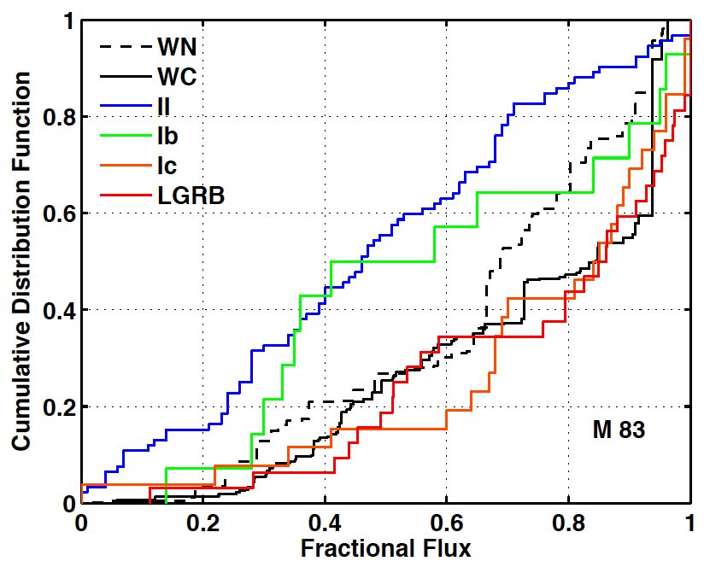
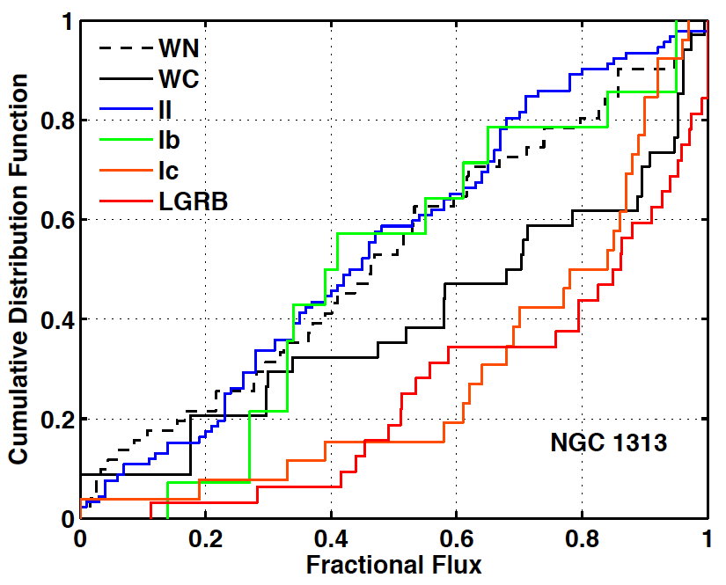
Results
WC in brighter locations than WN
Differences with metallicity exist
SNe II and WN stars compatible at low Z. Expected to some degree (e.g. Georgy+ 2009)

Slide 8
A poor man’s contour plot
Typical SN Ib/c host
M 83
NGC 1313
WR
WR
WN
WN
WC
WC
LGRB Ic Ib CC II Ia
LGRB Ic Ib CC II Ia
Increasing mass
Increasing mass
P < 0.3% EXCLUDED!
3σ
P < 4.6%
The right direction!
2σ
Can not
exclude
P < 31.7%
1σ
P > 31.7%

Slide 9
ConClusions
WR viable progenitors of SNe Ib/c and GRBs
The opposite would have been an upset!
WC distribution at brighter locations than WN
WC probabilistically more associated with SNe Ic and WN with SNe Ib
SNe II compatible with WR (esp. WN) at low Z
Monte Carlo simulations for:
Candidate stars (completeness)
Errors in star numbers
Foreground star removal effect
WN to WC transition

Slide 10
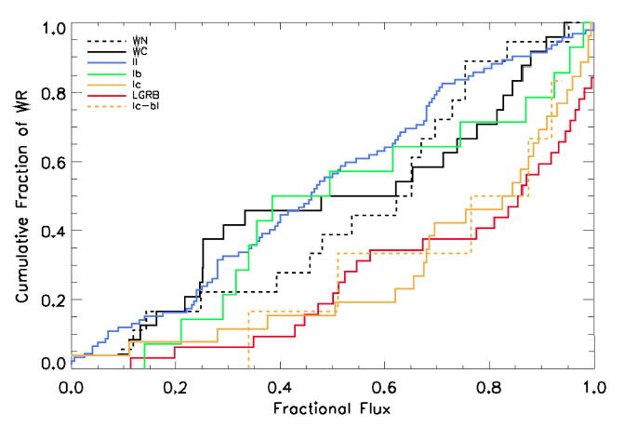
AN INCREASING SAMPLE
NGC 7793
NGC 5068
Credit: Joanne Bibby (not published)
Bibby & Crowther (2012)
WC at brighter locations than WN ?
WN compatible with SNe II (except Ib) ?
✓ ✗
✓ ✓
Remember: Steep metallicity gradient. MC simulations pending.

Slide 11
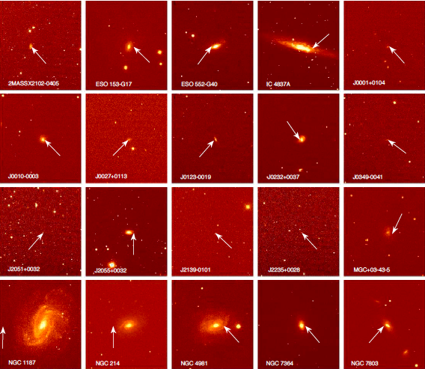
SPECTROSCOPY of normal SN Ib/c BIRTHPLACES
NTT + EFOSC2
20 host galaxies of normal SNe Ib/c
Some re-classified !
Selected to have good SN data
Both ‘bright’ CSP and SDSS galaxies
Targeted and non-targeted surveys
Slit through exact site and galaxy nucleus
Leloudas+ 2011

Slide 12
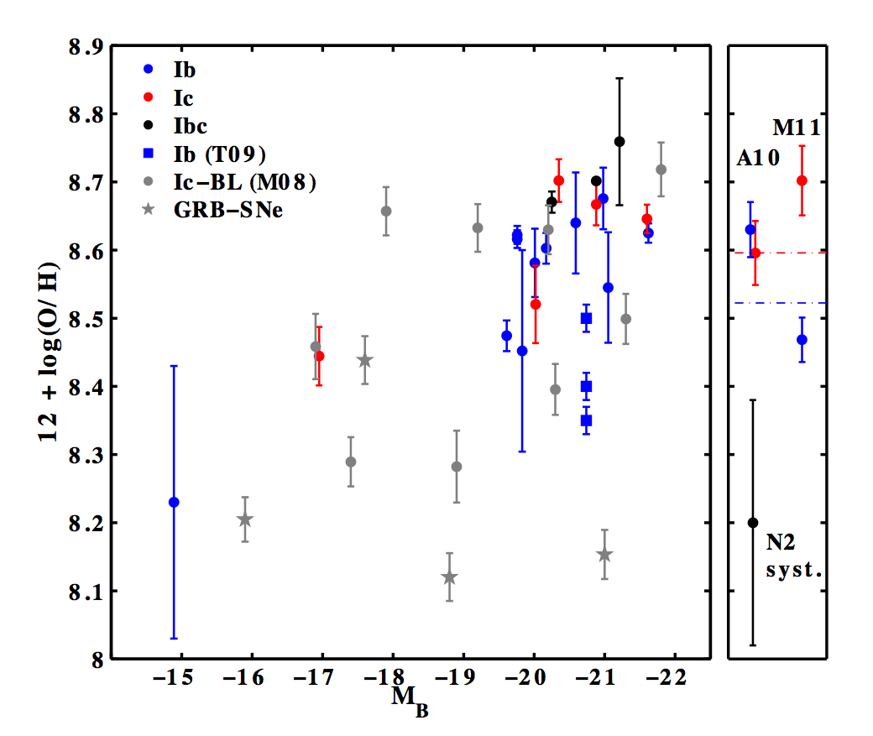
metallicities
Average metallicities:
SN Ib : 8.52 ± 0.05
SN Ic : 8.60 ± 0.08
Ours is one of 3 published direct studies
Anderson+ 2010 find Z_{Ib} ~ Z_{Ic} (27 hosts)
Modjaz+ 2011 report difference of 0.2 dex, p = 1% (35 hosts)
Biases play a role:
Targeted: 8.67±0.06 (σ=0.06); Non-targeted: 8.55 ±0.06 (σ=0.19); (see also Arcavi+ 2010)
KS p=17%
Stellar continuum removed by fitting BC03 models
My conclusion: differences appear too small and systematics are too big for method to be conclusive on binarity (fraction). Need very big sample, bias control and model expectation.

Slide 13
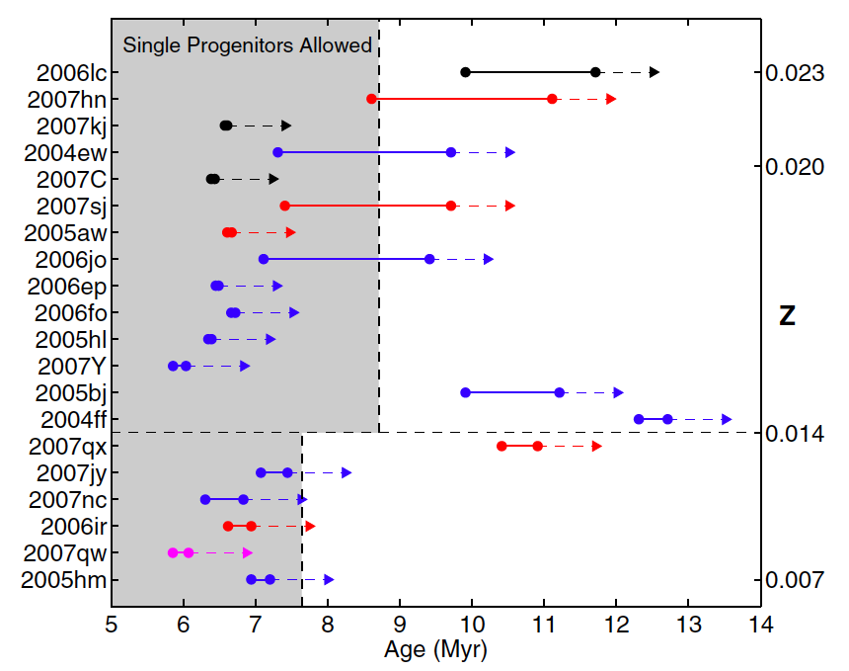
Stellar lifetimes comparison
Take youngest stellar population by Hα EW as lower age limit of SN region.
Starburst99 and assumption of instantaneous SF episode.
Compare to lifetimes of single stars: upper limits.
Geneva models (Meynet & Maeder 2003, 2005, Georgy+ 2009)
These are conservative limits
20-35% of regions examined too old to give SNe Ib/c from single progenitors.
But conclusion limited by assumption

Slide 14
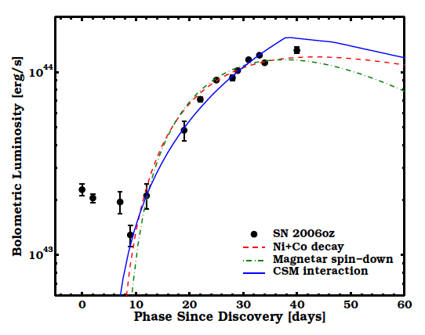
SN 2006oz: a superluminous event
H-poor (Quimby+ 2011)
Early observations from SDSS
Leloudas+ 2012

Slide 15
The End
Thank you!

