Slide 1
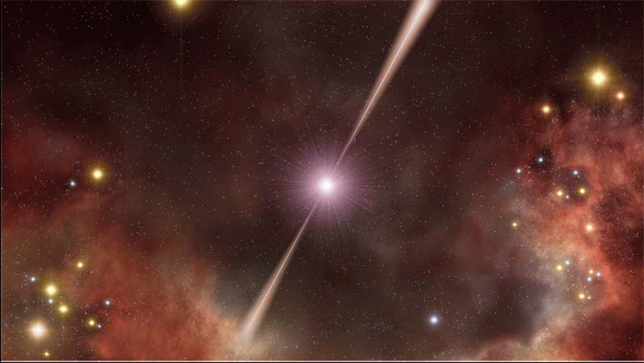
Dust and Metal Column Densities
in GRB Host Galaxies
Patricia Schady (MPE)
T.Dwelly, M.J.Page, J.Greiner,
T.Krühler, S.Savaglio, S.R.Oates, A.Rau, M.Still
+ GROND and UVOT team

Slide 2
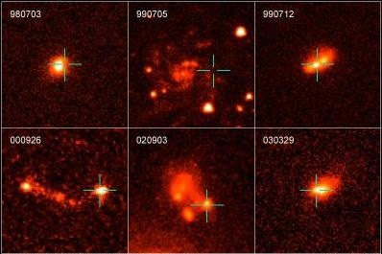
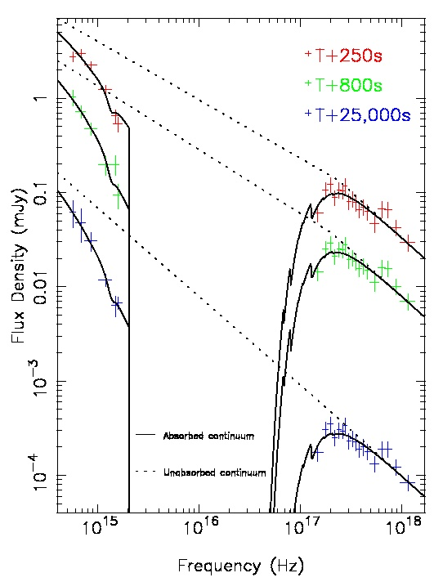
GRB hosts: probes to the distant Universe
Probe young, star forming galaxies
Highly luminous synchrotron featureless spectra
Dust extinction
Metals
absorption
Fruchter+06
< z >=2.2; Fynbo+09
GRB 090429B (z=9.4)
Number of GRBs
High-z
Blustin+06
Credit: Edo Berger
z

Slide 3
Notes:
VLT/UVOT

Slide 4
Notes:
VLT/UVOT

Slide 5
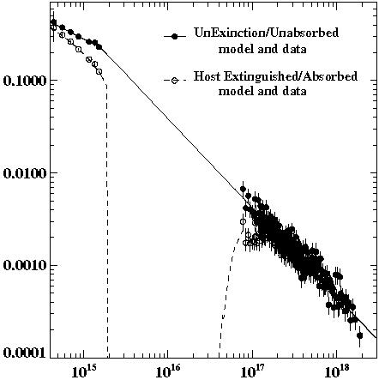
Optical vs. x-ray: the missing gas problem
(Watson et al., 2007)
Schady+10
Soft X-ray absorption gives measure of total oxygen column density, N_{O,X}
N_{O,X}
Lyα absorption gives measure of neutral hydrogen column density, N_{HI}
N_{HI}
Starling+07

Slide 6
Optical vs. x-ray: the missing gas problem
(Watson et al., 2007)
Schady+10
Optically bright
Optically dark
Soft X-ray absorption gives measure of total oxygen column density, N_{O,X}
N_{O,X}
N_{H,X}
QSO-DLAs
GRBs
Fynbo+09
Lyα absorption gives measure of neutral hydrogen column density, N_{HI}
N_{HI}
Starling+07
Fynbo+09

Slide 7
GRB Host: gas-rich
Watson+07
Typically
N_{H,X} >> N_{HI}
GRB host galaxies typically
supersolar environments
and/or
X-ray observations probe larger
column of gas than optical
N_{HI} (cm⁻²)
N_{H,X} (cm⁻²)

Slide 8
GRB Host: gas-rich
Watson+07
Typically
N_{H,X} >> N_{HI}
GRB host galaxies typically
supersolar environments
and/or
X-ray observations probe larger
column of gas than optical
Solar
N_{HI} (cm⁻²)
z
Savaglio+09
N_{H,X} (cm⁻²)

Slide 9
GRB Host: gas-rich
Watson+07
Typically
N_{H,X} >> N_{HI}
GRB host galaxies typically
supersolar environments
and/or
X-ray observations probe larger
column of gas than optical
N_{HI} (cm⁻²)
N_{H,X} (cm⁻²)

Slide 10
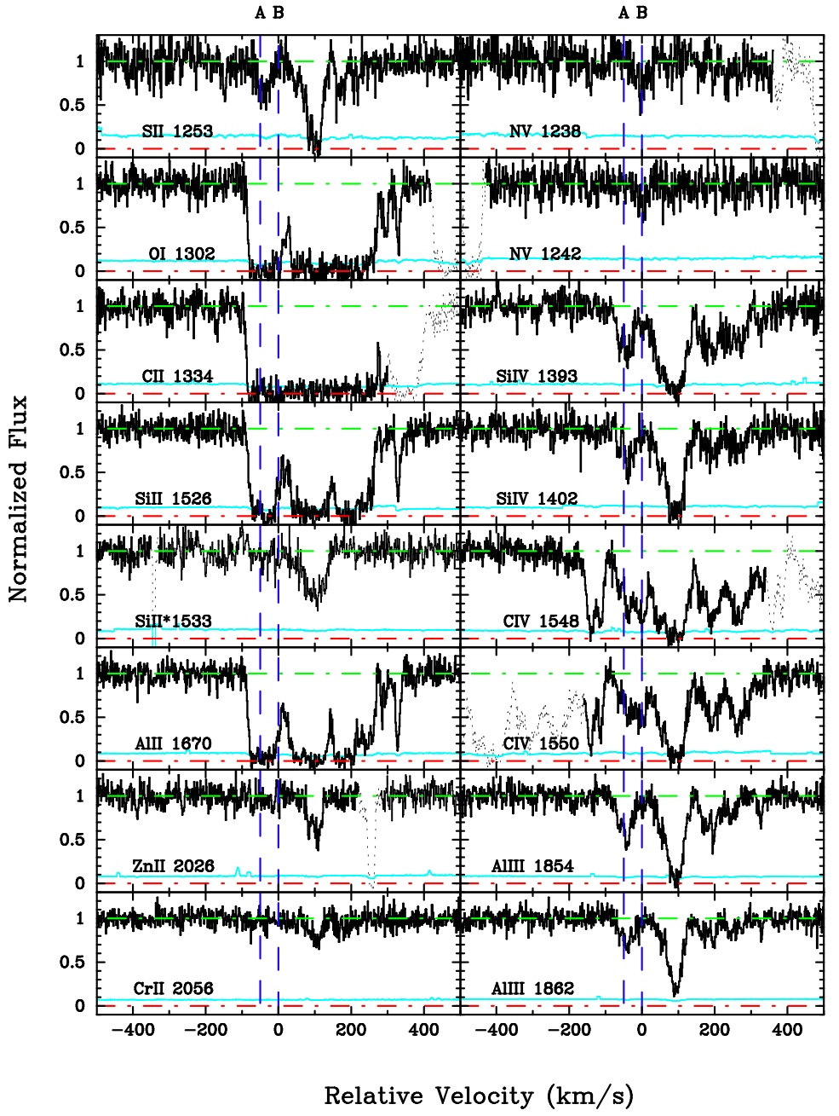
Metals vs. Metals
GRB050820A
More natural to compare N_{O,X} to metals
Use weakly-ionised metal lines to trace neutral gas (Zn II, S II, Si II or Fe II )
Correct for dust-depletion
Convert metal column densities to N_{H} (assuming solar abundances):
N_{H,MII} versus N_{H,X}
Chen+11

Slide 11
Neutral vs. Ionised Gas
N_{H,ZnII}
N_{H,SII}
Neutral gas = Total gas
N_{H,SiII}
N_{H,FeII}
Neutral Gas (Log N_{H,M})
90% additional gas
absorbing soft x-ray
20.0 20.5 21.0 21.5 22.0 22.5
Total Gas (Log N_{H,X})
Schady+11

Slide 12
Highly Ionised Gas Component
What is contribution to soft X-ray absorption from highly ionised gas?
CIV, SiIV, NV and OVI may trace gas closer GRB (Fox+08, Prochaska+08)
Chen+11

Slide 13
Fraction of Highly Ionised Gas
CIV
NV
Log N_{CIV}
12 13 14 15 16 17 18
Log N_{NV}
12 13 14 15 16 17 18
16.5 17.0 17.5 18.0 18.5 19.0
Log N_{CIV,X}
16.5 17.0 17.5 18.0 18.5 19.0
Log N_{NV,X}
Total N_{C} (Log N_{C,X})
Total N_{N} (Log N_{N,X})
SiIV
Only <10% of gas highly ionised
(i.e. IP~140eV)
Log N_{SiIV}
12 13 14 15 16 17 18
16.5 17.0 17.5 18.0 18.5 19.0
Log N_{SiIV,X}
Schady+11
Total N_{Si} (Log N_{Si,X})
Notes:
Alll, with IP of 28eV, frequently weaker than All, which has IP of 19eV. Therefore, missing gas cannot be in ionised form with IP between 20eV and 50eV. Must be in ultra-ionised form, with IP >200eV

Slide 14
What is the origin of the soft X-ray excess?
Ionised gas is in highly ionised state i.e. not seen in optical
X-ray absorbed by intervening gas external to host galaxy
Intervening galaxies along line-of-sight (Campana+12)
A Warm Hot Intergalactic Medium within local Universe (Bahar+11)
Milky Way soft X-ray absorption is underestimated
Notes:
Small fraction of ionised gas at with ionisation potentials smaller than 140eV,

Slide 15
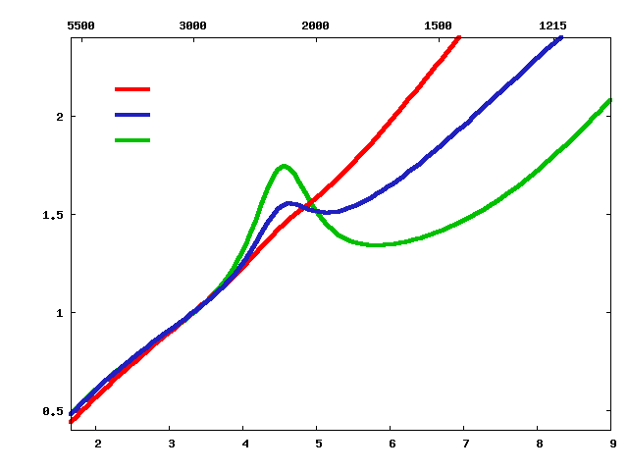
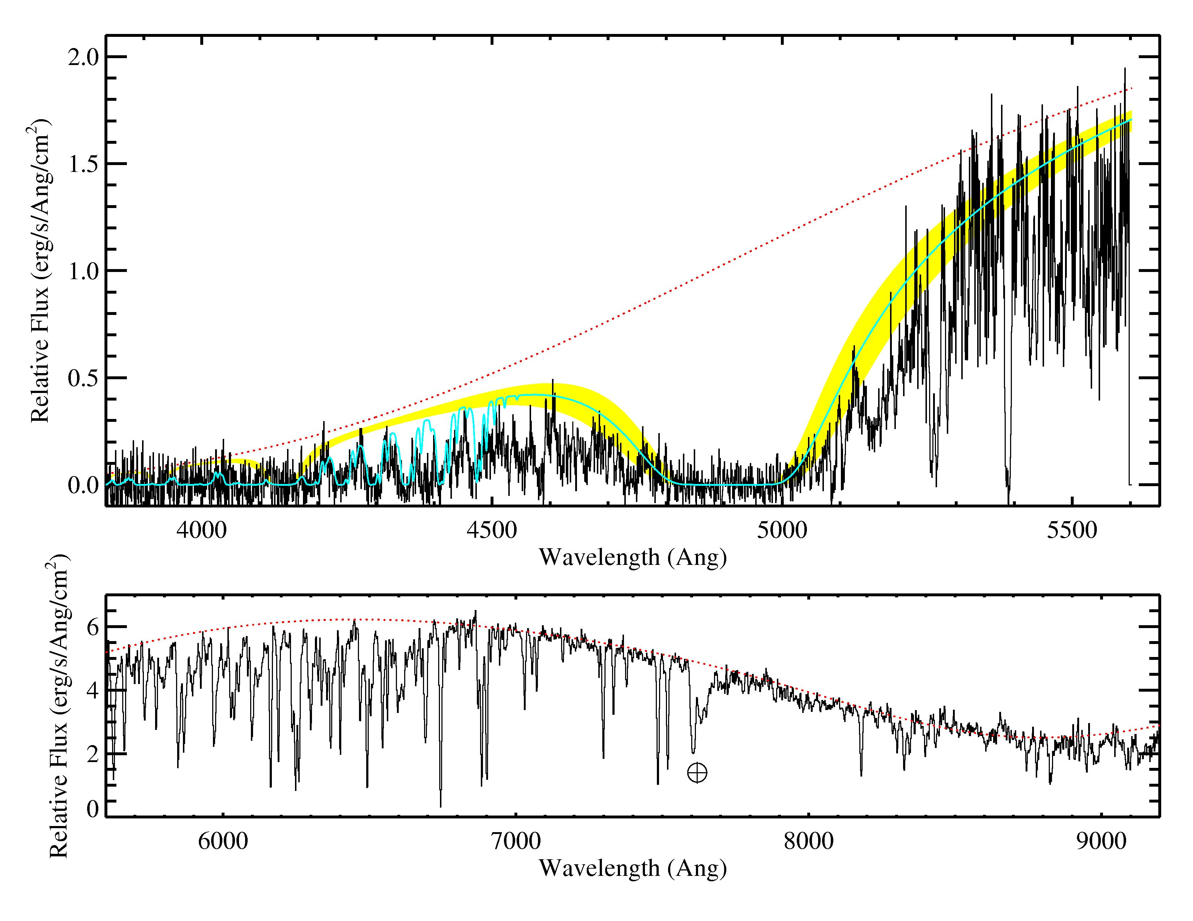
Probing the ISM of GRB Hosts
SMC
LMC
Milky Way
SED for GRB 060729
A_{V}
A_{λ}/A_{3000Å}
3000 2000 1000
Wavelength (Å)
Flux Density (mJy)
H₂
Lyα
Schady+10
Frequency (Hz)
2175Å
CO
Prochaska+09

Slide 16
GRB hosts: dust-poor?
Unbiased sample
Optically bright
GRB080607
(Perley et al. 2009)
Number of Afterglows
GRB070306
(Jaunsen et al. 2009)
Greiner+11
Afterglows A_{V} [mag]
3.2 5.5
Notes:
Since the detection of the first afterglow we have been probing the surrounding GRB environment, in particular the dust (e.g. Galama & Wijers 2001)

Slide 17
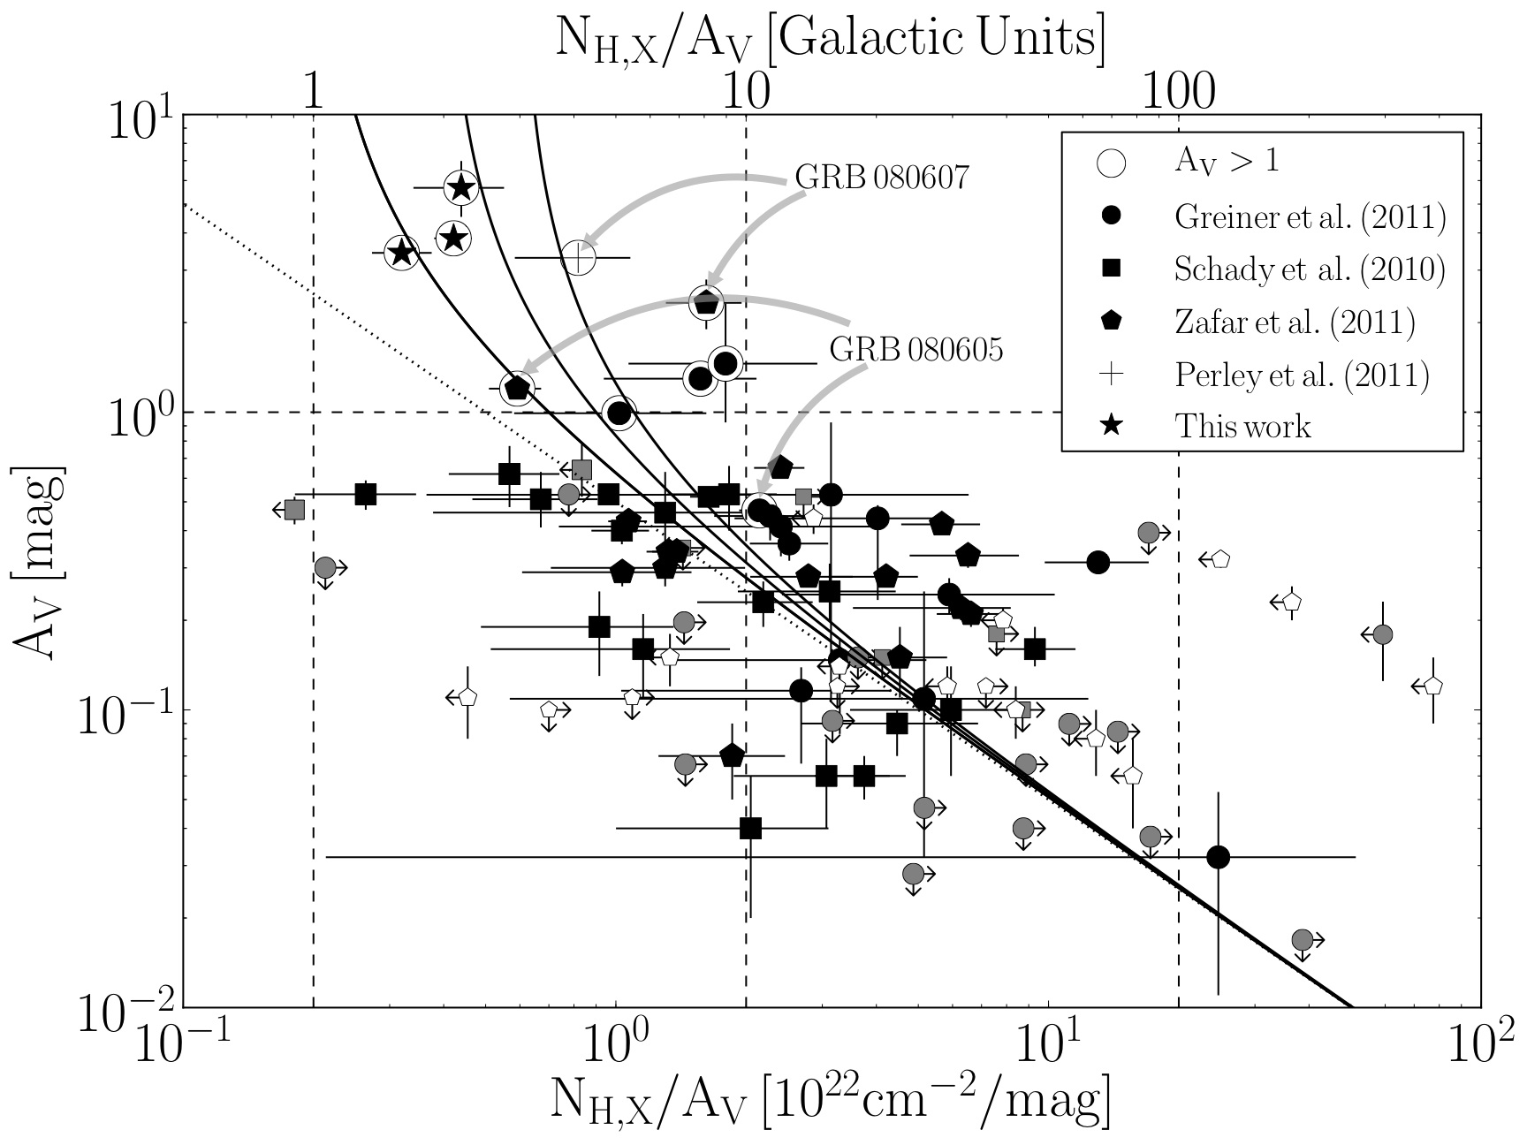
N_{H}/A_{V}
A_{V} > 1
[N_{H,X}/A_{V}]_{sol}
2x[N_{H,X}/A_{V}]_{sol}
3x[N_{H,X}/A_{V}]_{sol}
Krühler+11

Slide 18
Simultaneous SED analysis: Results
Wavelength (Å)
5500 3000 2000 1500 1215
Low A_{V} GRBs
SMC
LMC
Milky Way
<A_{V}> = 0.3
GRB 070802
GRB 080607
A_{v} = 1.2
(Perley+11)
A_{λ}/A_{3000Å}
A_{v} = 3.2
(Elíasdóttir+09)
2 3 4 5 6 7 8
Inverse Wavelength (μm⁻¹)
Schady+12
Notes:
FM90 best-fit model provided acceptable fit (at 97%; 2sigma) to all initial 50 GRBs analysis. SMC and LMC models provided acceptable fit to 49/50, and Milky Way model provided acceptable fit to 44/50 GRBs. WHICH OF THESE HAS Av DETETED AT 2SIGMA?

Slide 19
Dust depletion vs. Dust Extinction
GRB070802
Schady+11

Slide 20
Conclusions
Rich sample of GRB optical and X-ray afterglow spectra
Can probe ionisation state and relative abundances of host galaxy gas
Can probe A_{V} distribution and dust extinction law across cosmic time
Soft X-ray column densities typically an order of magnitude larger than neutral gas column densities
Majority of host gas is in a super ionised state ?
Soft X-rays absorbed by gas external to host; intervening galaxies, local WHIM, Milky Way?
Line-of-sight dust extinction properties (A_{V}, extinction curve) dependent on global host galaxy properties?
Older, more evolved galaxies have larger dust extinction and A_{V}/N_{H}, flatter extinction curves, more pronounced 2175Å bump

