Slide 1
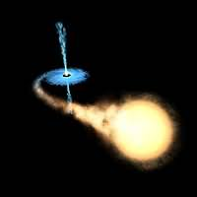
COSMIC EVOLUTION OF STELLAR BLACK HOLES
Félix Mirabel
CEA-Saclay-France & CONICET-Argentina

Slide 2
Outline
From current models on the formation and evolution of massive stars and from the observations of stellar black holes in the Local Universe I will show that:
There was a cosmic evolution of stellar black holes:
A large fraction of Pop III & Pop II stars must have ended as Black Hole High Mass X-Ray Binaries (BH-HMXBs)
Mirabel (2011): arXiV:1012.4944v1 [astro-ph.CO]
Cosmological implication: BH-HMXBs played an important role during the re-ionization era of the universe
Mirabel, Dijkstra, Laurent, Loeb, Pritchard (A&A 528, A149, 2011)
News & Views by Haiman in Nature of 7 April, 2011
This hypothesis is based on the following theoretical models & observations

Slide 3
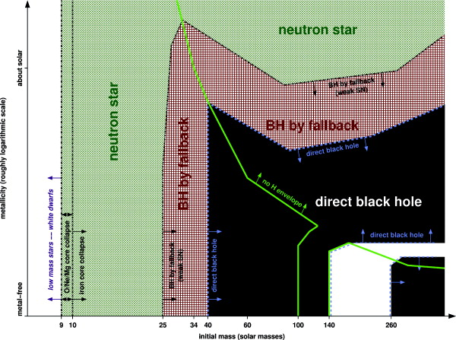
MODELS ON THE FORMATION OF COMPACT OBJECTS BY THE COLLAPSE OF SINGLE STARS
with no rotation (Heger+ 2003)
with rotation (Georgy+ 2009)
Z
solar metallicity
Mass of progenitor star
Low metal progenitors form BHs by IMPLOSION (Fryer, 1999)
But recent work shows binarity is important because

Slide 4
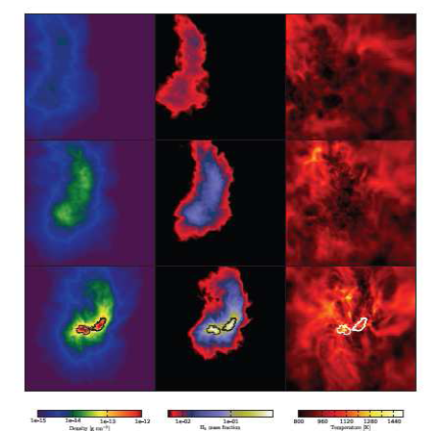
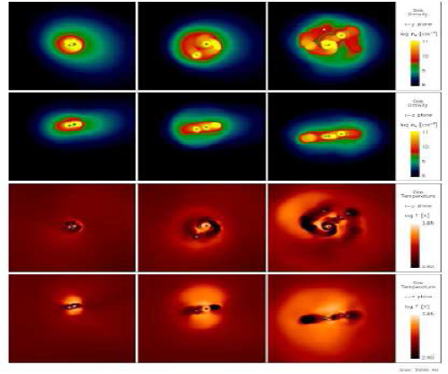
MASSIVE STARS ARE FORMED IN MULTIPLE SYSTEMS
Turk, Abel & O’Shea (Science 2009) Krumholz et al. (Science 2009)
Stacy, Greif & Bromm (ApJ 2010) Fragmentation: Clark+ (Science 2011)
Pop III stars were multiple systems dominated by binaries with 10-100 M
2) Feedback limited the mass of Pop III stars to M = 43 M (Yye, this meeting)
3) Observations in MW ⇒ >70% of OB type stars are binaries (e.g. Chini+, 2011)

Slide 5
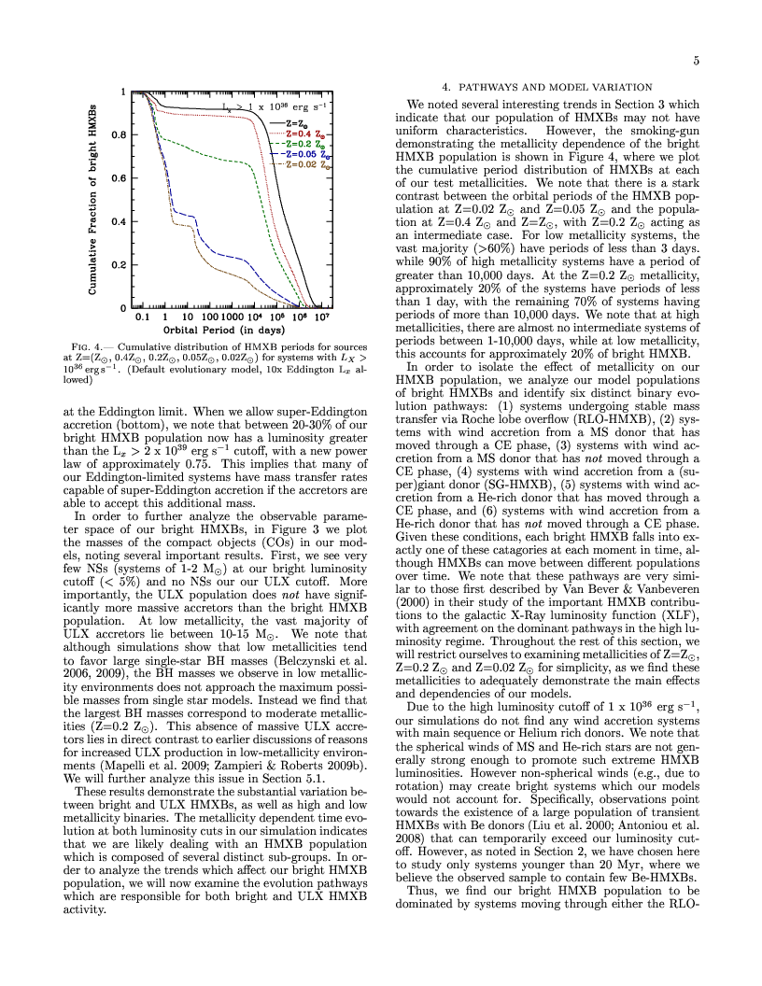
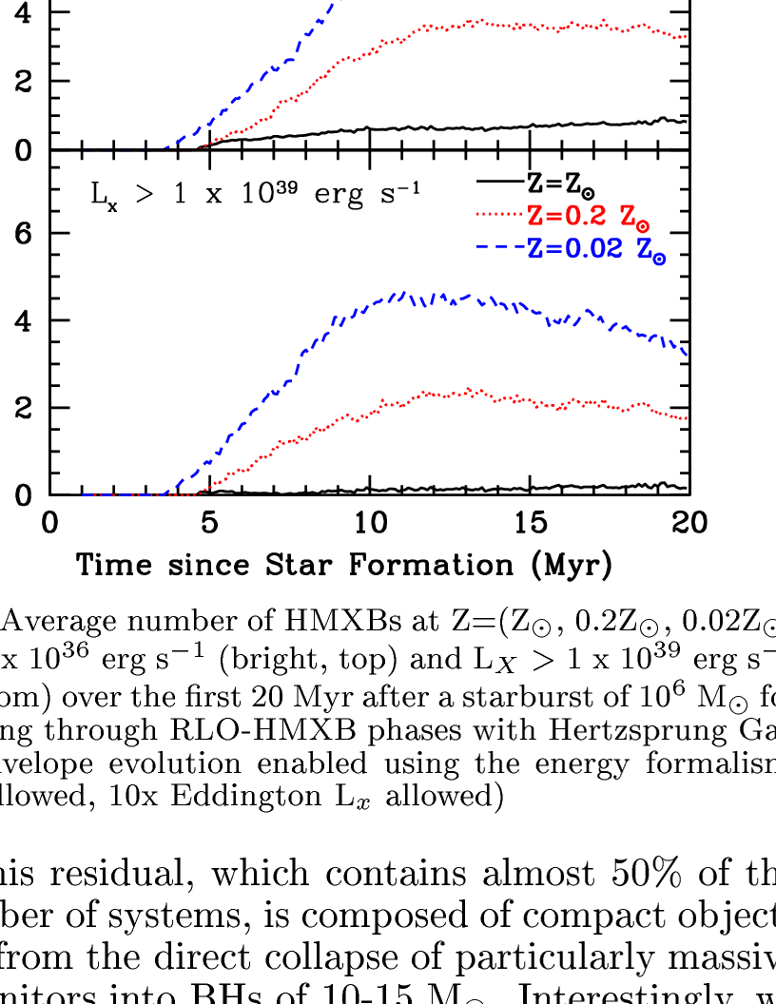
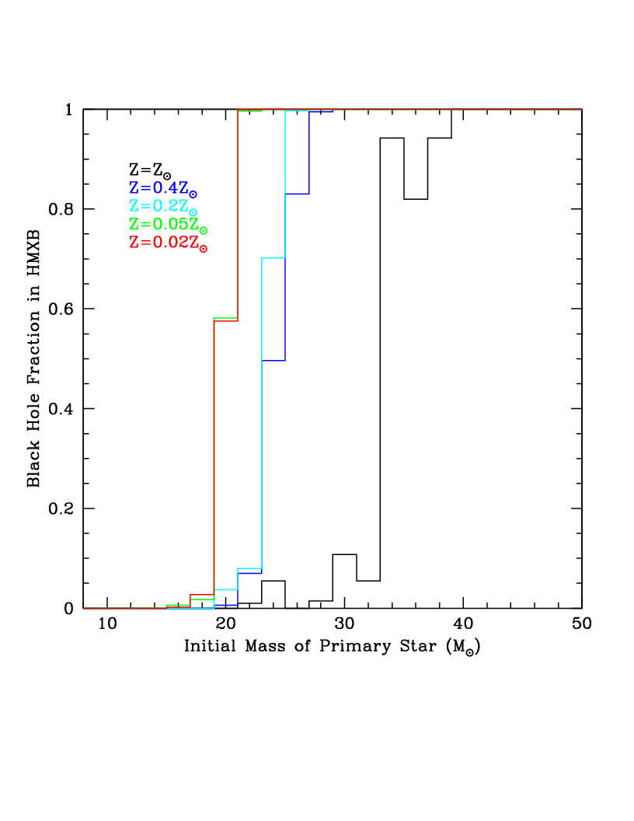
THE FORMATION OF HMXBs IS STRONGLY METALLICITY DEPENDENT (Linden, Kalogera+ 2011)
Number of HMXBs per starburst of 10⁶ M
AT LOW Z
the number of HMXBs increases
the orbital period decreases
progenitors of > 20 M end as BHs

Slide 6
FROM CURRENT MODELS OF MASSIVE STAR FORMATION AND EVOLUTION
THE FRACTION OF BLACK HOLES / NEUTRON STARS
THE FRACTION OF BINARY / SOLITARY BLACK HOLES
SHOULD INCREASE WITH DECREASING METALLICITY OF THE PROGENITORS
Because at low Z’s BHs form directly (with no energetic SNe), the fraction of binary systems that remain gravitationally bound increases, and therefore, from a theoretical point of view one expects that
THE FRACTION OF BH-HMXBs INCREASES WITH DECREASING METALLICITY
WHAT OBSERVATIONS CAN TEST THESE THEORETICAL PREDICTIONS?

Slide 7
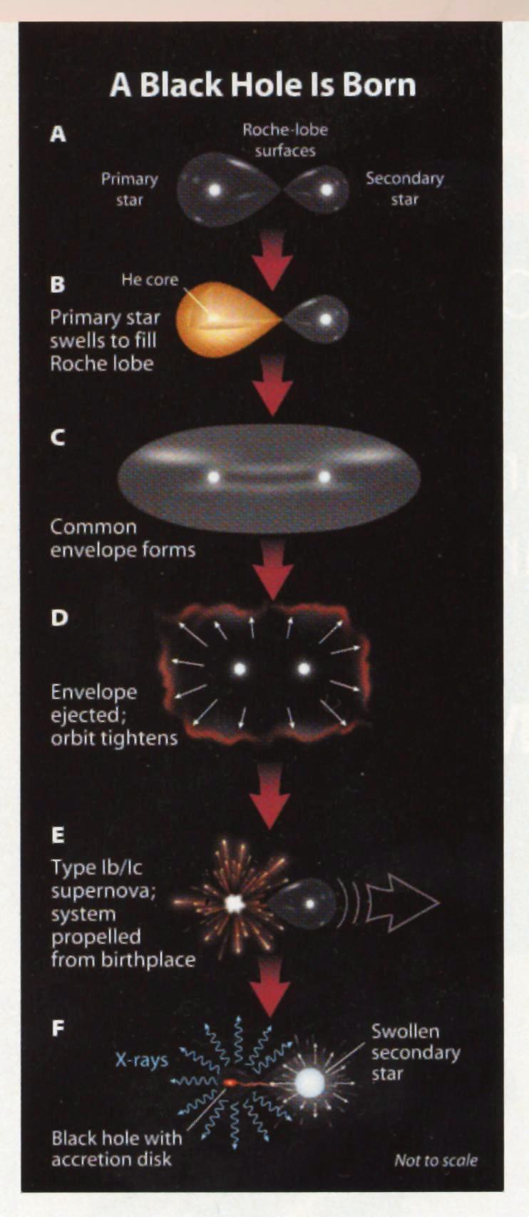
IS THERE ANY EVIDENCE OF BLACK HOLE FORMATION BY DIRECT COLLAPSE?
CORE COLLAPSE MODELS:
DELEYED VERSUS DIRECT COLLAPSE AS A FUNCTION OF THE MASS OF THE CORE:
Massive black holes (M>10 M) should form without luminous SNe & energetic kicks
(Fryer & Kalogera; Woosley & Heger; Nomoto et al.)
USE THE KINEMATICS OF μQSOs TO TEST THE CORE COLLAPSE MODELS
Mirabel & Irapuan Rodrigues (2001-2009 )
Credit S&T

Slide 8
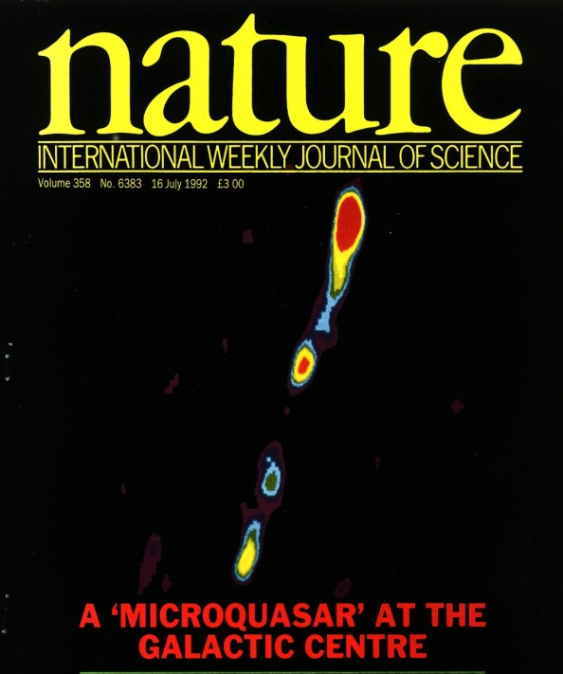
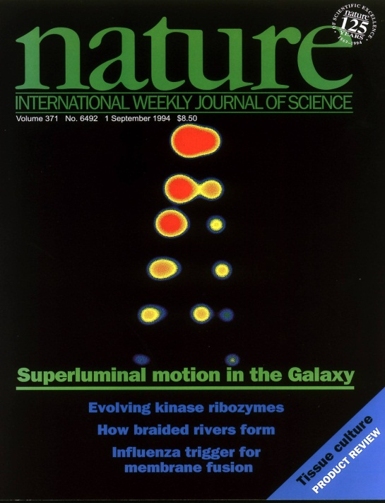
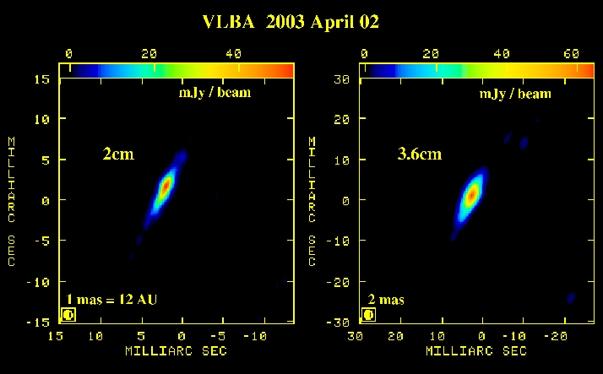
JETS IN MICROQUASARS
Mirabel, Rodriguez+ 1992
Mirabel & Rodríguez 1994
TRANSIENT
JETS
STEADY
JETS
VLA
Dhawan, Mirabel, Rodríguez (2007)
COMPACT JETS
In low hard state. Size ~ 100 AU. Same PA
USED TO DETERMINE PROPER MOTIONS
(with VLBI to get sub-miliarc sec precision)
λ3.6 cm
λ3.6 cm

Slide 9
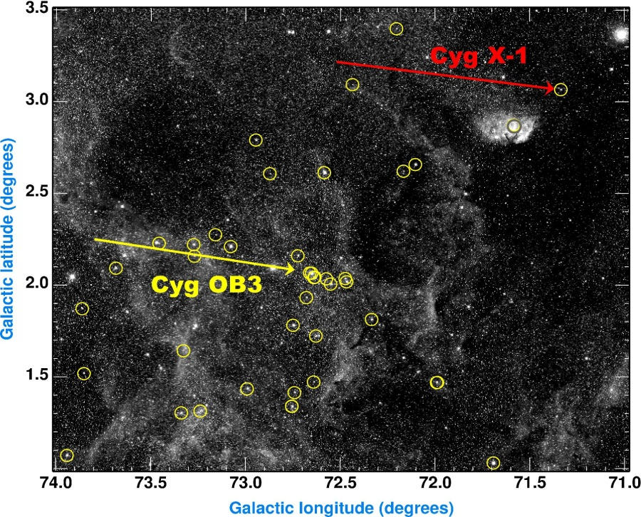
THREE BLACK HOLES OF >10 M FORMED BY DIRECT COLLAPSE
Mirabel & Rodrigues (Science, 2003)
Proper motion by Lestrade et al. (1999)
Cygnus X-1
V_{p}< 9+/-2 km/s ⇒ < 1 M ejected in a SN confirmed by Gou, McClintock+ (2011)
Otherwise it would have been shot out from the parent stellar association
THE ~10 M BH IN Cyg X-1 WAS FORM BY DIRECT COLLAPSE
GRS 1915+105: Vp=50-80 km/s & W=7+/-3 km/s (Dhawan,Mirabel,Rodríguez 2001) V404 Cyg: Vp= 45-100 km/s & W = 0.2+/-3 km/s (Miller-Jones et al. 2009)
BHs with > 10 M form with no energetic SNe
⇒ AT LOW Zs BINARIES CAN REMAIN BOUND AFTER BH FORMATION

Slide 10
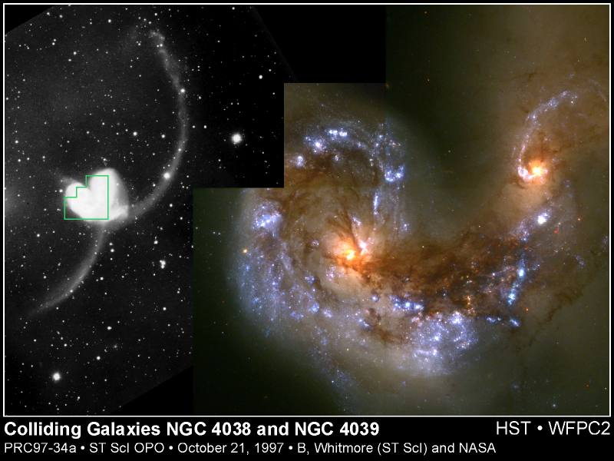
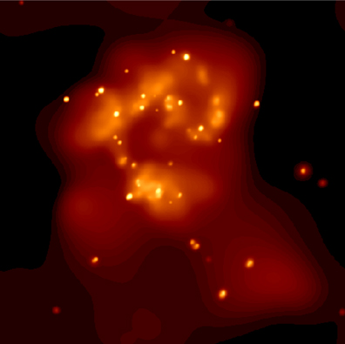
ULTRALUMINOUS X-RAY SOURCES: MOST ARE BH-HMXBs
THE OCCURRENCE RATE OF ULXs PER UNIT GALAXY MASS IS A DECREASING FUNCTION OF METALLICITY (Zampieri & Roberts)
Fabbiano et al.
X-ray (Chandra)
Antennae

Slide 11
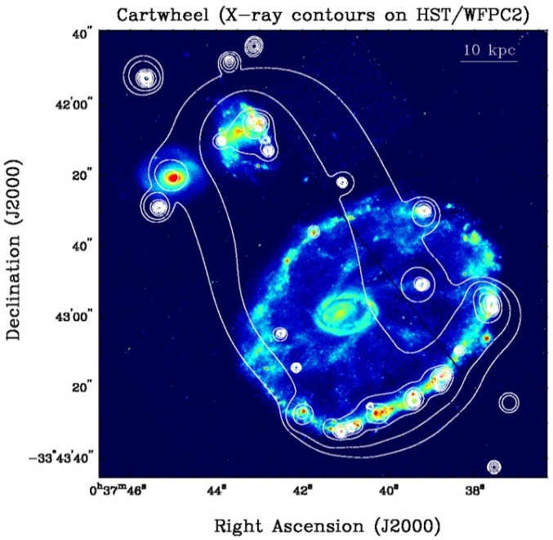
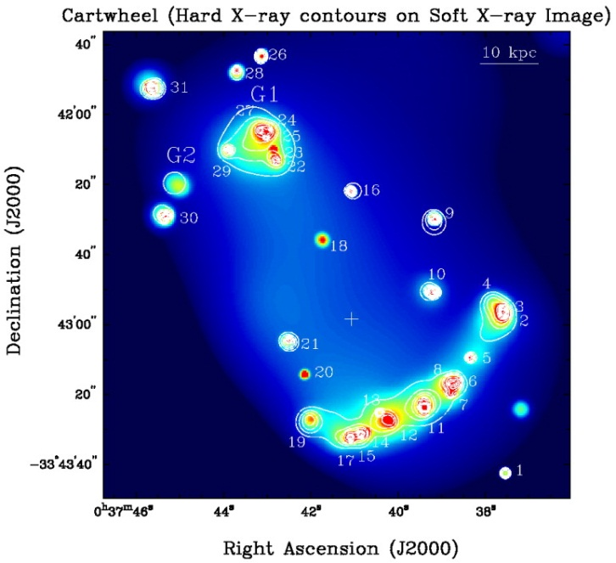
ULXs IN THE CLOSEST TEMPLATES OF HIGH z GALAXIES
The ULXs luminosity of ~10⁴² erg s⁻¹ in the Cartwheel rivals that of AGN
(Gao+ 2003)

Slide 12
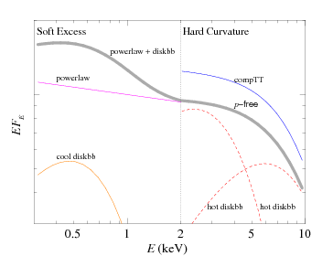
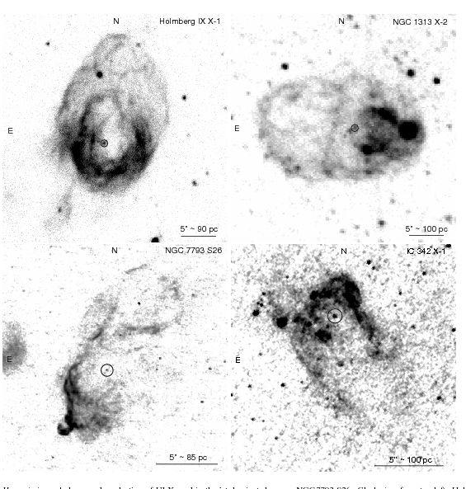
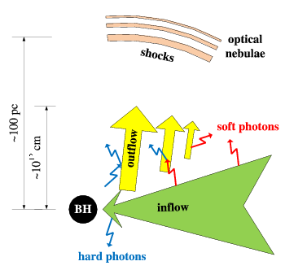
BH-HMXBs IN LOW METAL-STAR-FORMING GALAXIES
Spectra
Figures from Feng & Soria (2011)
shock & photonionized bubbles of > 100 pc size
Hα images
Massive outflows
BH-HMXB
E > 10⁵³ erg
Pakull et al. Nature (2011)

Slide 13
Because massive stars with low Z end as black holes by direct collapse
THE COSMIC EVOLUTION OF METALLICITY ⇒ A COSMIC EVOLUTION OF BH-HMXBs
THE FRACTION OF BLACK HOLES/NEUTRON STARS
THE FRACTION OF BINARY/SINGLE BLACK HOLES
SHOULD INCREASE WITH REDSHIFT
Beyond the theoretical uncertainties (e.g. mixing due to rotation in Pop III stars), the observation of ULXs in the Local Universe support this hypothesis
WHAT ARE THE COSMOLOGICAL IMPLICATIONS OF LARGE POPULATIONS OF BH-HMXRBs DURING THE DARK AGES THAT LASTED FROM 4x10⁴ up to 10⁹ yr?

Slide 14
Ionizing power of μQSOs versus ionizing power of massive stars
Counting ionizing photons Mirabel, Diskra, Laurent, Loeb, Pritchard (2011)
f_{edd} = fraction of Eddington luminosity for a time t_{acc}
N_{phot} = number of ionizing photons emitted per atom of H nucleus
<E>_{γ} = mean photon energy emitted by the accreting BH
f_{esc,*} (f_{esq,BH}) = fraction of ionizing photons that escape
For fiducial values of the model parameters:
THE ACCRETING BLACK HOLE EMITS A TOTAL NUMBER OF IONIZING PHOTONS THAT IS COMPARABLE TO THAT OF ITS PROGENITOR STAR
But in a fully neutral medium N_{sec*} = 25 (E_{γ} /1 keV), where E_{γ} is the photon energy
However, not all stars will be massive and lead to the formation of BH-HMXBs…

Slide 15
BH-HMXBs LIMITED THE MASS OF DWARF GALAXIES
From Loeb (2010): T_{vir} = 1.04 x 10⁴ (μ/0.6) (Μ/10⁸ Μ)^{2/3} [(1+z)/10] K
M_{min} ~ 10⁹ (ρ/100ρ_{c})^{-1/2} (μ/0.6)^{−3/2} [Τ(Κ)/10⁴]^{3/2} [(1+z)/10]^{-3/2} Μ
ρ_{c} = critical mass density for a flat universe, r = mass density in the galaxy m = mean molecular weight, z = redshift, T = temperature of the IGM
X-ray and UV heating of the diffuse IGM during reionization resulted in an additional increase of the minimum galaxy mass. Once the IGM was heated to ~10⁴ K by the UV and X-rays from BH-HMXBs, dark matter haloes with masses below a certain mass (10^{x} M) could not accrete gas from IGM.
THE THERMAL HISTORY OF THE IGM DETERMINED BY ACCRETING BLACK HOLES HAD A DIRECT IMPACT ON THE PROPERTIES OF THE FAINTEST GALAXIES AT HIGH REDSHIFTS AND THE SMALLEST GALAXIES IN THE LOCAL UNIVERSE

Slide 16
CONCLUSION
Theory and observations suggest a cosmic evolution of HMXBs ⇒
During the reionization epoch large populations of HMXBs are form.
HMXBs determine the early thermal history of the universe, and maintain the IGM ionized over large volumes of space.
HMXBs have a direct impact on the properties of the faintest galaxies at high redshift, the smallest galaxies in the local universe, and on the future surveys of HI in the early universe.
This has implications on observational constraints to the Cold Dark Matter model of the universe

