Slide 1
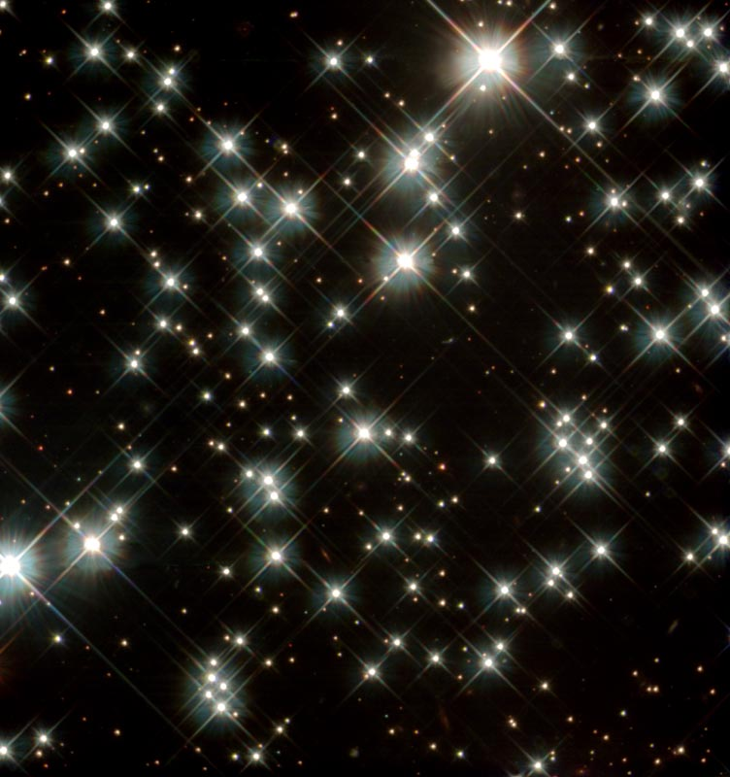
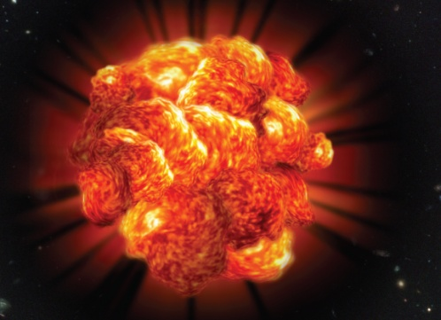
Pair-Instability Explosions: observational evidence
Avishay Gal-Yam,
Weizmann Institute
Nikko 2012

Slide 2
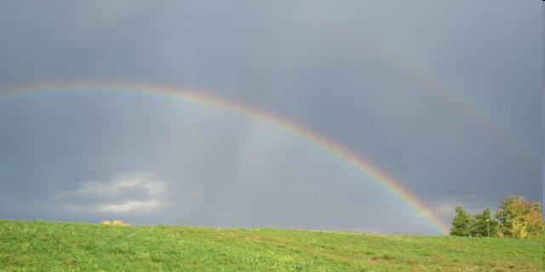
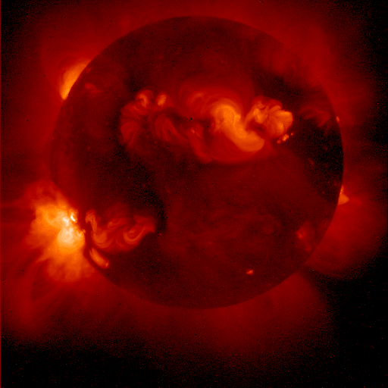
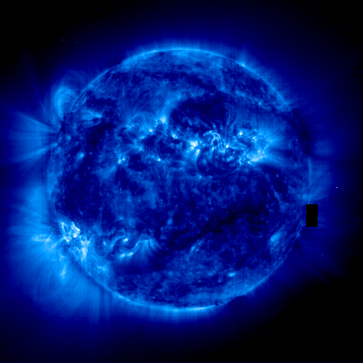
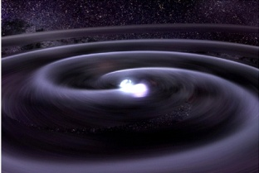
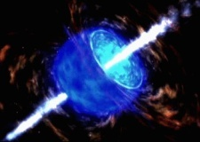

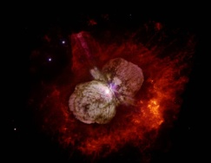

The Core-Collapse Spectrum
Lower mass limit unclear:
<7..11 solar; stable C/O core
NS NS
NS BH
BH No remnant
EC SN?
AIC
RSG=II-P
W-R = Ib/c?
GRB
BSG
SN IIn
PI SNe
M: 7-11
M: 8-16
M: 17-25
M: 25-30
M: 40-50
M: 50-150
M> 150

Slide 3
Pair Instability Supernovae (PISNe)
(Shaviv & Rakavi 1967; Barkat, Rakavi & Sack 1967 ; Heger & Woosley 2002; Waldman 2008 …)
* Helium cores above ~50 solar masses become pair unstable
* In these low-density high-T cores, γγ→e⁺e⁻ wins over oxygen ignition, heat is converted to rest mass and implosion follows
* Inertial oxygen ignition leads to explosion and full disruption
Waldman
* “This is a uniquely calculable process” (Heger & Woosley 2002); “this is a trivial calculation” (Barkat 2009); “Pretty neat homework problem” (Gal-Yam 1996)
“Smoking gun”:
Core mass > 50 solar

Slide 4

Pair Instability Supernovae (PISNe)
* Helium cores above the threshold robustly explode
* PISNe care not for metallicity, but for mass loss
* PISNe progenitors seem not to exist in our Galaxy – require M > 140 solar - (though transitional pulsational events might)
* At the early Universe, M~1000 stars may have existed (or not)

Slide 5
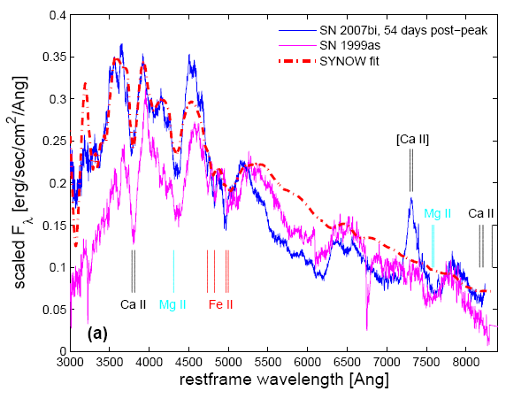
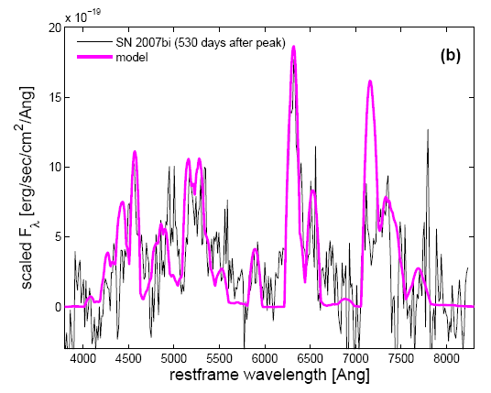
SN 2007bi=SNF20070406-008
(PTF “dry run”)
* Type Ic SN. No H, He, no interaction, no dust, v=12000 km/s
* Luminous peak (-21.3), slow rise (~77 days), ⁵⁶Co decay
* ejected mass ~100 solar, E_{k}~1e53, 4-11 solar masses of ⁵⁶Ni (87A)
* Well-fit by models (Kasen)
* Nebular spectra: 4-6 solar mass of ⁵⁶Ni; >50 solar total (Direct comparison with 98bw; Mazzali models)
Core mass > 50 robustly established;
Gal-Yam et al. 2009, Nature, 462, 624

Slide 6
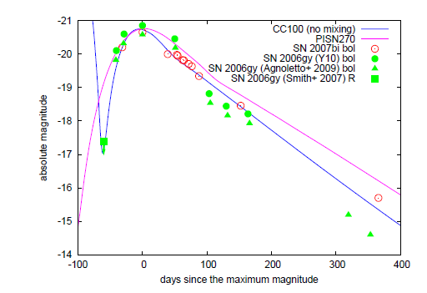
Alternative model?
Moriya et al. 2010

Slide 7
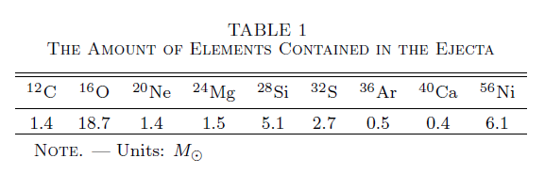
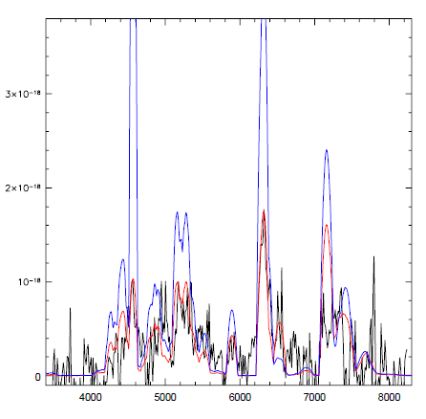
Alternative model?
Moriya et al. 2010
Same amount of ⁵⁶Ni within a smaller total ejecta mass: emission lines too strong.
CC model cannot explain SN 2007bi nebular spectra (caveat)

Slide 8
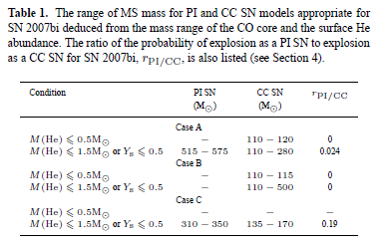
Implications for mass loss
Yoshida & Umeda 2011
If CC model ruled out, either we have found stars with initial mass > 500 solar, or standard mass loss theory needs to be revised

Slide 9
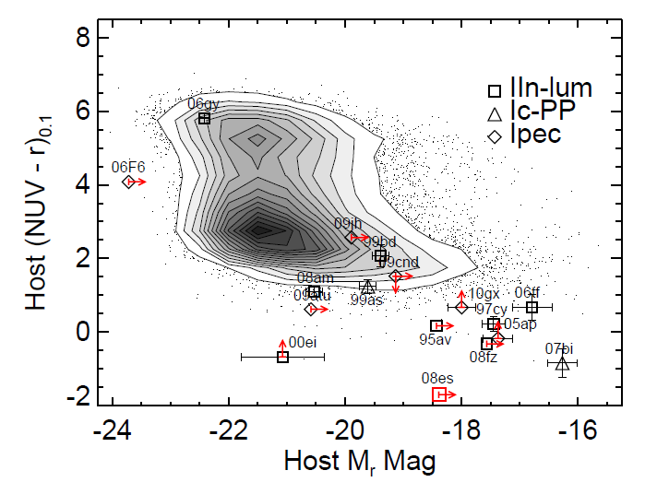
Extreme host
Neill et al. 2010

Slide 10
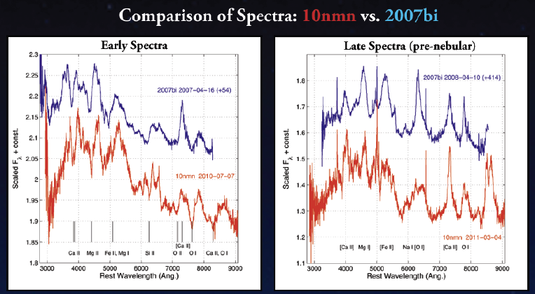
PTF 10nmn: new results from PTF
(Yaron)
SN 2007bi lookalike

Slide 11
PTF 10nmn: new results from PTF
(Yaron)
Complicated light curve, but slow rise (in favor of PISN)

Slide 12
PTF 10nmn: new results from PTF
(Yaron)
Nebular spectrum: Ni⁵⁶=5, total=100 solar; lots of C/O (and Ca); IR: key observable (but tough)

Slide 13
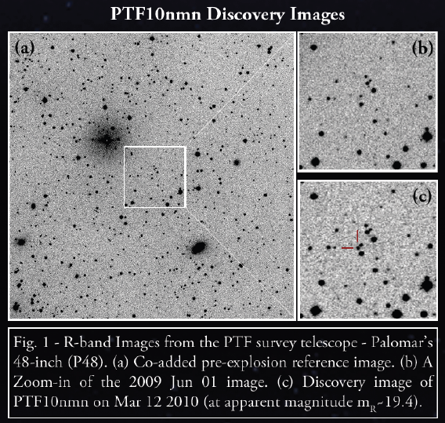
PTF 10nmn: new results from PTF
(Yaron)
Host: another dwarf (<< LMC); HST needed

Slide 14
PTF 10nmn: new results from PTF
(Yaron)
Rate at low-z is about ~1 per year, these are ~5 times rarer than SLSN-I (roughly): truly at top of the IMF
Roughly consistent with prediction from stellar runaway collision model (Pan, Kasen & Loeb) ~10⁻⁹ Mpc³

Slide 15
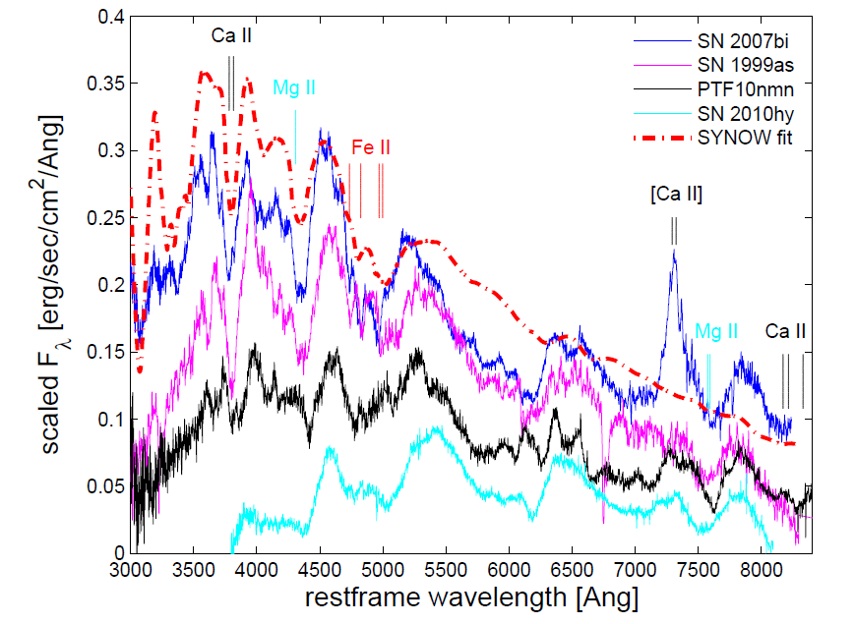
More local examples
Nomoto talk;
Moriya model
Gal-Yam 2012, Science

Slide 16
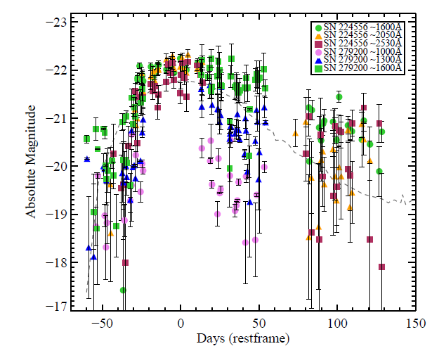
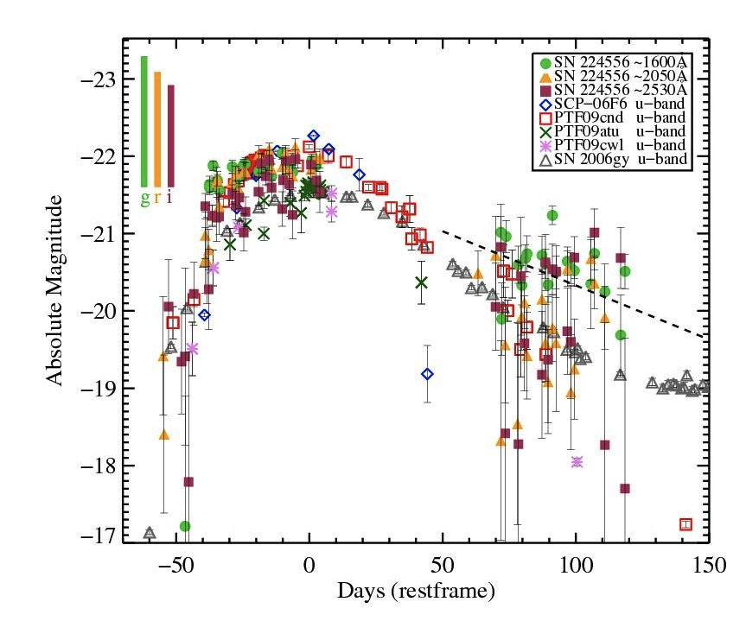
PISNe at high redshift
(Cooke)
PISNe are also detected at high redshifts (Cooke; PS1)
Cooke, Sullivan, Barton, Gal-Yam+ (Preliminary)

Slide 17
PISNe at high redshift
(Cooke)
PISNe are also detected at high redshifts (~4)
They are also rare there
At the top of the IMF also at high-z

Slide 18

Implications
(Gal-Yam et al. 2009)
* A helium core ~100 solar detected at Z ~ SMC
Many mass loss models are wrong (c.f Langer models)
* PISNe happen locally, Universally, SN models are ~ok
* Dwarfs have stars above Galactic limit (>200 solar, probably)
* Hydrogen efficiently removed (pulsations?)

Slide 19
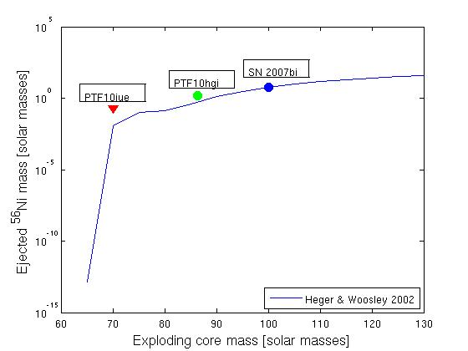
Implications (observational)

Slide 20
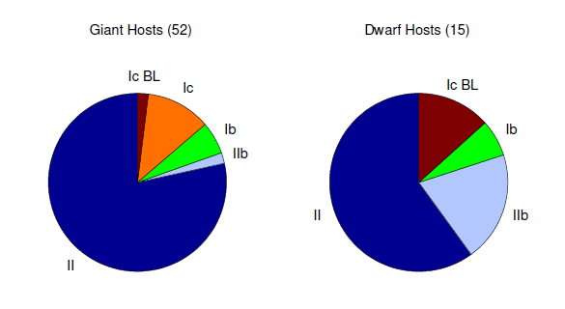
Dwarf and giant galaxies: different populations of massive star explosions
(Arcavi et al. 2010)
Arcavi et al. 2010, ApJ, 721, 777

Slide 21
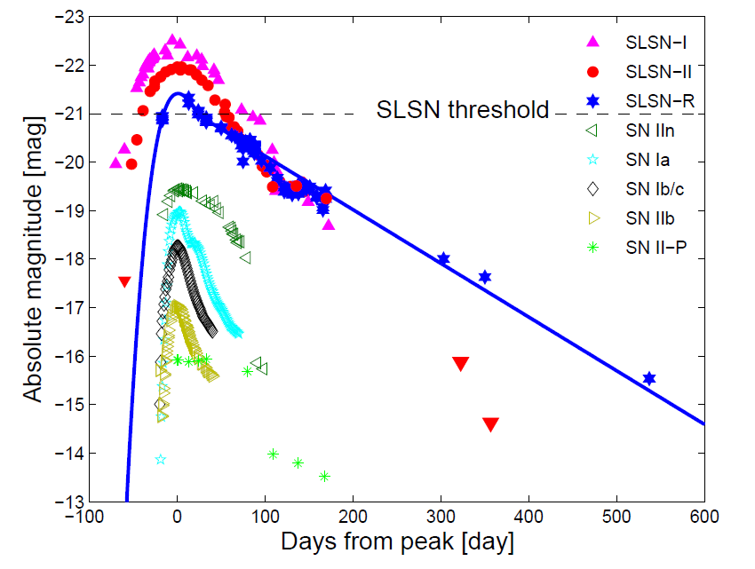
Superluminous Supernovae (SLSNe)
Gal-Yam 2012, Science

Slide 22
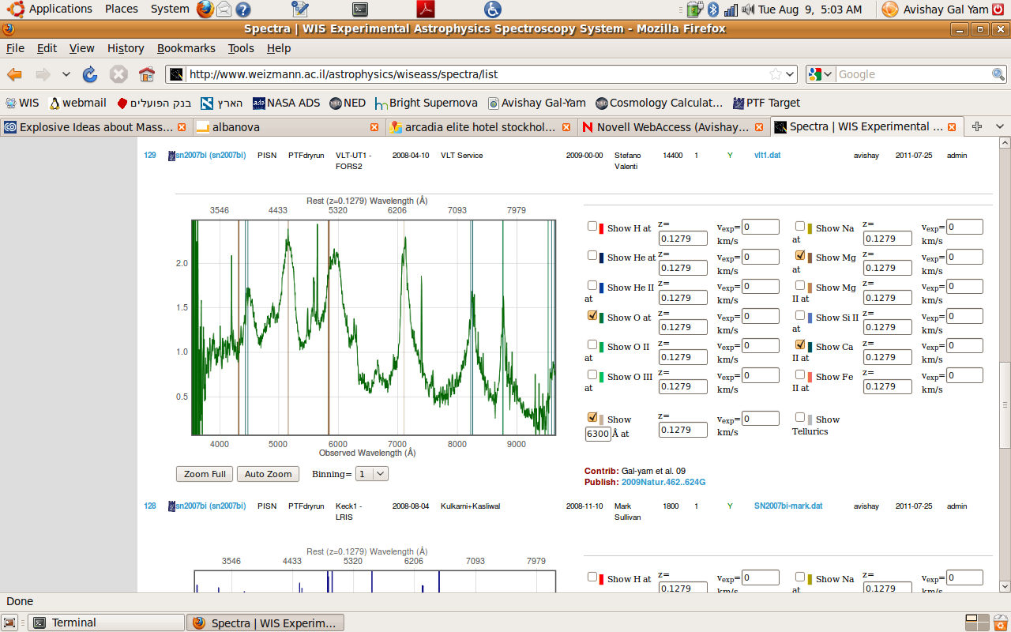
The Weizmann Institute of Science Experimental Astrophysics Spectroscopy System (WISEASS)

Slide 23
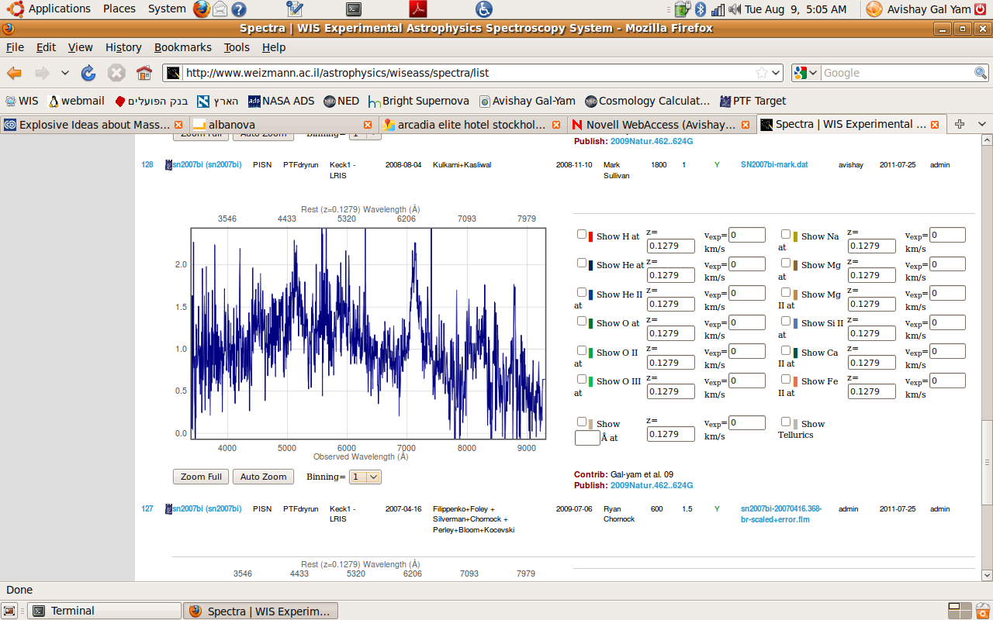
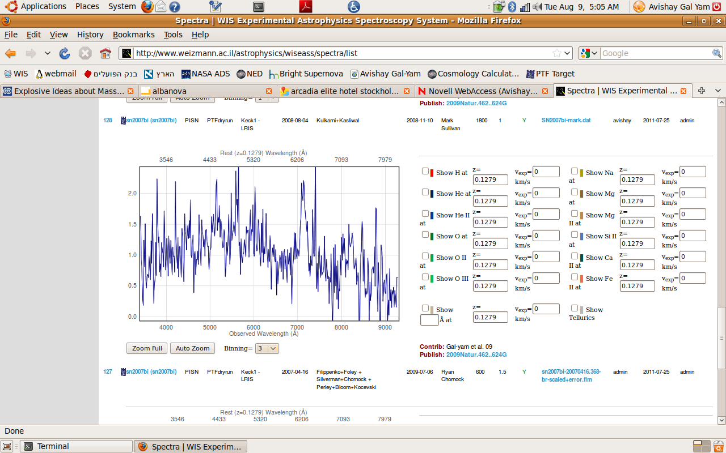
The Weizmann Institute of Science Experimental Astrophysics Spectroscopy System (WISEASS)

Slide 24
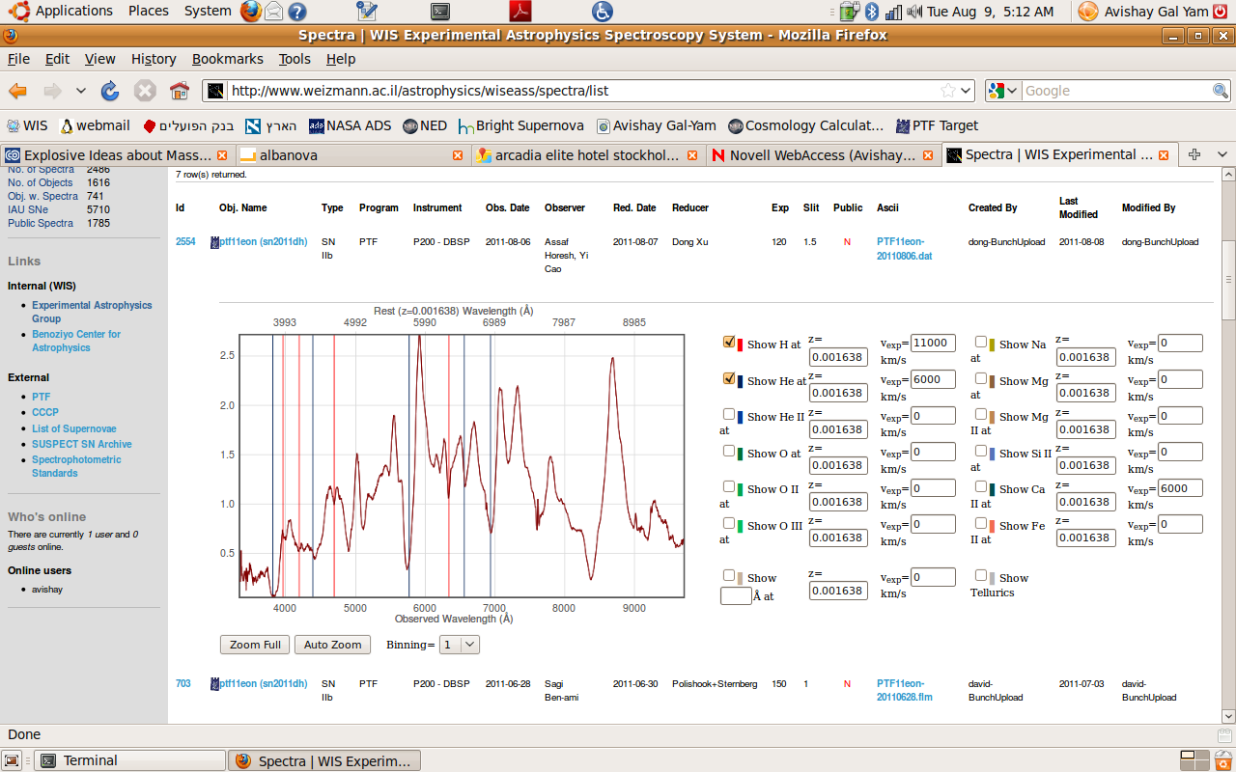
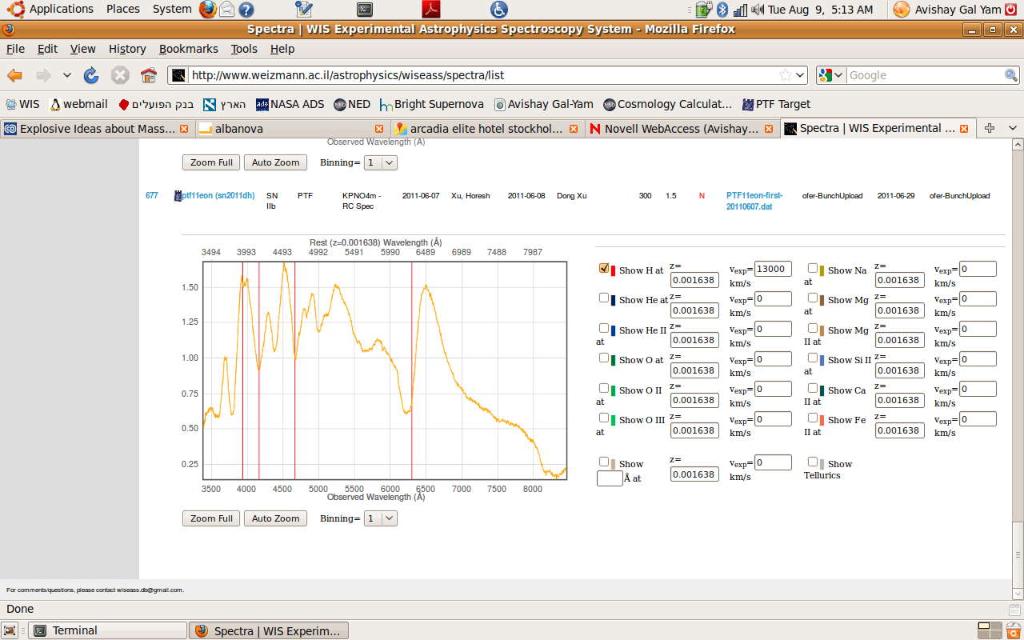
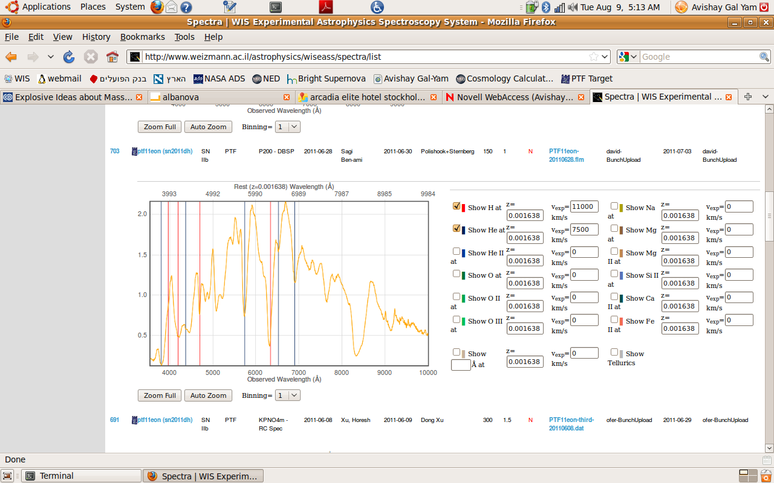
The Weizmann Institute of Science Experimental Astrophysics Spectroscopy System (WISEASS)

Slide 25
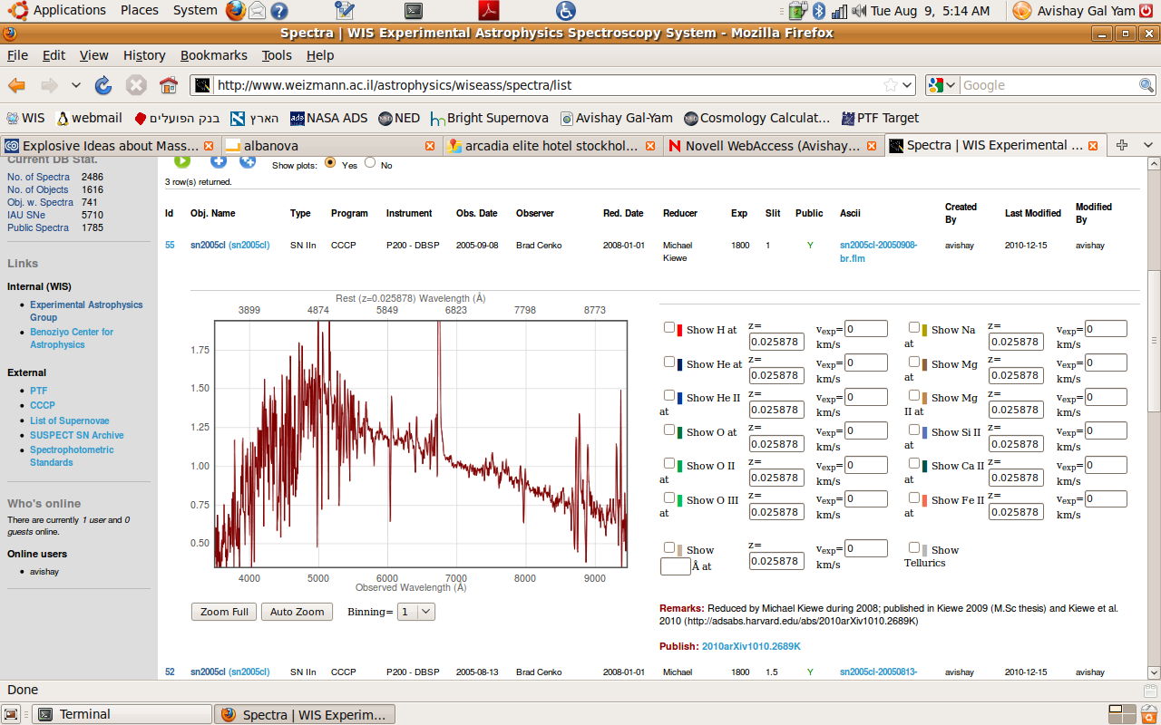
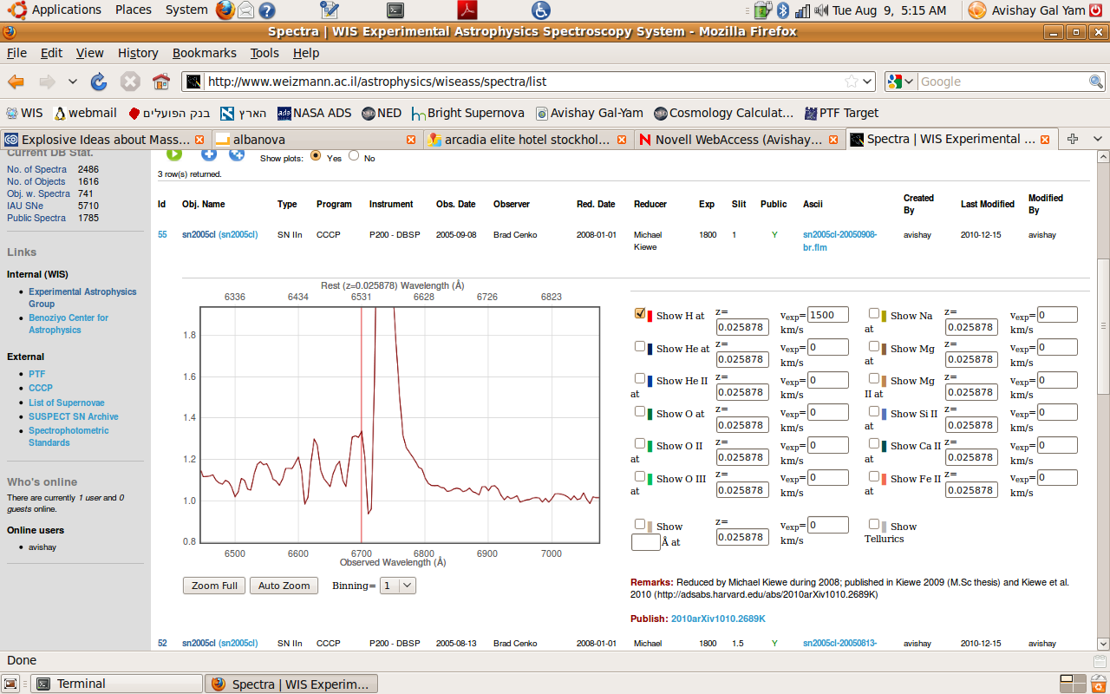
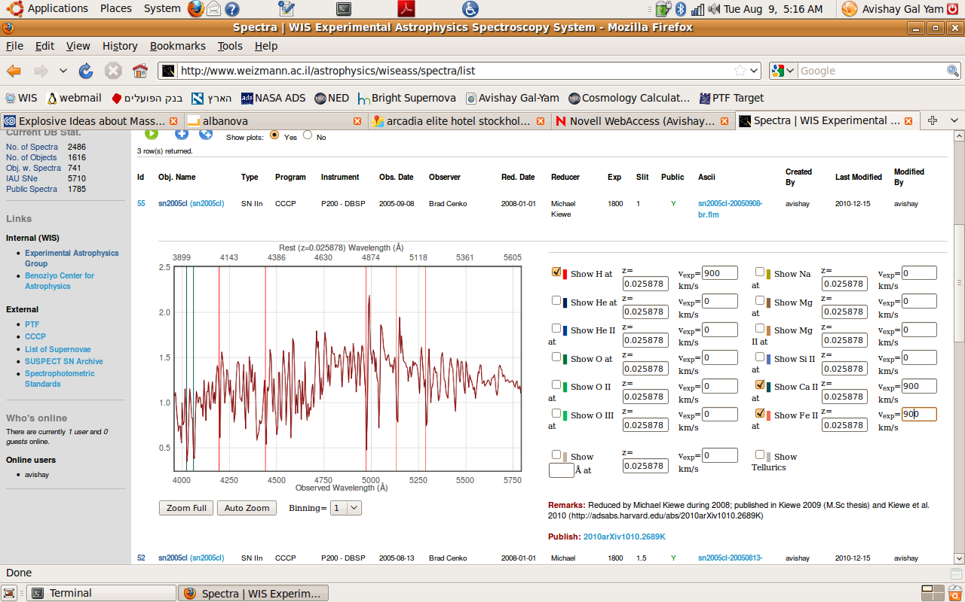
The Weizmann Institute of Science Experimental Astrophysics Spectroscopy System (WISEASS)

Slide 26
WISEASS:
Browse and download
Archive your published spectra
Dataset hosting ofer.yaron@weizmann.ac.il

Slide 27
Thanks
(and happy birthday Giorgios)

