Slide 1
IAU Symposium 279
Death(s) of Massive Stars
S R Kulkarni
Caltech Optical Observatories

Slide 2
A magnificent & elegant Setting

Slide 3
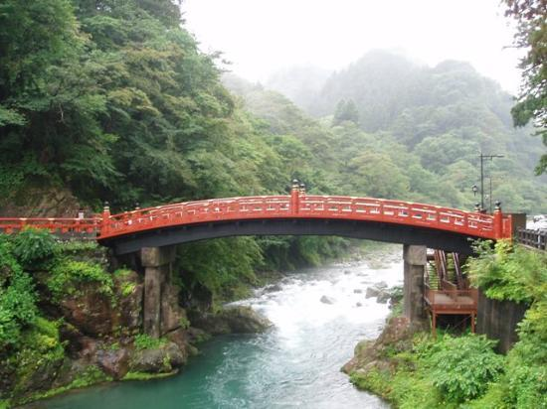

Slide 4
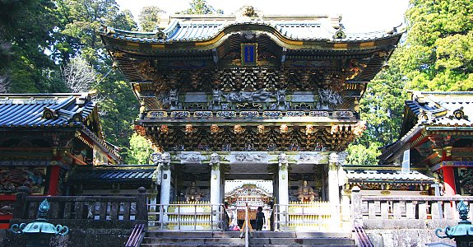

Slide 5
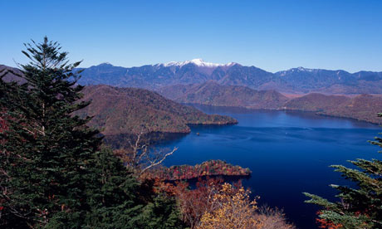

Slide 6


Slide 7


Slide 8


Slide 9
But NIPPON is also …
(a personal perspective)

Slide 10
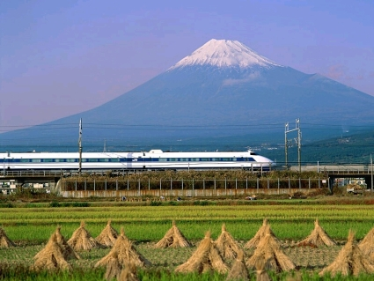
Nippon is also …

Slide 11
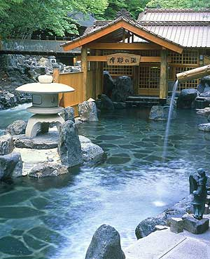
Nippon is also …

Slide 12
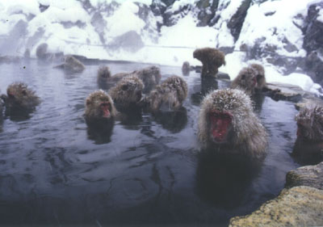
Very clever ….

Slide 13
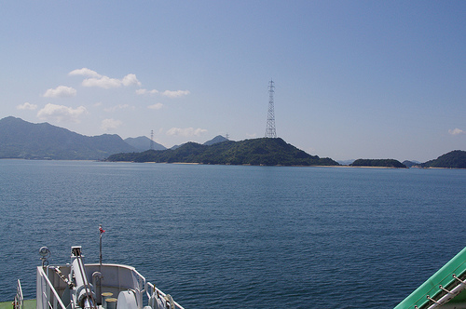
Nippon is also …

Slide 14
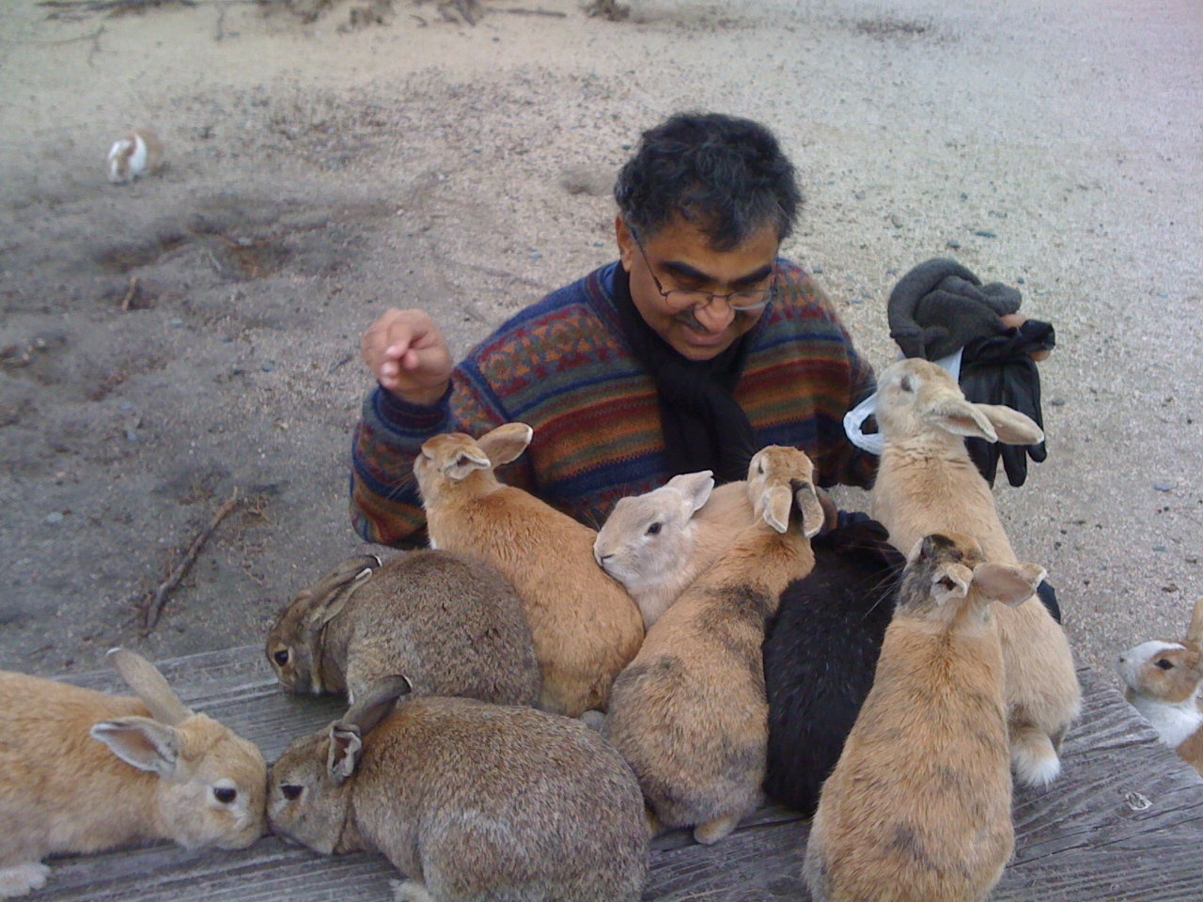
Nippon is also…

Slide 15
Nippon is INDOMITABLE SPIRIT
我慢

Slide 16
Many thanks
The LOC
  Great choice of location
  Impeccable arrangements
  Firm Bell Person
The SOC
  Excellent choice of speakers
  Giving young people opportunities
The Speakers
  Keeping to time
  High quality
Funding agencies
  IAU, MEXT, Tokodai, IPMU, SWRI, JSPS, ASJ

Slide 17
Now to serious business

Slide 18


Slide 19


Slide 20
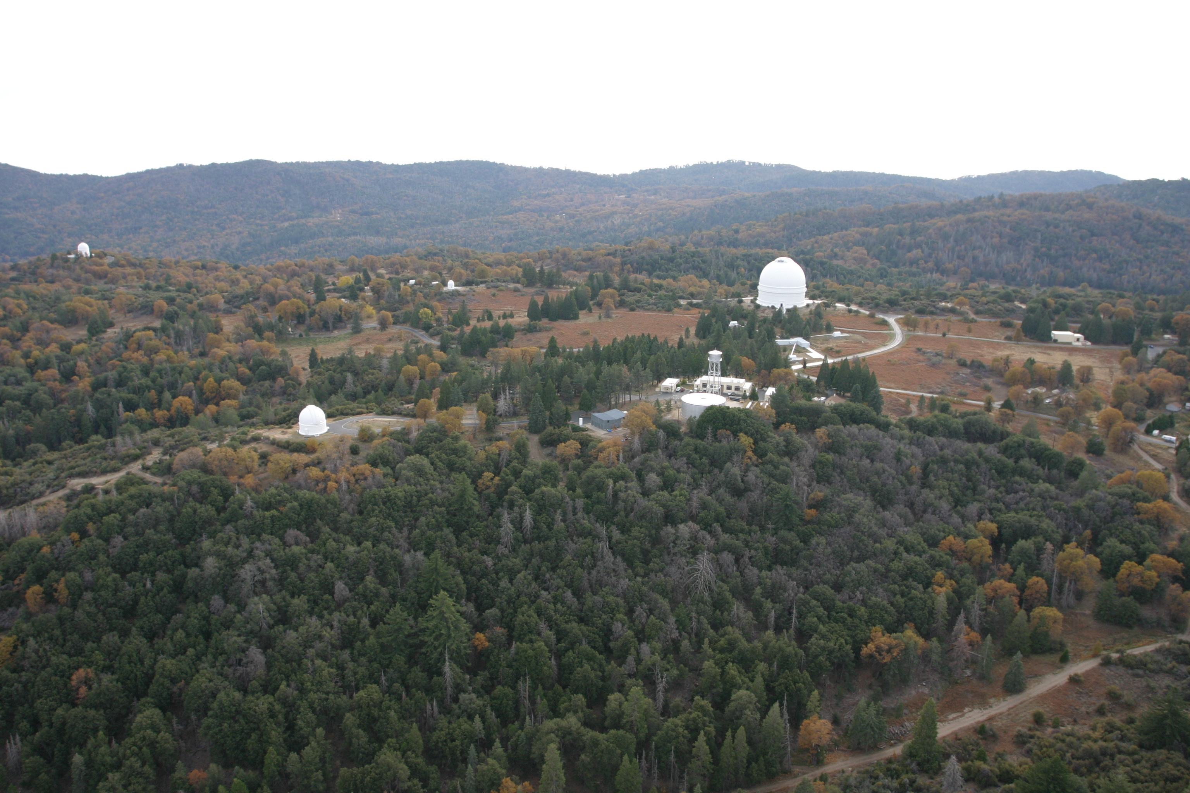
Palomar Sky Survey
The Beginning of Supernovae Research

Slide 21
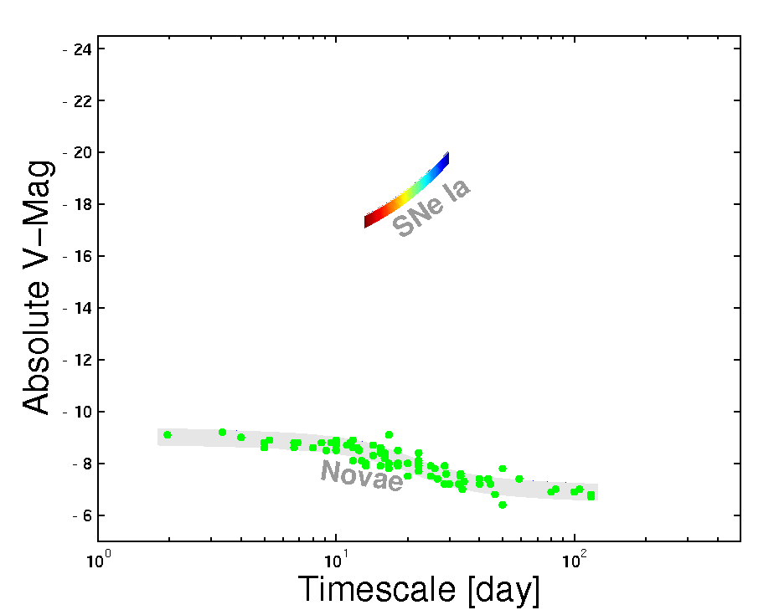
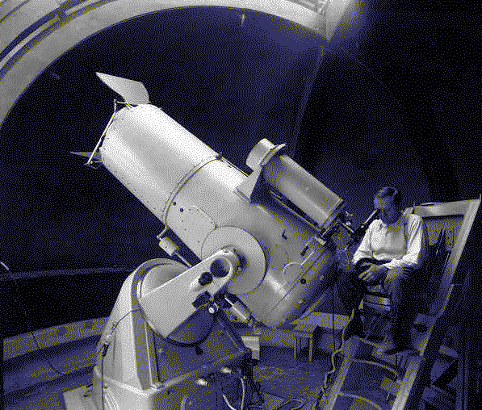
Fritz Zwicky at P18
Notes:
It wasn’t hardly centuries ago that mankind thought the universe was unchanging. The discovery of transients has now led us to believe that the universe changes not only on month and weeks but also days, hours and minutes!
In Ay 1, or any introduction to cosmic explosions, two classes of optical transients are introduced - novae and supernovae. our understanding about them has grown in leaps and bounds in the past two decades. And for good reason. They are both easy to find and Novae are faint but plentiful, supernovae are rare but bright. Since the time of Hubble, this curious gap has been noted, and we have asked, are there are hitherto an undiscovered class of transients? Let us quantify this gap next.

Slide 22
Notes:
It wasn’t hardly centuries ago that mankind thought the universe was unchanging. The discovery of transients has now led us to believe that the universe changes not only on month and weeks but also days, hours and minutes!
In Ay 1, or any introduction to cosmic explosions, two classes of optical transients are introduced - novae and supernovae. our understanding about them has grown in leaps and bounds in the past two decades. And for good reason. They are both easy to find and Novae are faint but plentiful, supernovae are rare but bright. Since the time of Hubble, this curious gap has been noted, and we have asked, are there are hitherto an undiscovered class of transients? Let us quantify this gap next.

Slide 23
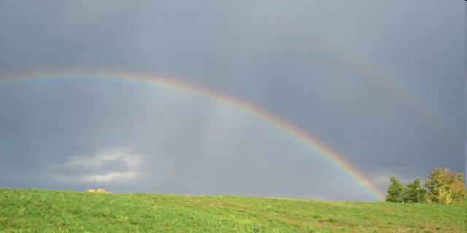
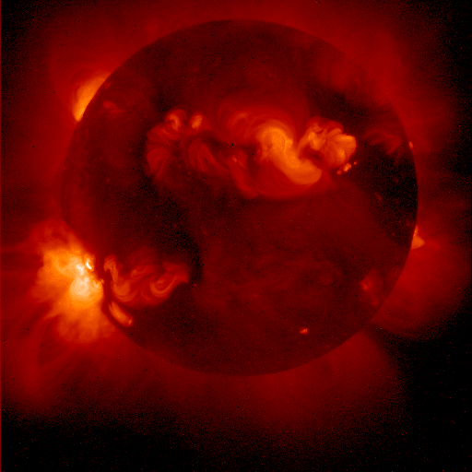
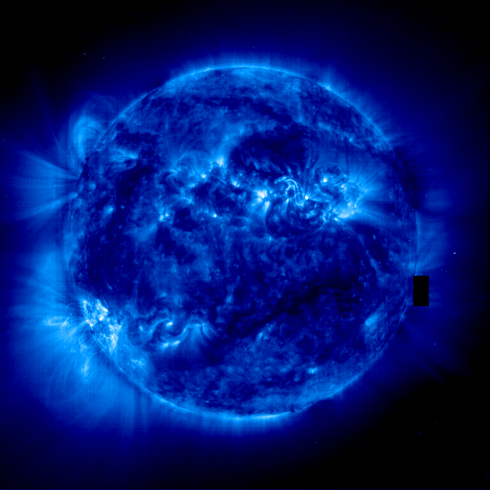
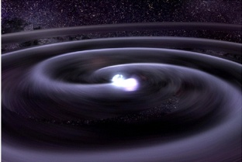
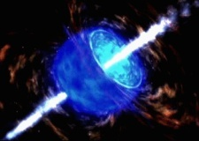

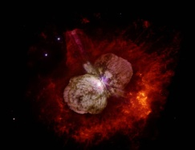
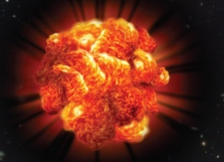
The Core-Collapse Spectrum
Lower mass limit unclear:
<7..11 solar; stable C/O core
NS NS
NS BH
BH No remnant
EC SN?
AIC
RSG=II-P
W-R = Ib/c?
GRB
BSG
SN IIn
PI SNe
M: 7-11
M: 8-16
M: 17-25
M: 25-30
M: 40-50
M: 50-150
M> 150

Slide 24
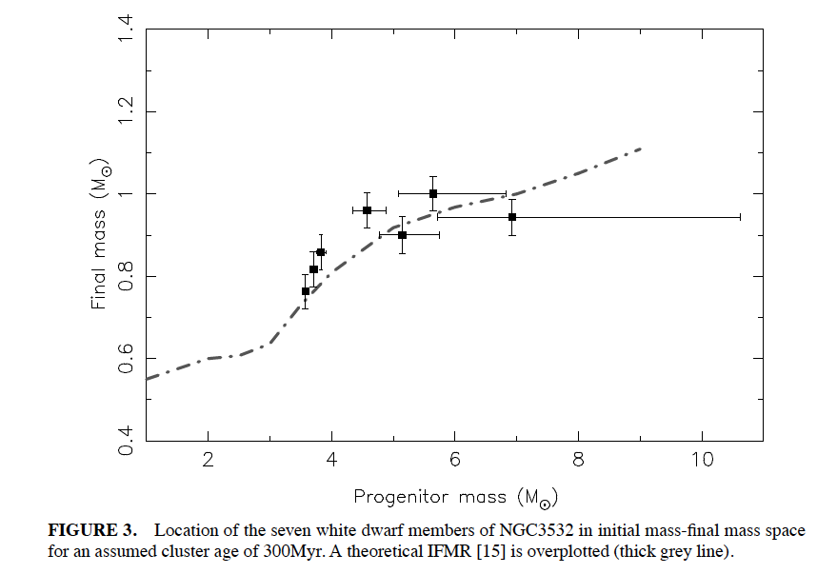
The WD-NS boundary is well determined
For massive stars mass loss determines destiy

Slide 25
Progenitors: Progress
Type IIP progenitors now well established (RSG)
Progenitors of Ic are compact objects (not more than 10¹¹ cm)
Progenitors for long duration GRBs are massive stars
Progenitors of Super-luminous SN are massive stars and very large R₀
Progenitors of Pair Instability SN are very massive stars
Type IIn and LBVs are linked

Slide 26
Open questions & controversies
What (rare) type of massive stars end as GRBs?
What is the mass spectrum of Population III stars? (40 versus 400 M_{o}!)
What factors determine NS versus BH outcome?
What factors determine NS versus magnetar?
Is stellar collisions important for certain outcomes?
Are there some LGRBs without SNe?
Is there a fundamental difference between GRB890425 and classical GRBs?

Slide 27
Obvious questions but likely messy answers
What factors determines mass loss rates?
How does the environment shape the IMF?
What is the role of metallicity?
  Determining IMF
  Retaining (or radiating) angular momentum
Do (slowly rotating) BH outcomes produce detectable SN?
Explosion Mechanism for CC SNe:
  Are there many cases which require bipolar explosion mechanism?
LGRB:
  How is energy carried? (relativistic jets versus Poynting vector)
  What determines jet opening angles?
Are Ultra-high energy Cosmic Rays produced by stellar death?
What re-ionizes the early Universe?

Slide 28

Stellar Deaths: Not an Unfinished Chapter but an Unfinished Book

Slide 29
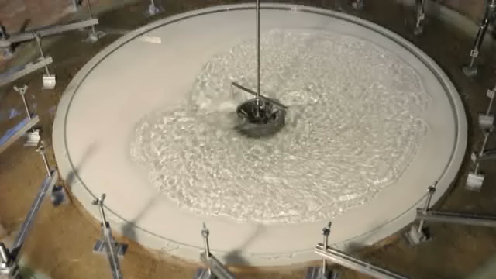
Angular momentum budget
rotating wave + advected vorticity = 0

Slide 30
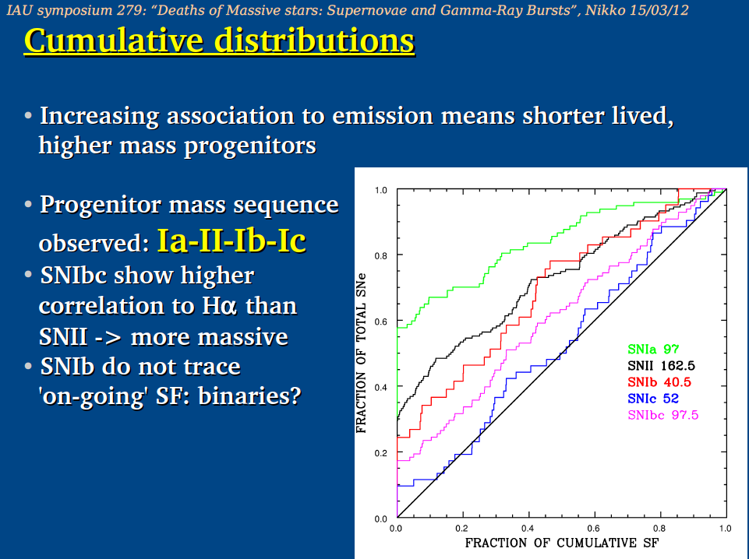

Slide 31
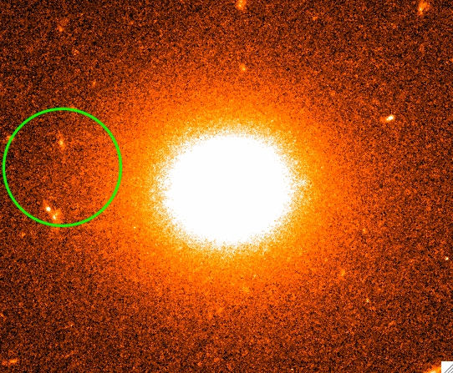
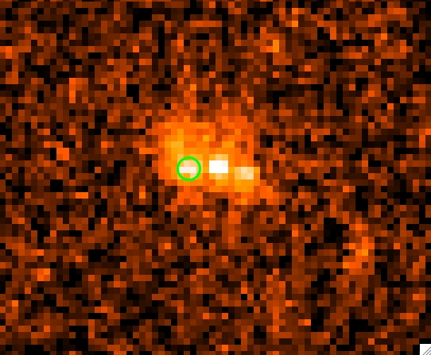
Constraints: progenitors of GRBs
SGRB
CCSN
LGRB
Fruchter et al. 2006; Svensson et al. 2010; Fong et al. 2010

Slide 32
Long Duration GRBs (LGRBs)
LGRBs are extremely rare explosions
LGRBs are produced in copiously star forming regions
Be more common at low metallicity but not precluded in high metalicity regions
GRB explosions are strongly collimated (``jetted’’)
Notes:
So to conclude, from our studies of LGRB progenitor environments we now know that the modern LGRB progenitor model must…

Slide 33
Either GREAT BEGINNINGS or MERE curiosities

Slide 34
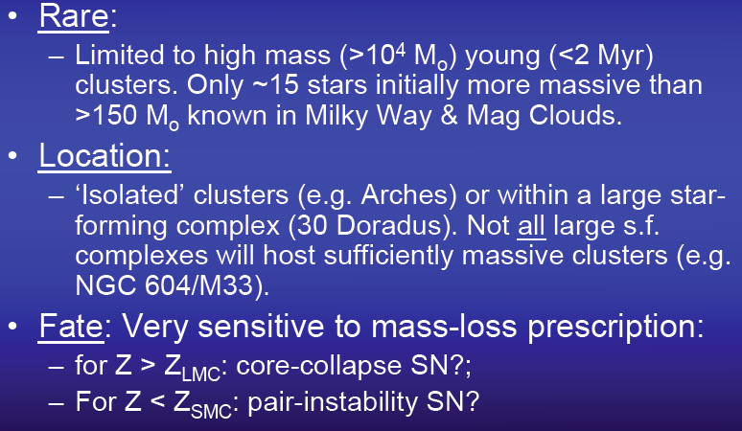
Massive Stars Exist Locally

Slide 35
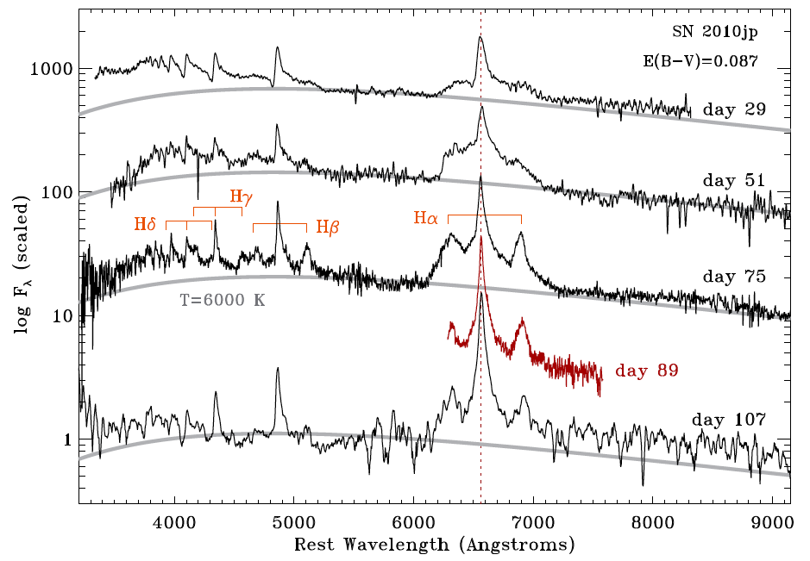
SN2010jp: A Truly Bipolar Supernovae
MMT
Palomar
Keck
MMT
Keck

Slide 36
Blackbody Component in LGRBs
GRB-SN z E_{pk} E_{iso} T₉₀ kT F_{BB}/F_{tot} L_{BB} R_{BB}
keV erg s keV % erg/s cm
060218 0.033 40→3 4x10⁴⁹ 2100 0.22→0.14 50+ -- 5x10¹¹
100316D 0.059 40→14 >4x10⁴⁹ >1300 0.14 30 3x10⁴⁶ 8x10¹¹
090618 0.54 13 2.5x10⁵³ 113 0.9→0.3 20 1x10⁴⁹ 6x10¹²
101219B 0.55 70 4x10⁵¹ 51 0.2 11 1x10⁴⁷ --

Slide 37
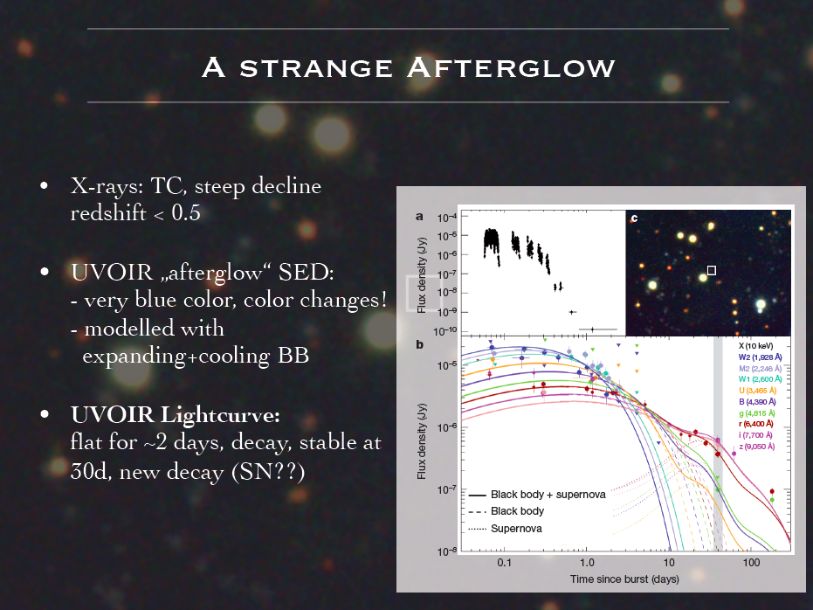

Slide 38
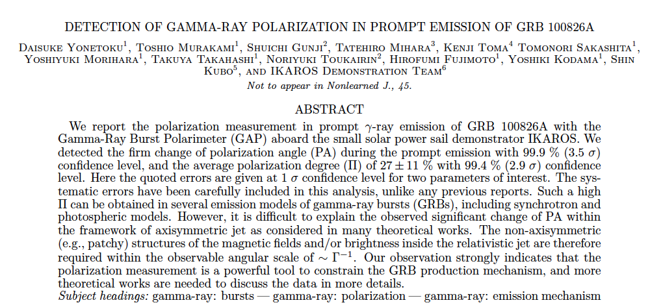

Slide 39
“will not shy away from tough issues”

Slide 40


Slide 41

Metalicity

Slide 42
There is plenty of room to grow sideways …

Slide 43
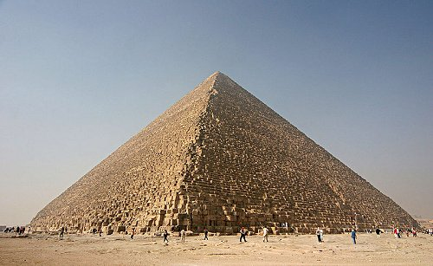
Ancient (Impressive)

Slide 44
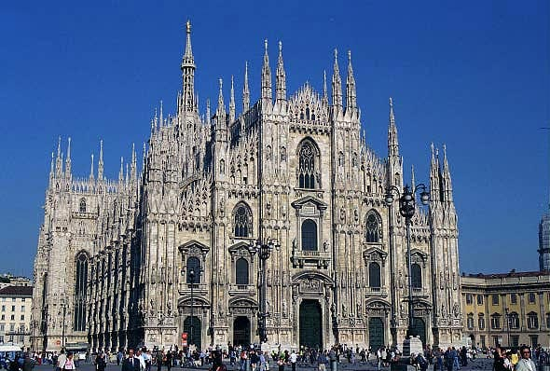
Cathedrals (->Bankruptcy)

Slide 45
Notes:
It wasn’t hardly centuries ago that mankind thought the universe was unchanging. The discovery of transients has now led us to believe that the universe changes not only on month and weeks but also days, hours and minutes!
In Ay 1, or any introduction to cosmic explosions, two classes of optical transients are introduced - novae and supernovae. our understanding about them has grown in leaps and bounds in the past two decades. And for good reason. They are both easy to find and Novae are faint but plentiful, supernovae are rare but bright. Since the time of Hubble, this curious gap has been noted, and we have asked, are there are hitherto an undiscovered class of transients? Let us quantify this gap next.

Slide 46
Kasliwal 2011 (PhDT)

Slide 47
Parameter space
SGRBs
LGRBs
?
TDEs?
SGRs
LLGRBs
AGN
031203
060218
030329
100316D
Galactic sources (SGR, LMXB, HMXB, microquasar, gamma-ray pulsars etc)

Slide 48

Inverted (Pretty)

Slide 49
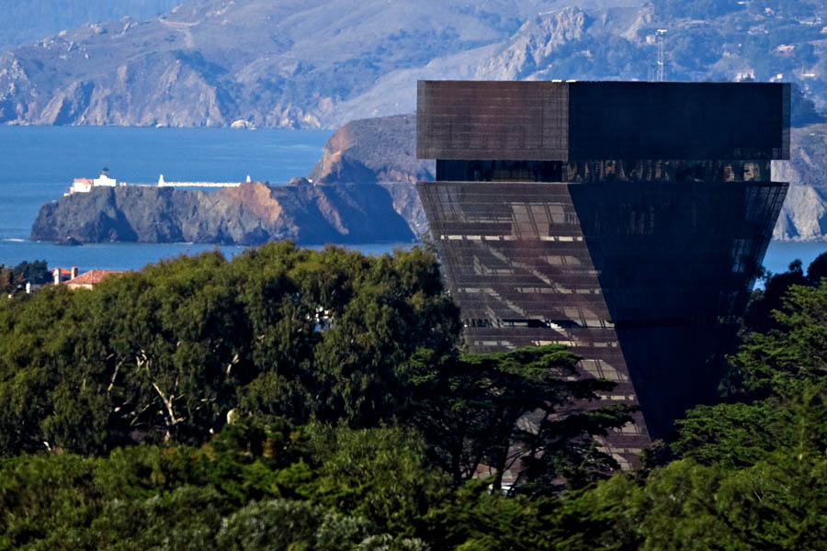
Inverted (The Exciting Future)

Slide 51
Bibliography
Speakers who freely gave me their talks
xkcd (geeky cartoons)
Google (for images)
Rabbits of the Okunoshima Island

Slide 52
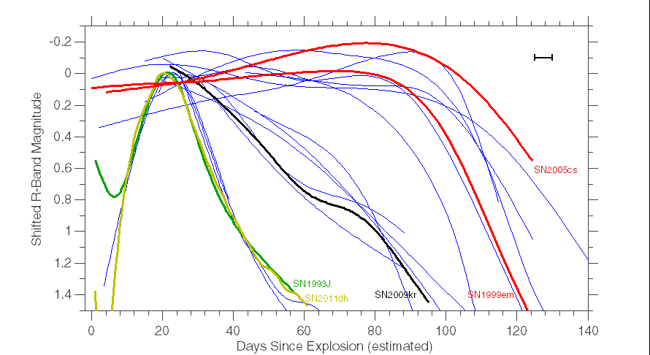
Results | three light curve families
Plateau
Rapid Decline
Slow Decline
SN1993J – Richmond et al. 1994
SN1999em – Leonard et al. 2002
SN2004fx – Hamuy et al. 2006 (preliminary)
SN2005cs – Pastorello et al. 2009
SN2011dh – Arcavi et al. 2011
Notes:
4 missing refs, 4 bad subs, 2 no texp, 1 few data, 3-pec, 1 rising, 15 in the plot.

